Slide 1
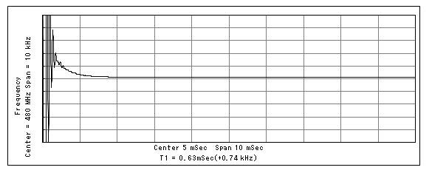
・LMX2571 Lock Detection time
Power Down Time [mSec] | Lock Detection Time [mSec]
1700 | 75
1400 | 65
1100 | 50
900 | 35
550 | 0.5
*1 : Confirm the LMX2571EVM
CE pin
(Power UP/Down)
Power Down Time
LE pin
(Power UP/Down)
Less than 1msec, all time
RFout
(Actual Lock time)
MUXout pin
(Lock Detection time)
Lock Detection Time
This waveform is measured by LE rising edge after CE pin is enabled .
1msec

Slide 2
【Question】
1． Why does the Lock Detection time become longer as the Power Down time is longer?
[The actual lock time(output frequency) is less than 1msec.]
2． Is it possible to reduce the lock detection time to the actual lock time ?
[The customer wants to reduce the lock detection time for battery power saving.]
3．What is the cause the difference between the Lock Detection time and power down time ?
(1) circuit , for example capacitance value.
(2) response time of lock detection circuit in the LMX2571.
(3) other reason

