Slide 1
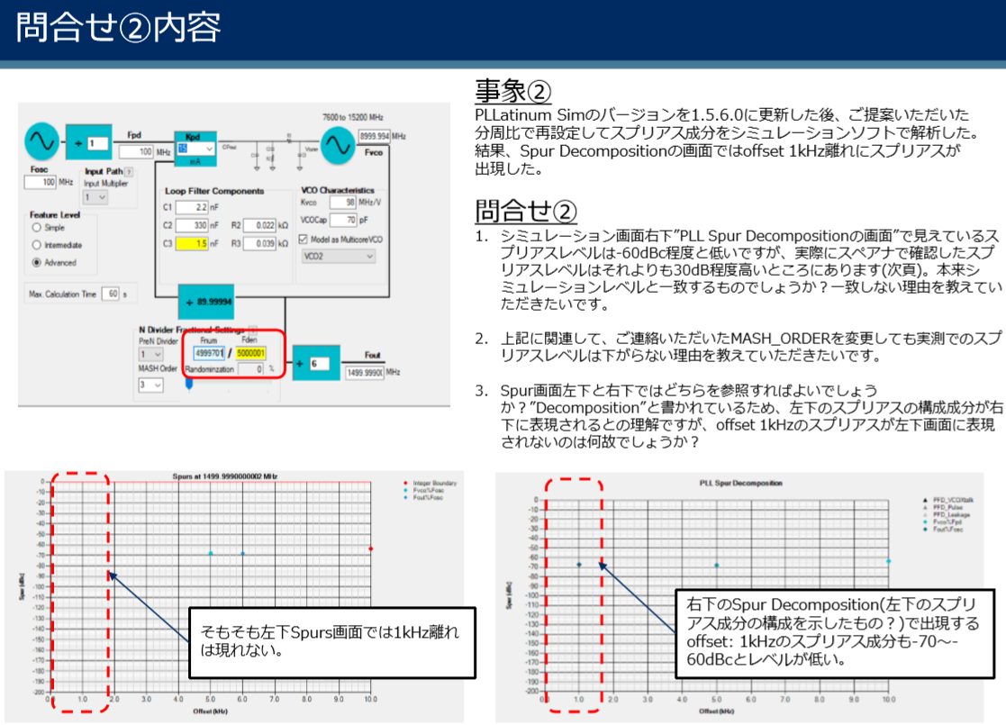
Additional Questions
Update
After updating the version to 1.5.6.0, we analyzed the spurious components at the suggested division ratio. As a result, spurious appeared on the screen of Spurs decomposition at offset 1khz.
Questions
The spurious level seen on the screen of "PLL Spur Decomposition" at the bottom right of the simulation screen is as low as -60dBc, but the spurious level actually confirmed with a spectrum analyzer was about 30dB higher than that. Is this discrepancy expected between the simulation and the actual machine results?
They would like to know the reason why the actual spurious level does not decrease even if MASH_ORDER is changed.
Which should they refer to? The spur screen on the bottom left or bottom right? Since it says "Decomposition", they understand that the components of the lower left spurious are displayed in the lower right, but why is the offset 1kHz spurious not displayed in the lower left screen?
The offset: 1khz spurious component that appears in the lower right Spurs decomposition is also low at -70 to -60dBc.
Spurs does not appear in 1khz on the lower left Spurs screen.

Slide 2
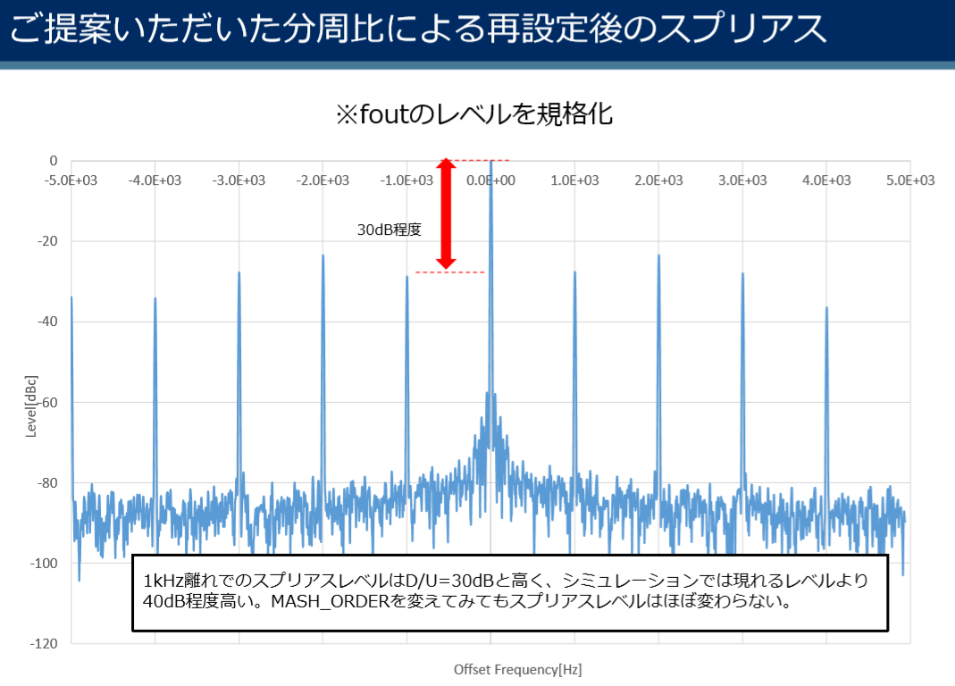
Spurious based on the proposed division ratio
Standardize fout level
The spurious level at 1khz is as high as D / U = 30dB, which is about 40dB higher than the level that appears in the simulation. They also tried changing MASH_ORDER, but hardly changes.

