Slide 1
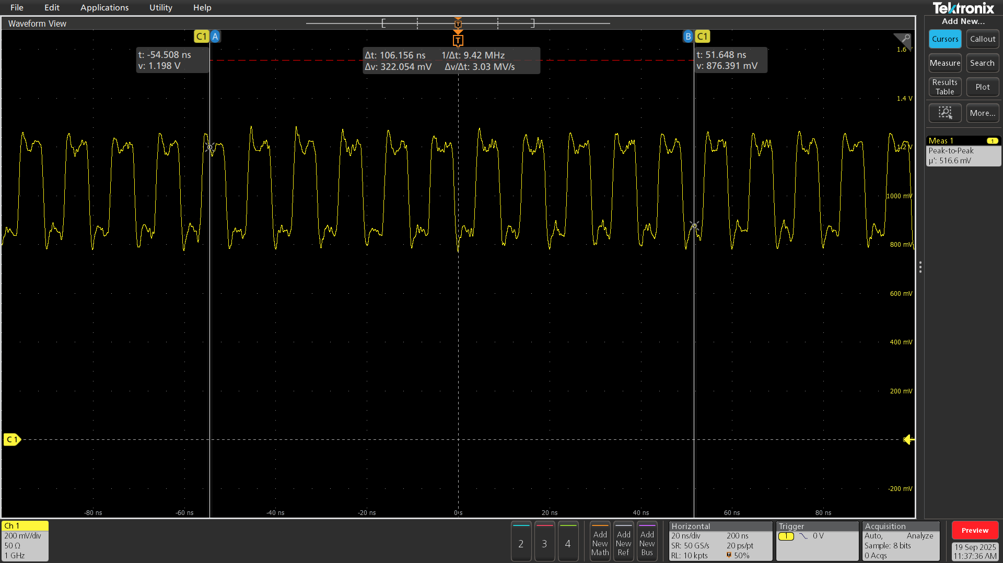
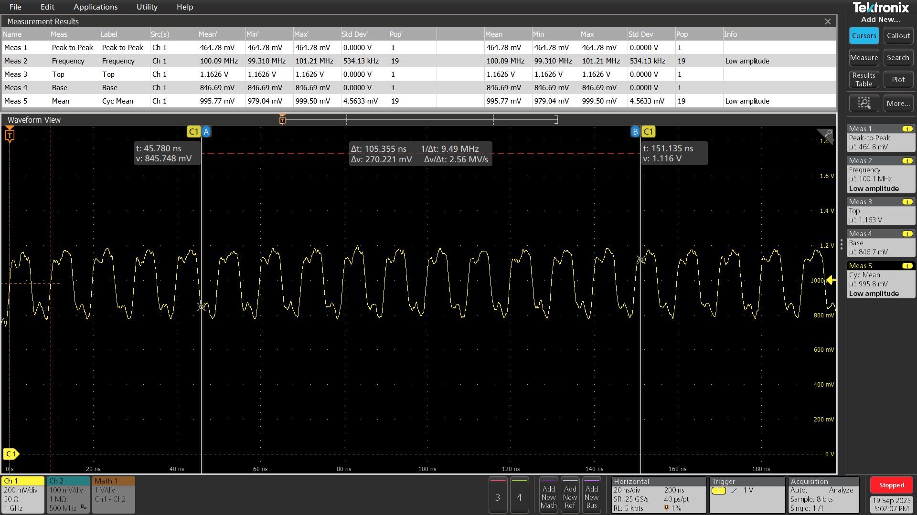
r54

Slide 2
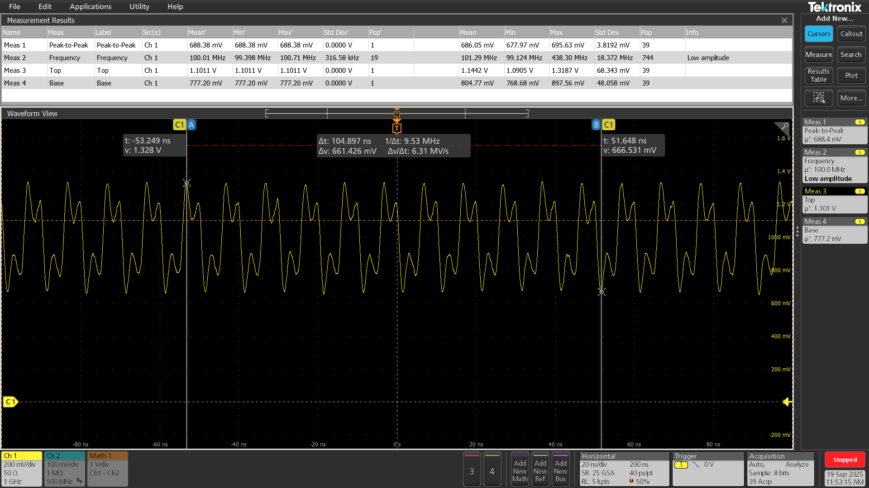
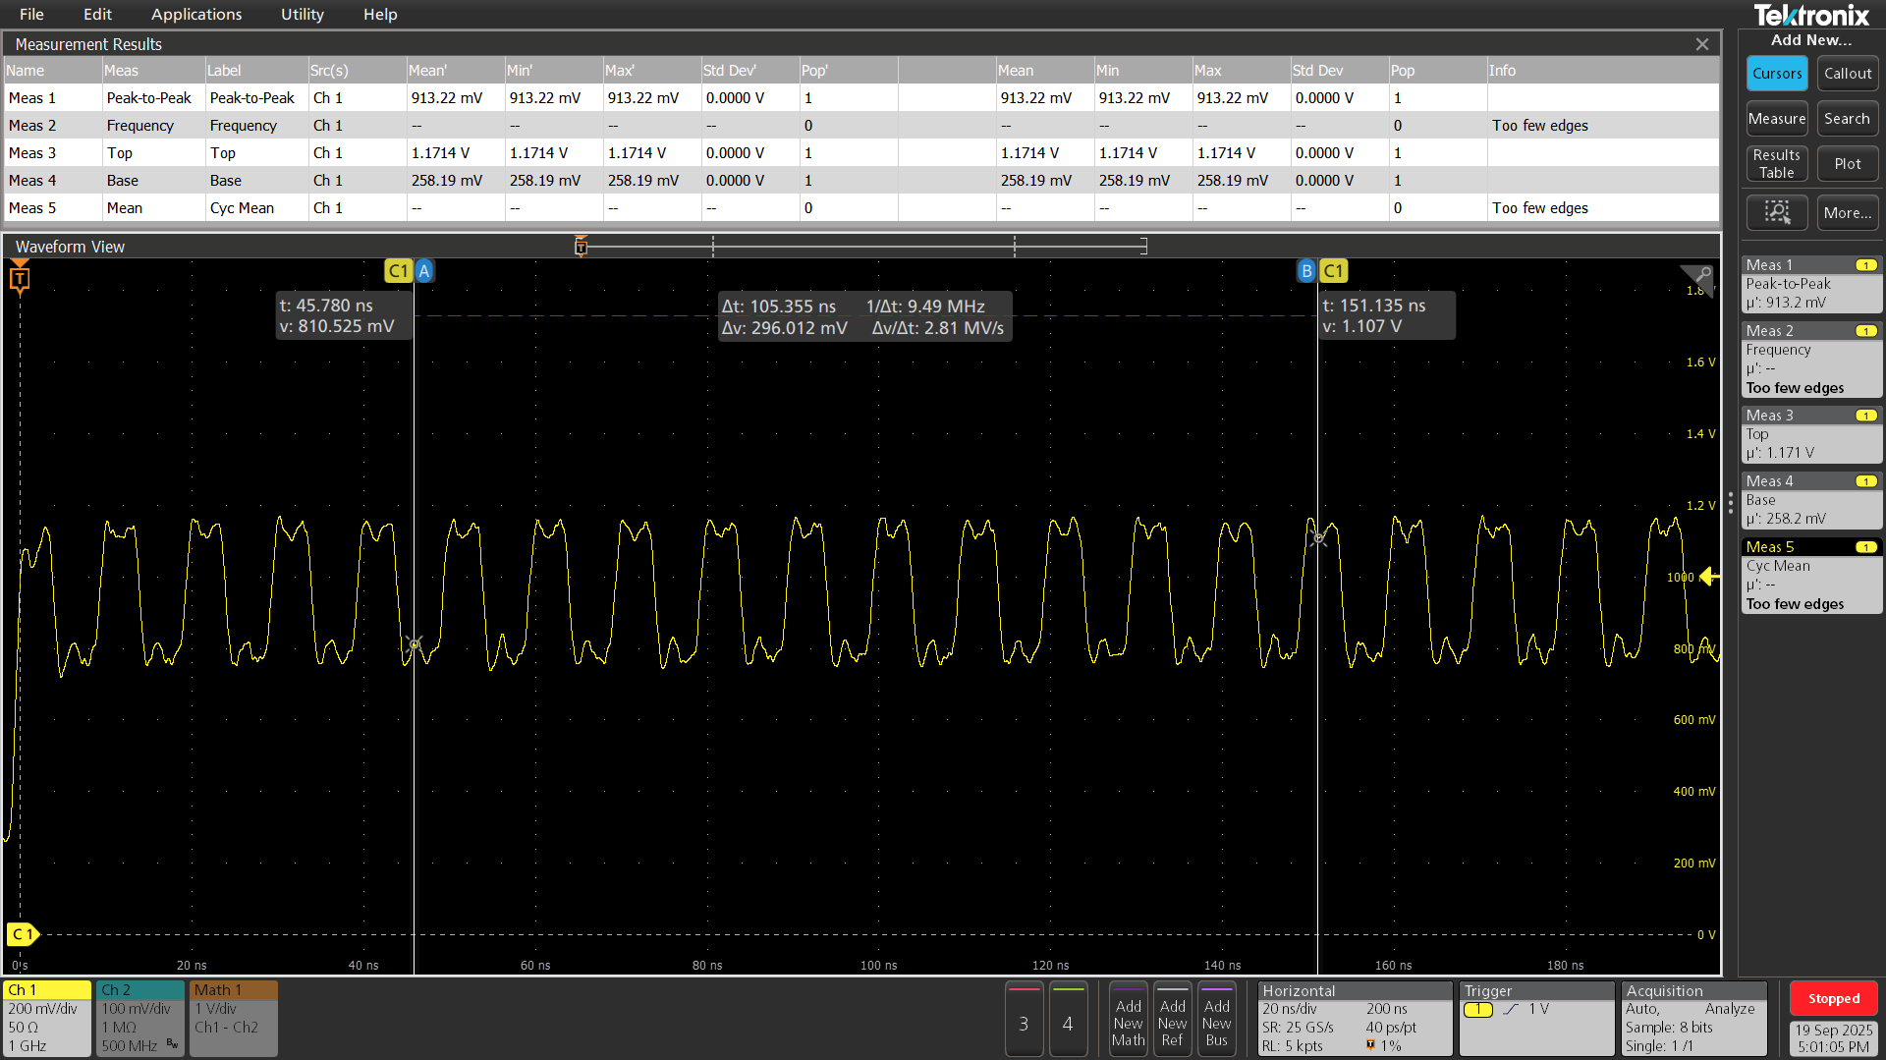
r55

Slide 3

r218

Slide 4
Average power is the integral of the instantaneous power over one cycle
MATLAB code used to manually import the data and perform a trapezoidal approximation of the
Integral of the instantaneous power to get the average power:
R54
Power_avg = 3.8mW
R55
Power_avg = 4.2mW
R218
Power_avg = 1.2mW
Note: The probe used was a differential probe, so the scope shot that shows the measurement across R218 is 2x the
voltage seen across the resistor.

