Slide 1

Updating USB2ANY firmware

Slide 2
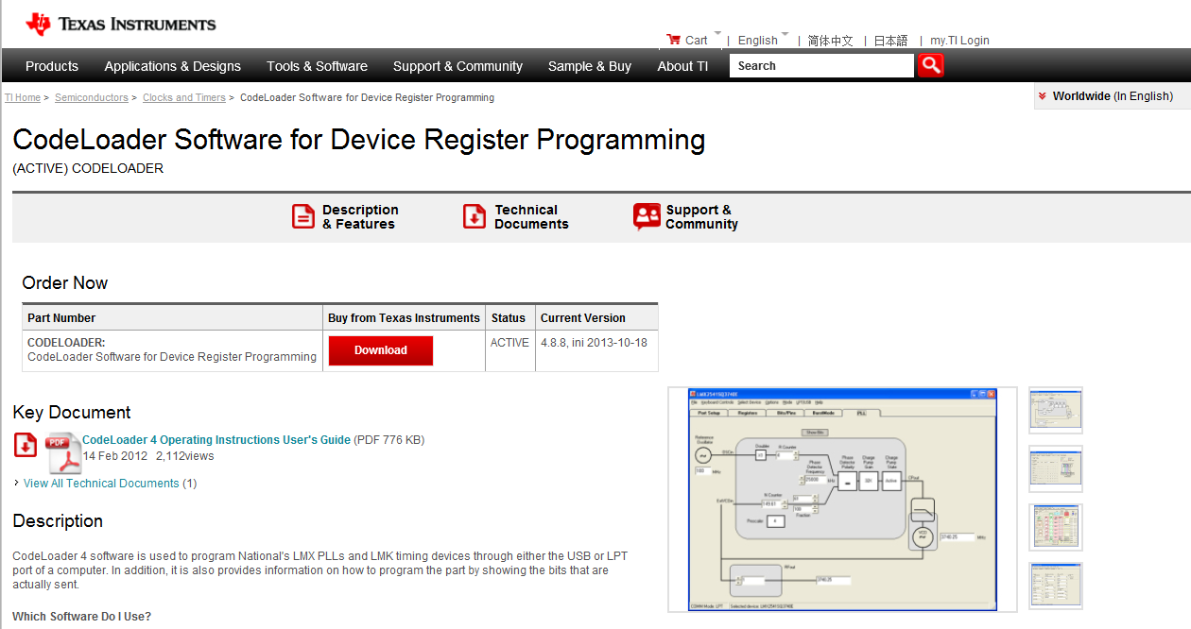
Download latest codeloader from TI.com http://www.ti.com/tool/codeloader

Slide 3
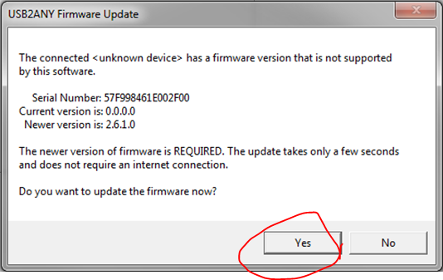
Open codeloader software then plug in USB2ANY to computer via USB
You should see window pup up like below with newest version listed:

Slide 4
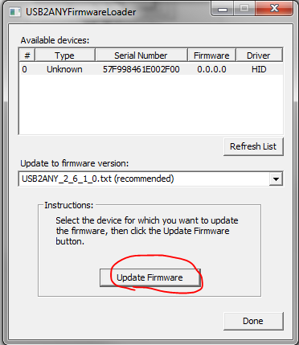
You should see window like below, then click ‘Update Firmware’

Slide 5
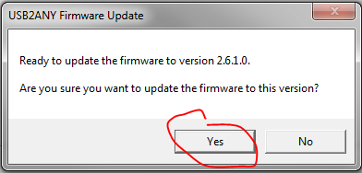
Next pop up window should look like:

Slide 6
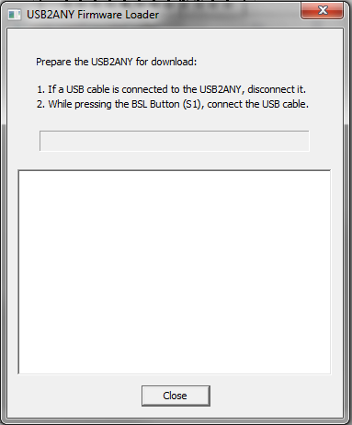
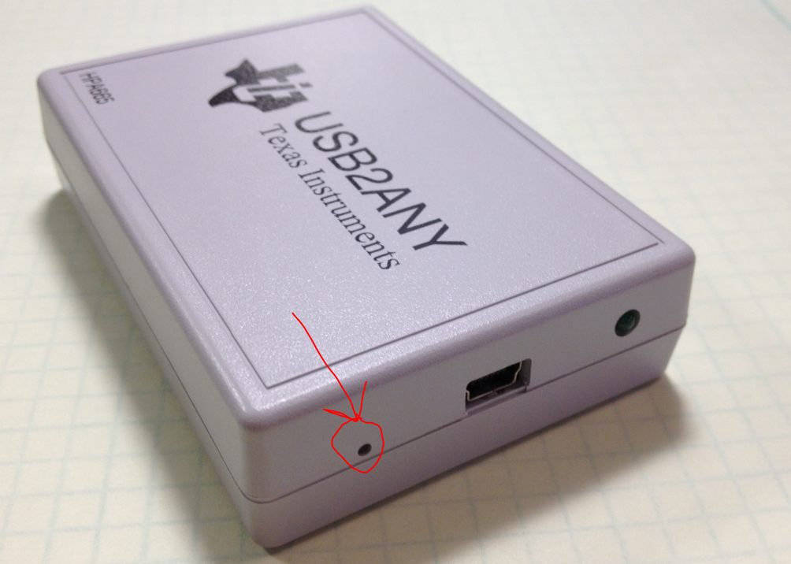
Then you should see window like on the right
Unplug your USB wire
There is a button next to the USB connector on the USB2ANY which you should press with a pin or sharp object. Keep it pressed until you plug the USB back in

Slide 7
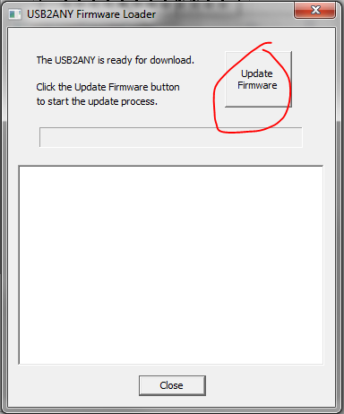
You should see something like on the right

Slide 8
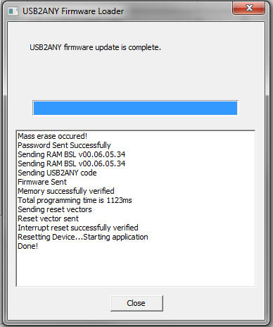
You will see the progress in box and the bar go from left to right.
Then you are done

