Slide 1
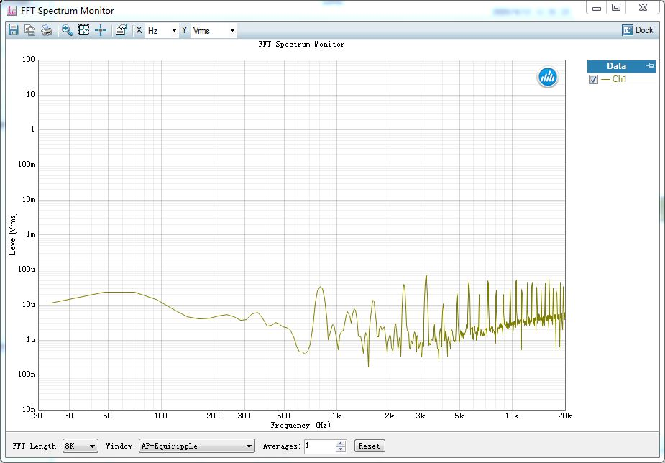
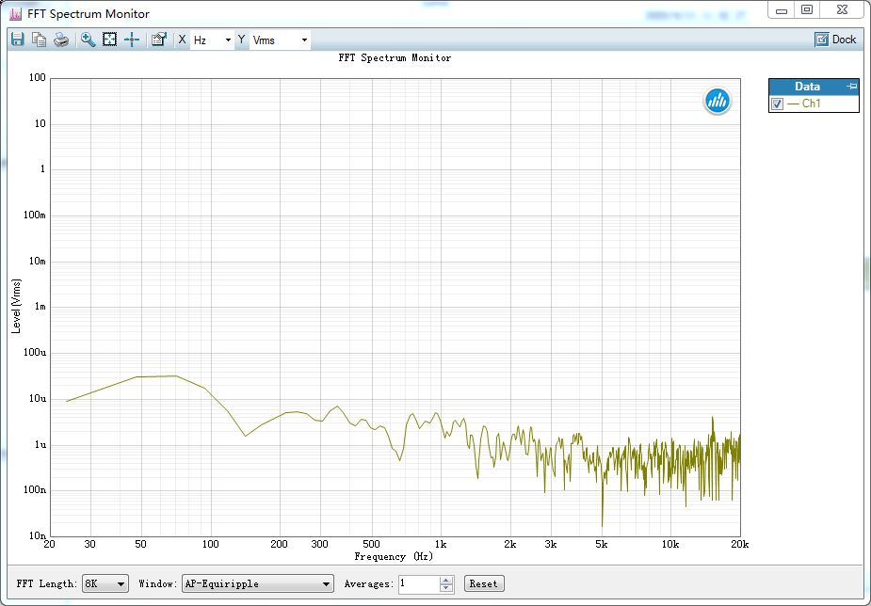
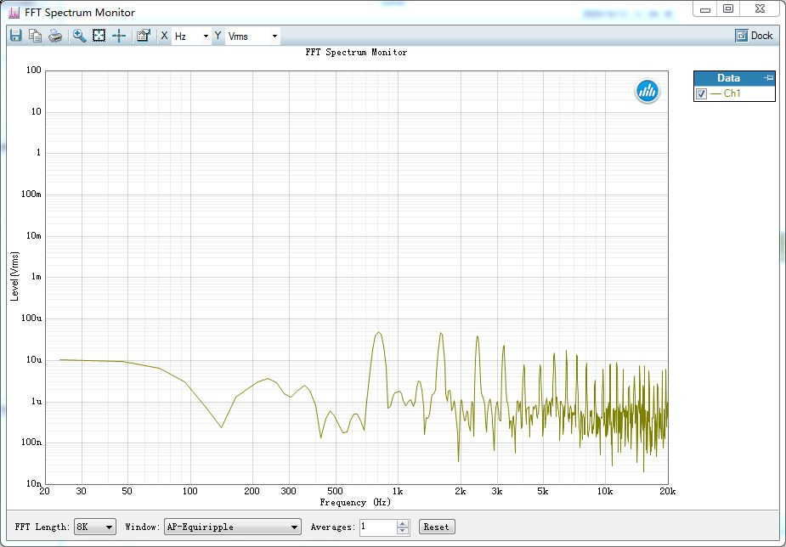
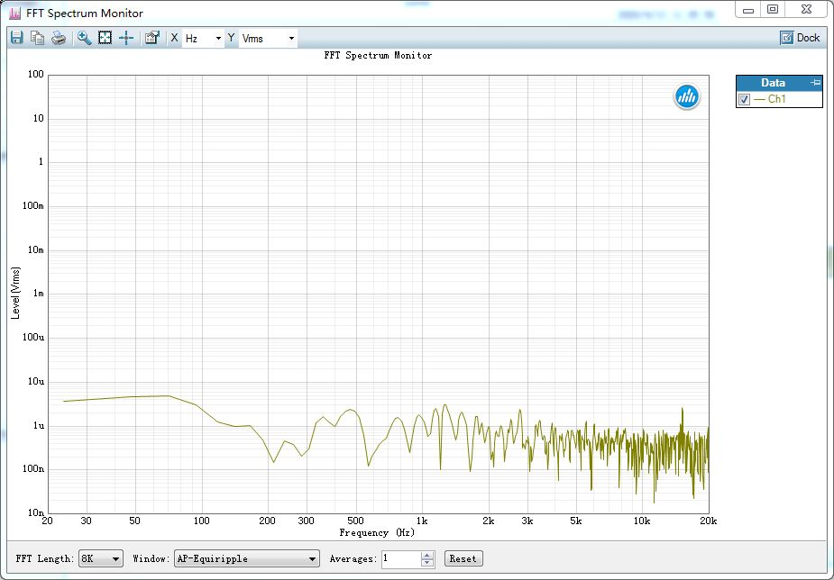
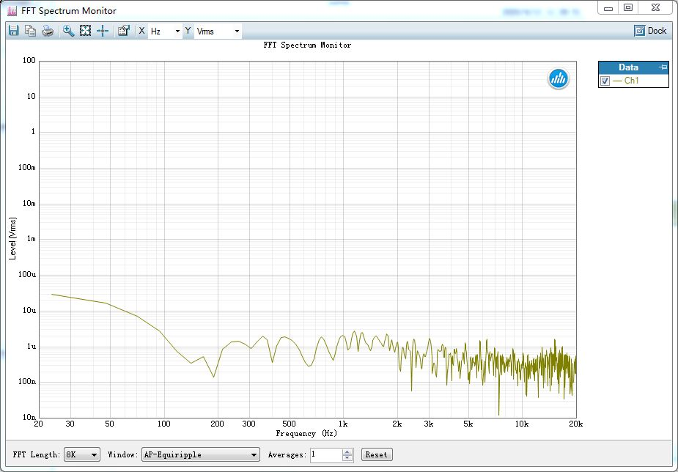
Test equipment : AP525 ,PC
Issue ：
1-headset power on , connect Bluetooth ，the noise will impact battery voltage, then headset will have audio noise.
2-disconnect Bluetooth , shutdown CC2564, then the noise will disappear.
Power on headset
Bluetooth match
Connect Bluetooth
Disconnect Bluetooth
Shutdown Bluetooth power
Abnormal noise

Slide 2
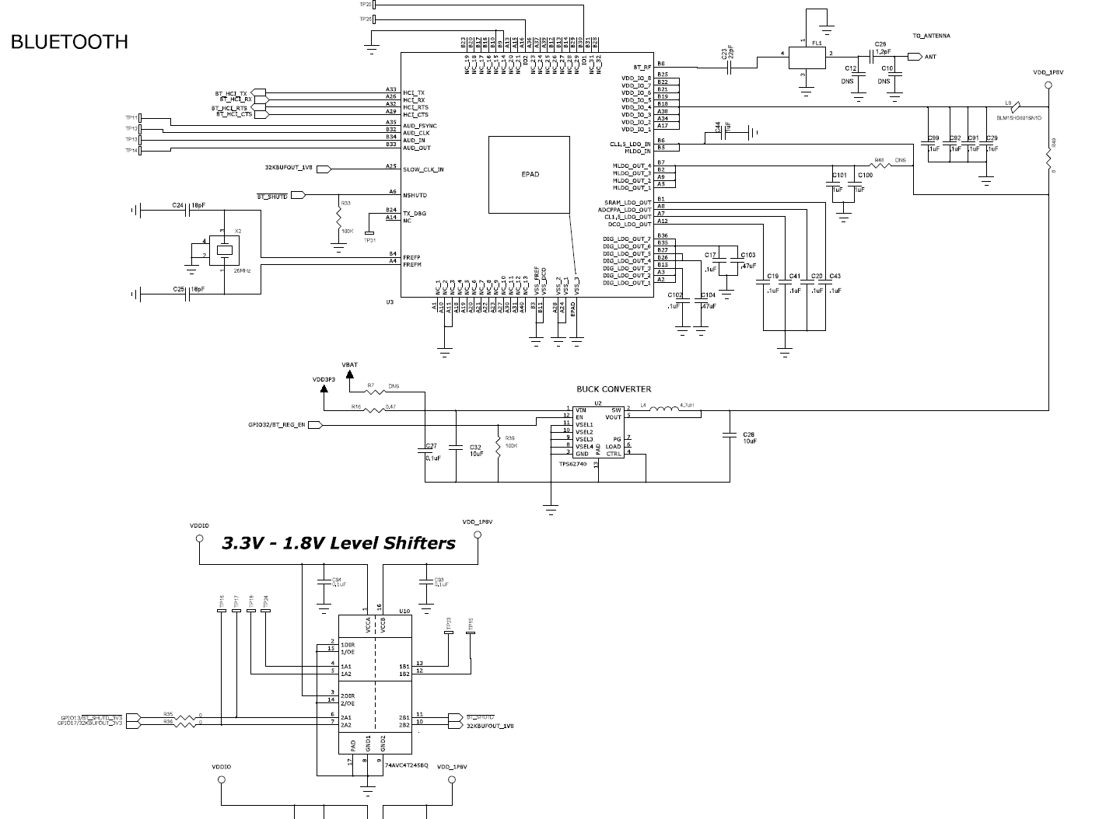

Slide 3
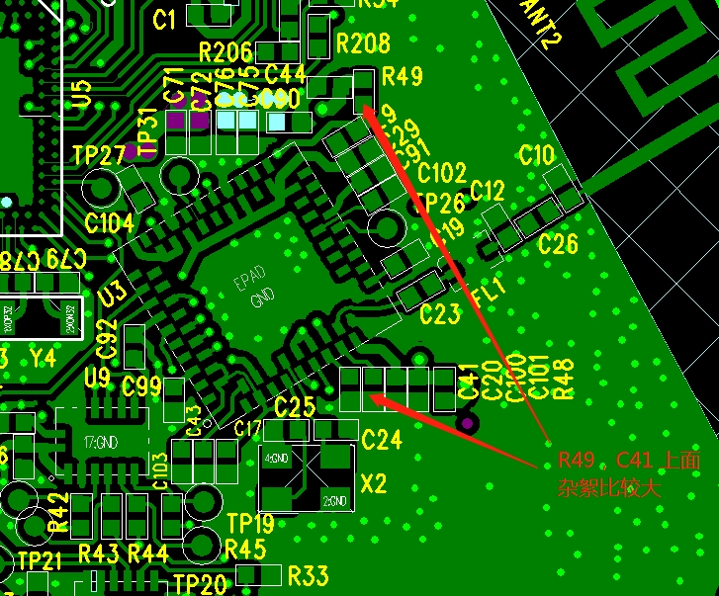
CC2564 Top layout
R49, C41 has large noise that will impact battery voltage

Slide 4

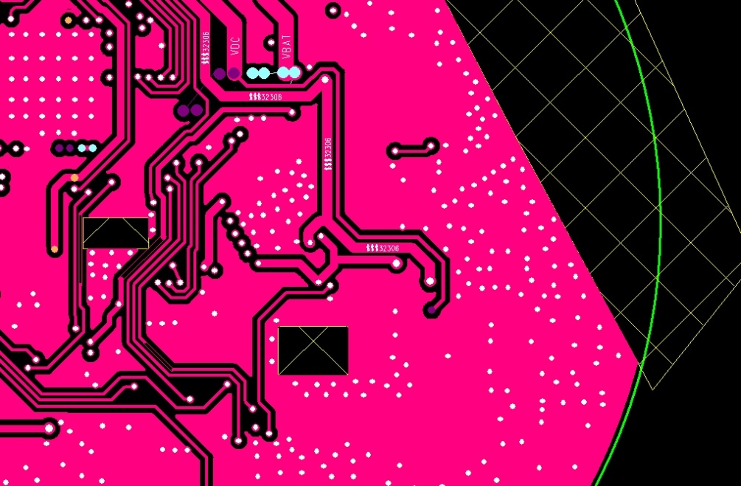
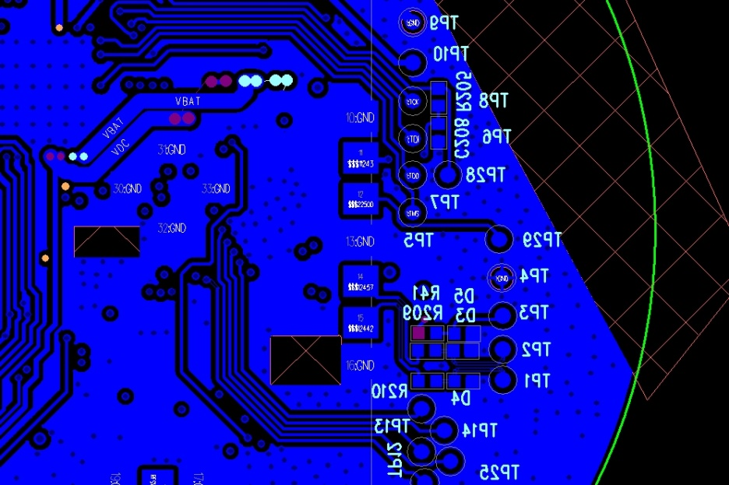
LAYER2
LAYER3
Bottom

