Slide 1

Antenna Theory and Matching
Farrukh Inam
Applications Engineer
LPRF TI

Slide 2
Agenda
Antenna Basics
Antenna Parameters
Radio Range and Communication Link
Antenna Matching Example

Slide 3
What is an Antenna
Converts guided EM waves from a transmission line to spherical wave in free space or vice versa.
Matches the transmission line impedance to that of free space for maximum radiated power.
An important design consideration is matching the antenna to the transmission line (TL) and the RF source. The quality of match is specified in terms of VSWR or S11.
Standing waves are produced when RF power is not completely delivered to the antenna. In high power RF systems this might even cause arching or discharge in the transmission lines.
Resistive/dielectric losses are also undesirable as they decrease the efficiency of the antenna.

Slide 4
When does radiation occur
EM radiation occurs when charge is accelerated or decelerated (time-varying current element).
Stationary charge means zero current ⇒ no radiation.
If charge is moving with a uniform velocity ⇒ no radiation.
If charge is accelerated due to EMF or due to discontinuities, such as termination, bend, curvature ⇒ radiation occurs.

Slide 5
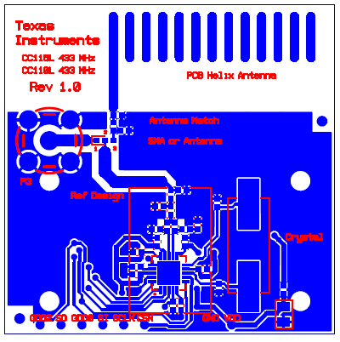
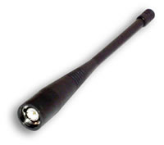
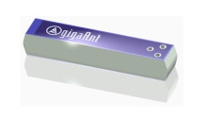

Commonly Used Antennas
PCB antennas
  No extra cost
  Size can be demanding at sub 433 MHz (but we have a good solution!)
  Good performance at > 868 MHz
Whip antennas
  Expensive solutions for high volume
  Good performance
  Hard to fit in many applications
Chip antennas
  Medium cost
  Good performance at 2.4 GHz
  OK performance at 868-955 MHz
  Poor performance at 433-136 MHz
Wire / Helical antennas
  Low cost
  Good performance
  Ideal at sub 433 MHz

Slide 6
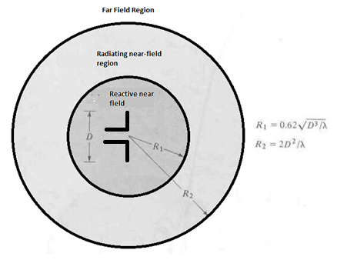
Antenna Radiation Regions
Space surrounding the antenna is usually divided in three regions as functions of dimensions and wavelength of operation
Typically we are only interested in the far-field
region of the antenna for practical purposes
Electric and magnetic fields are perpendicular to each other
Electric and magnetic field amplitude drops as 1/r
E.g a 2 ft diameter dish operating at 10GHz would have the start of far-field region at 24m.
From Balanis

Slide 7
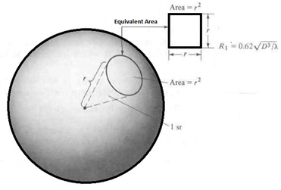
Isotropic radiator
An isotropic source radiates in all direction uniformly
The radiated power goes through a sphere in all directions with same intensity
Power and energy bearing EM waves are used to transport information signals through a wireless medium. Poynting vector is a quantity used to describe the power in the EM wave.
Geometry describing a unit solid angle – Steradian.
Where U (W/unit solid angle)is the radiation intensity
A 2W isotropic radiator will have 160nW/m^2 power density at 1km away from source.

Slide 8
Non-Isotropic radiator
A non-isotropic source doesn't not have same radiation intensity in all direction.
A non-isotropic antenna concentrates power in a desired direction more than any other.
Hence, the term directivity is associated with non-isotropic sources.
Directivity is the antenna’s ability to focus energy in a desired direction when transmitting or to receiving maximally. An antenna that radiates more or less equally in any orthogonal plane is called an omnidirectional antenna where as isotropic radiator is a hypothetical lossless antenna radiating in all directions
Directivity is the ratio of radiation intensity of an antenna w.r.t an isotropic radiator.
In general an antenna with 6dBi specification of directivity means that the intensity is 6dB more in the maximum direction of radiation compared with an isotropic antenna
Where U (W/unit solid angle)is the radiation intensity

Slide 9
Non-Isotropic radiator - Example
What is the power density of a 2W non-isotropic source at 2km if the directivity is 50 in the maximum beam direction?
What is the directivity in dBi?

Slide 10
Antenna Gain
Gain of an antenna is closely related to directivity and efficiency. Usually antenna gain is a relative quantity which is measured w.r.t a reference radiator. Relative gain is expressed as the ratio of power gain in a given direction to the power gain of a reference antenna.
Where is the radiation efficiency = Prad/Pin
An antenna with 90% efficiency and a directivity of 120 would have a gain of

Slide 11
Antenna Gain – Cont’d
Gain of an antenna is proportional to its effective area Ae[m2]
And inversely proportional to operating wavelength
Effective area is related to physical area
Where is the aperture efficiency

Slide 12
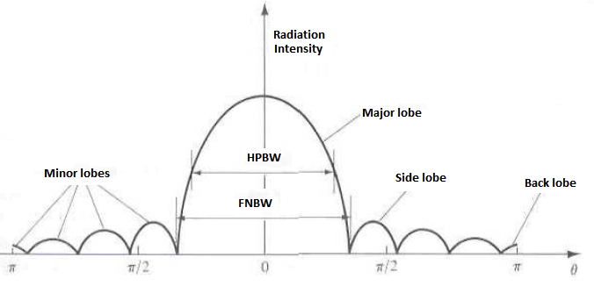
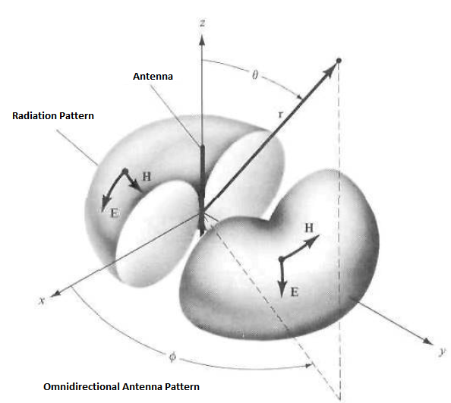
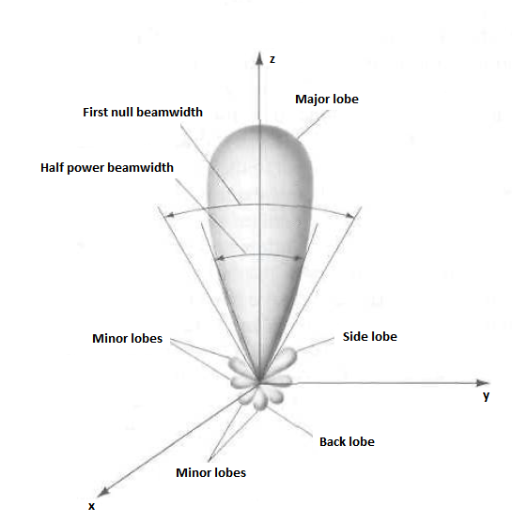
Radiation pattern
Radiation patterns describe the relative strength of the radiated or received field in various directions from the antenna, at a constant distance. Although EM radiation takes place in 3 dimensions, the patterns documented are a 2-dimensional slice of the 3-dimensional pattern, in the horizontal or vertical planes.
From Balanis

Slide 13
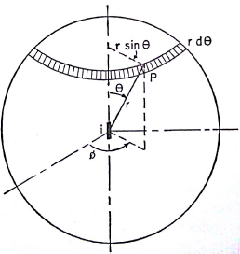
Antenna Radiation Resistance
The radiation field components from the current element are tangential to the spherical surface and the Poynting vector is perpendicular to the surface indicating radial flow of power from the current element. The average power in is one half the product of the fields:
Total power being radiated is the surface integral of the Poynting vector over the surrounding surface usually a sphere
This is the same power as would be dissipated in a resistance Rr by current Im in absence of any radiation
Area vector for Poynting vector integration.
From Ryder
Notes:
Radiation resistance is due to power radiated. The total resistance of an antenna is made up of the radiation resistance plus the resistance due to other power losses.
For high efficiency the value of radiation resistance should be large w.r.t the loss resistance

Slide 14
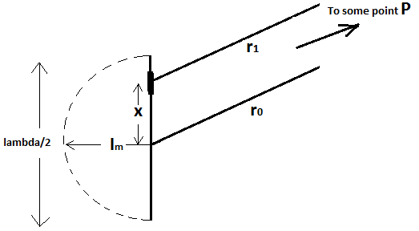
Application - Half-Wave Antenna in Space
One of the simplest antennas and frequently used is half wave long thin wire dipole. Assuming the antenna is far removed from earth and obstacles.
The current at the end of the antenna has to be zero since there is nowhere for it to go. A sinusoidal distribution exists for a thin straight wire and in figure below and using the center of wire as reference the current along the antenna is
Choosing a point P far away radius vectors r0 and r1 can be considered parallel with
The r.m.s fields the E and H fields are as follows:
Fields are mutually at right angles and in time phase.
Poynting vector using r.m.s values is give by:
From Ryder

Slide 15
Antenna Polarization
In order for a TX and RX antenna to have a link, they must have same polarization
Polarization of a plane wave shows how the instantaneous electric or magnetic filed is oriented at a given point in space.
Polarization mismatch will cause signal loss
There are 3 types of polarization:
  Linear(vertical or horizontal): if E or M field vector is always oriented along the same straight line every instance of time
  Circular: if E or M field vector at that point traces out a circular path as a function of time.
  Elliptical: if E or M field vector at that point traces out a elliptical path as a function of time.

Slide 16
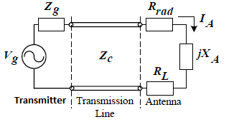
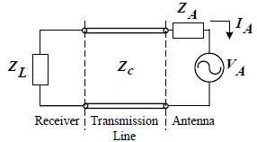
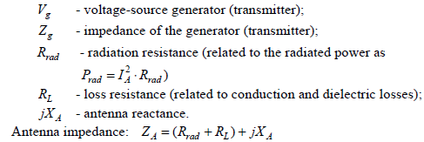
Antenna Circuit Models
Generally an antenna is the transition that interfaces a transmission line to free space as efficiently as possible while maintaining a desired EM distribution pattern in free space.
From Balanis

Slide 17
Radio Link
When setting up a radio link, the maximum range between a transmitter and receiver is often desired.
Realistic range estimation can be made by employing 2-ray Friis model for RF propagation which can take into account typical building construction materials
Maximum range can be influenced by:
  Antenna performance and location
  Output power of transmitters and reciever sensitivity
  Unwanted RF jammers
  The operating frequency
  Radio configuration
  Building material between TX and RX

Slide 18
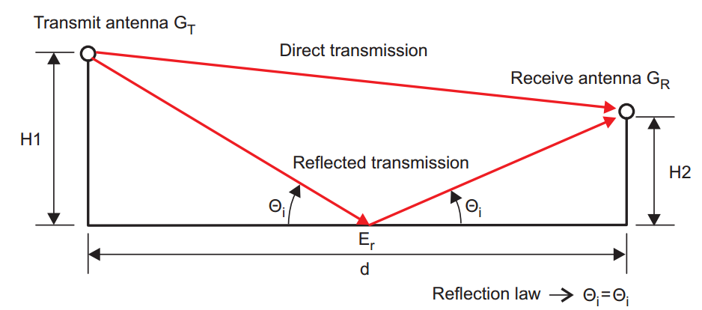
Friis Transmission Equation and Range
For TX and RX antennas that are matched for polarization and reflection and aligned for maximum directional radiation and reception the ratio of RX power to TX power is given by the following:

Slide 19
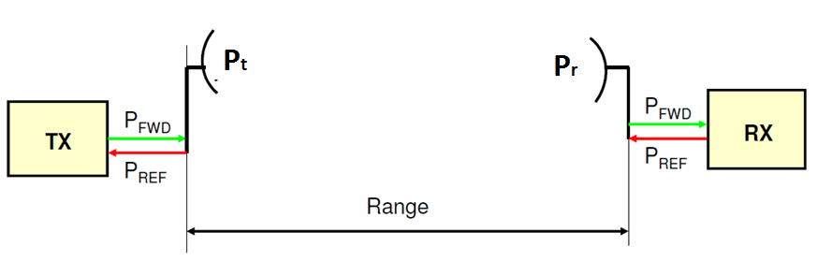
Range of LOS Link
By solving Friis formula for R and replacing the received power with minimum detectable signal we can get the expression for maximum range:

Slide 20
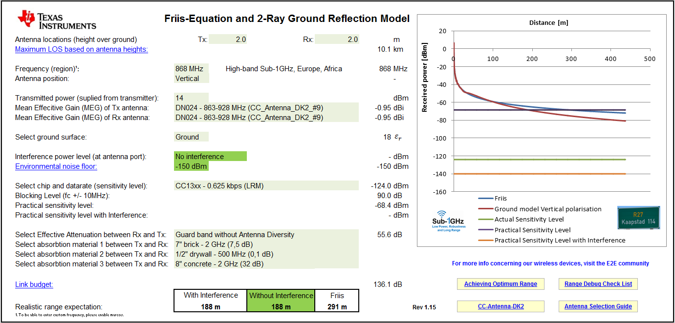
Excel sheet for Range estimation

Slide 21
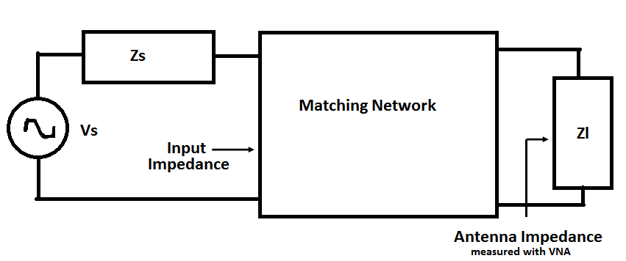
Antenna Matching
Only inductors or capacitors should be used for matching.
Matching circuits, distributed or lumped, have losses due to limited quality factor.
If an antenna has a reasonable initial resonance, the improvement obtained from the matching circuit will compensate for the loss it introduces

Slide 22
Antenna Matching Consideration
Input Impedance is the impedance presented by the antenna at its terminal. Maximum power is transferred to the antenna during conjugate match. Transceivers and their transmission lines are typically designed for 50Ω. If the antenna has an impedance different from 50Ω, then there is a mismatch and an impedance matching circuit is required.
In conjugate match, half of power is dissipated in Rg of generator and the other half that makes to the antenna, part of it is radiated through the radiation resistance Rr and rest is dissipated in the Rl of the antenna.
Return Loss is a way of expressing mismatch. It is a logarithmic ratio measured in dB that compares the power reflected by the antenna to the power that is fed into the antenna. The quality of match is specified most often in terms of VSWR or S11 under matched conditions.

Slide 23
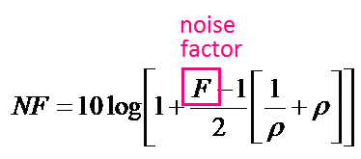
Antenna VSWR and Noise Figure
Antenna VSWR changes according to the environment around the antenna and therefore matching conditions can change accordingly. This change in VSWR, if large enough, can disrupt the noise figure of the front end of a receiving system.
The influence of antenna VSWR on the noise figure(NF) is given by (in dB):

Slide 24
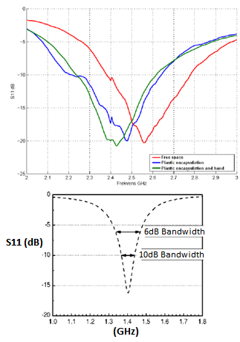
Antenna Bandwidth
Bandwidth refers to the range of frequencies over which the antenna can operate with acceptable VSWR.
Typically a BW of operation when VSWR is less than 2:1 is acceptable. This translates to a return loss of about -9.5dB

Slide 25
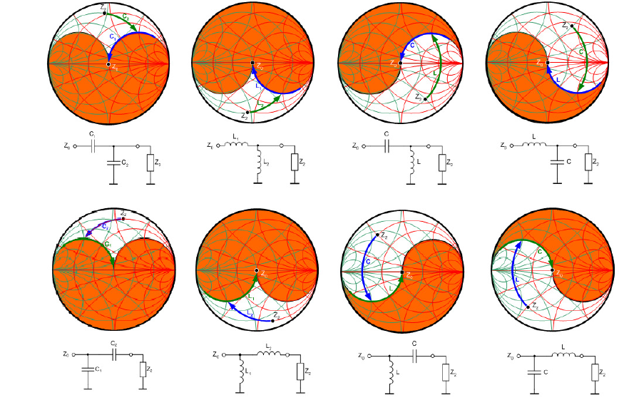

L-Network can always match the antenna

Slide 26
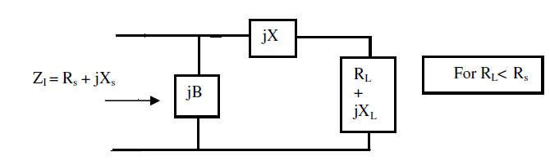
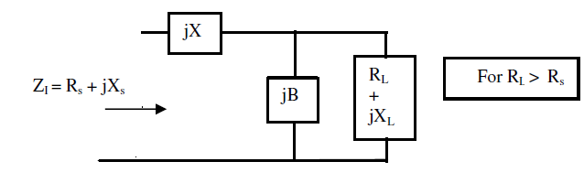
Analytic Expressions for L-Match
Antenna Impedance

Slide 27
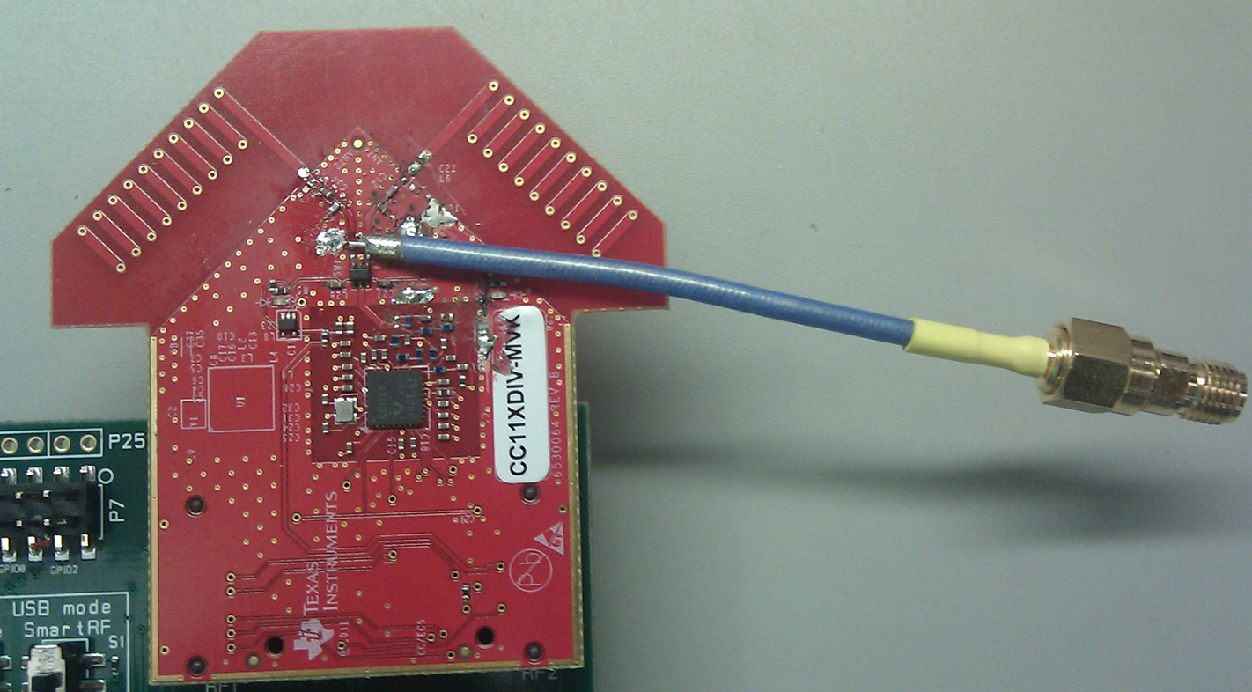
Antenna Matching Process
Semi rigid cables are very useful in this regard for debugging RF.
First the shielding is soldered onto the ground plane and then the middle conductor is soldered on pads. This minimizes the risk of ripping off pads from PCB.

Slide 28
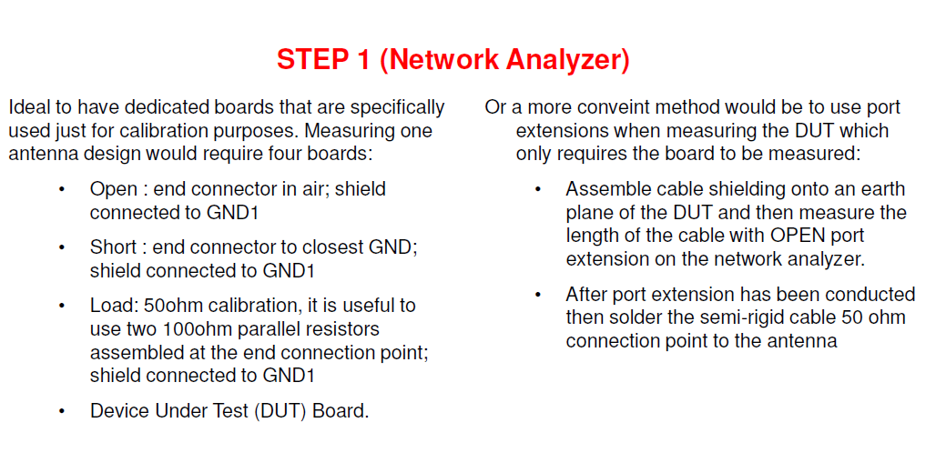
System Calibration
By performing either of these methods then the semi-rigid cable is also taken care of during the calibration. By just using network analyzer calibration kit, then the semi-rigid cable will be a part of the measurements

Slide 29
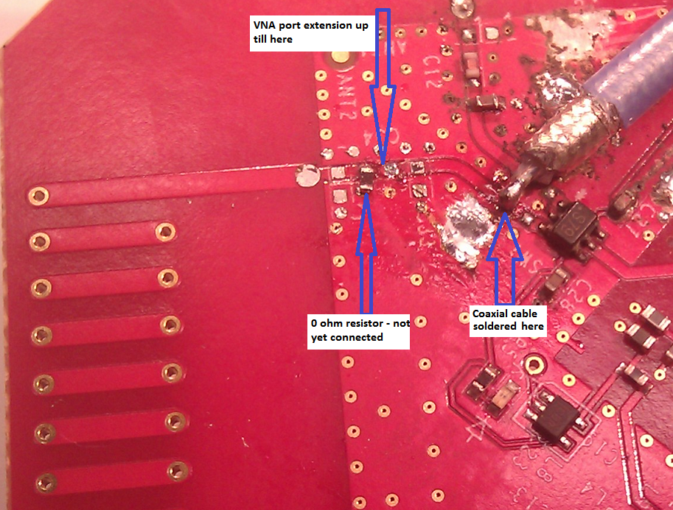
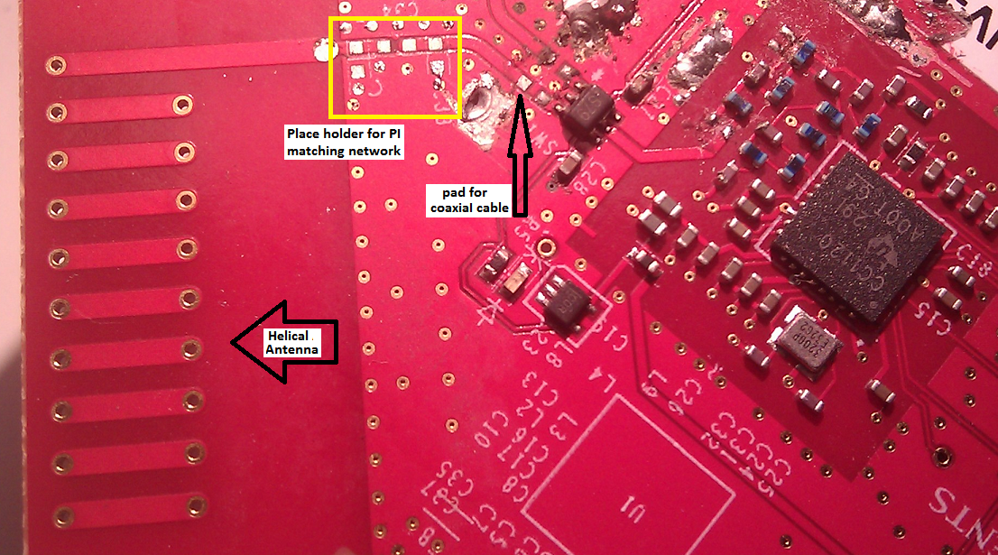
Antenna Match Example for 868MHz
A compact PCB helical antenna at 868 MHz is matched to 50-ohm source.
This antenna should be larger in size but it has been purposely designed to be as compact as possible. The PCB helical antenna is loaded in the match so the resonance will be at 868 MHz
FIG 2
FIG 1

Slide 30
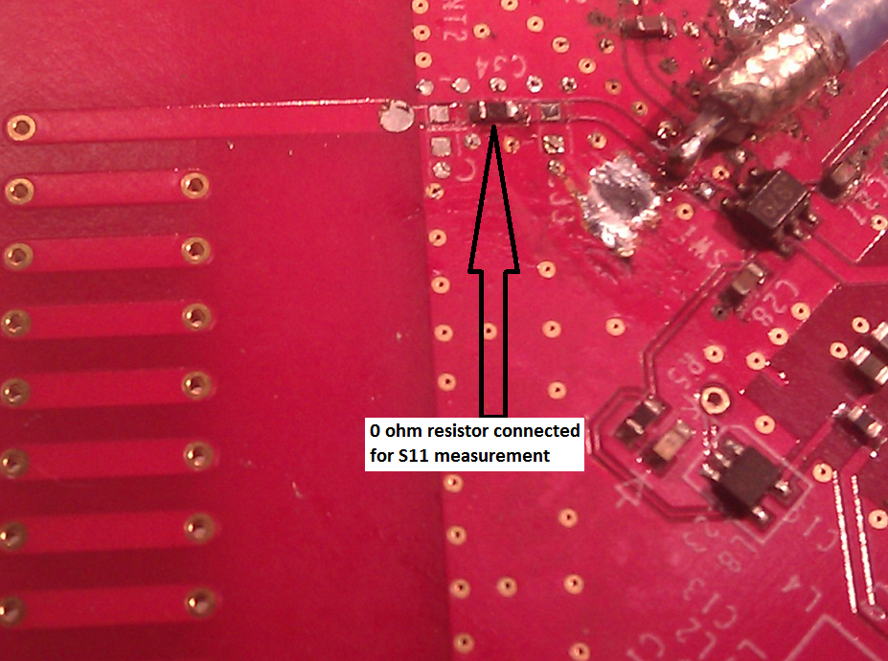
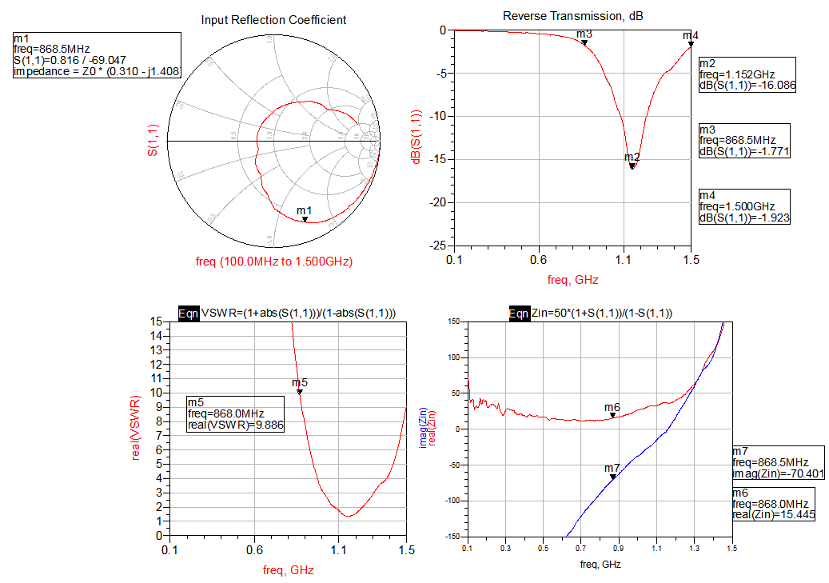
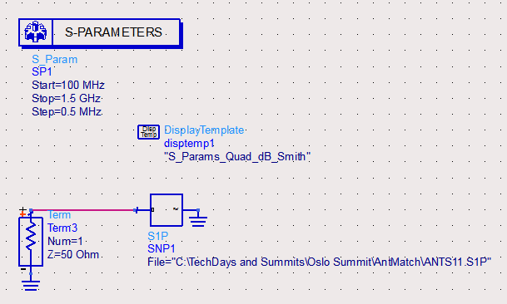
Antenna Measurement on VNA
S11 of unmatched antenna is measured and antenna impedance is calculated (or read directly from VNA) at 868MHz. The value turns out to be 15.4 – j70.4 @ 868MHz
VSWR = 9.8

Slide 31
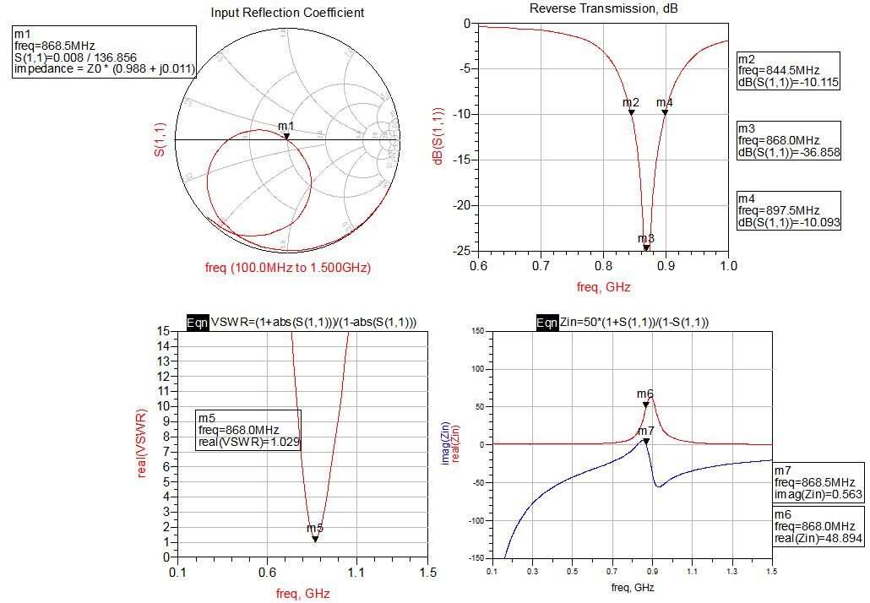
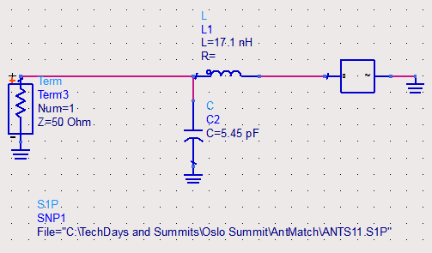
Analytic Solution at 868MHz -Theoretical Values
Using the analytic solutions, equations (9) to (12), the theoretical values and result of the L-Match can be calculated as shown.
The simulation is done again by choosing models of values available from vendors that are closest to the calculated ones.
Once realistic models are chosen and simulated for desired performance, these values are put on the board and results are measured.

Slide 32
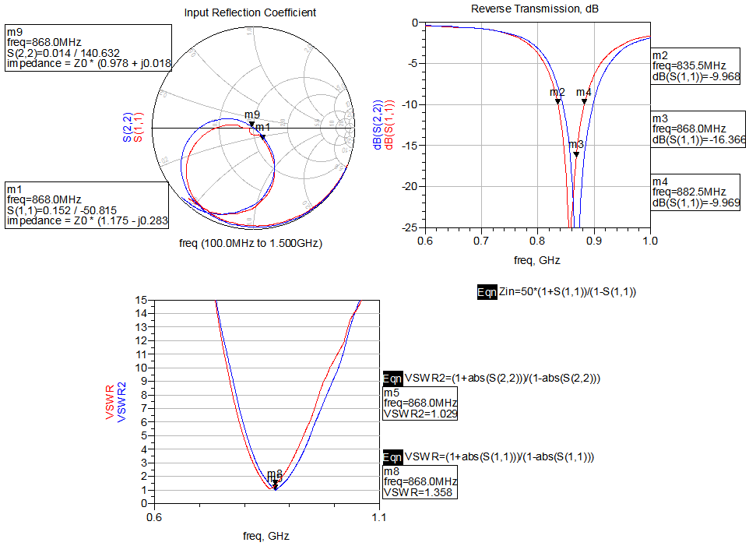
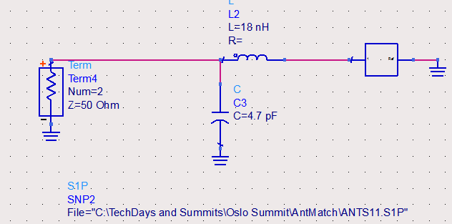
Solution With Real Values at 868MHz
Most likely the measurements will still be off and values are then tweaked on the board to give final acceptable antenna performance.
Here we find that L=18nH and
C = 4.7pF provide an acceptable
match (red curves)

Slide 33
PCB Layout Practices for Antennas
Important considerations for Antennas
If using an antenna from a TI reference design, be sure to copy the design exactly as drawn and check if the stack-up in the reference design matches your stack-up.
Changes to feed line length of antenna will change input impedance match.
Any metal in close proximity, plastic enclosure, and human body will change the antennas input impedance and resonance frequency, which must be taken into account for matching.
For multiple antenna on same board, use antenna polarization and directivity to isolate.
For chip antennas verify that the spacing from and orientation with respect to the ground plane is correct as specified in their datasheet.

Slide 34
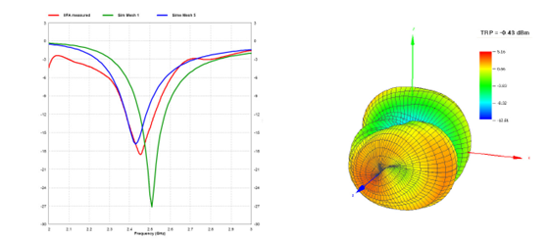
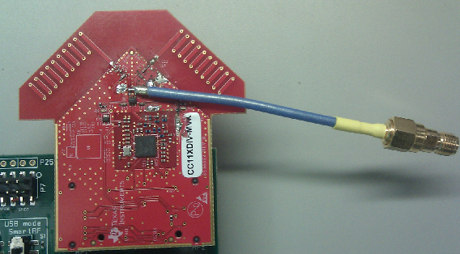
Antenna Radiation Pattern
Measure the radiation pattern in an anechoic chamber with defined output power and signal
generator.

Slide 35
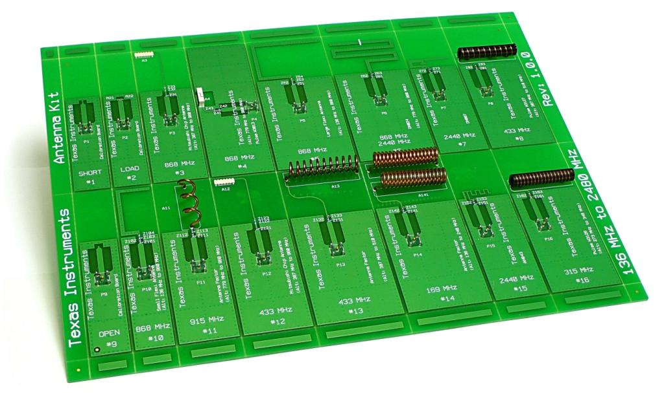
Antenna Evaluation Kit
Antenna reference designs (PCB, Chip and Wire antennas)
13 low cost antennas and 3 calibration boards.
Frequency ranges from 136 MHz to 2.48 GHz.
See also DN031
www.ti.com/lit/swra328
CC-ANTENNA-DK
Price $49
Notes:
35
The CC-Antenna-DK contains 13 low cost antennas and 3 calibration boards. The antennas cover the frequency range as low as 136 MHz to 2.48 GHz.
The main purpose of the CC-Antenna-DK is to ease the decision for which type of low cost antenna can be implemented as well as give an estimation of the performance that can be achieved.
All antennas are tuned for connecting to an EM board on the EB platform. A matching network is used on each antenna design so the antenna boards can matched for other GND sizes than the EB board.
Antennas are categorized under the operating frequency (169 MHz, 315 MHz, 433 MHz, 868 / 915 MHz or 2.44 GHz) and then the type of antenna (PCB Antennas, Chip Antennas, and Wire Antennas). The main focus is on PCB, Wire and Chip antennas, since these are mainly used in high volume products.
• 169 MHz (136 – 240 MHz) Antenna
• 315 MHz (273 – 348 MHz) Antenna
• 433 MHz (387 – 510 MHz) Antenna
• 868 MHz (779 – 960 MHz) Antenna
• 915 MHz (779 – 960 MHz) Antenna
• 2440 MHz Antenna

Slide 36
References
Antenna Theory: Analysis and Design by Constantine Balanis
Networks, Lines and Fields by J. D. Ryder
Antenna design kit measurement summary
  http://www.ti.com/lit/an/swra328/swra328.pdf
Antenna Selection guides and measurements
  http://www.ti.com/lit/an/swra161b/swra161b.pdf
  http://www.ti.com/lit/an/swra328/swra328.pdf
Excel sheet for indoor outdoor range estimation
  http://e2e.ti.com/cfs-file/__key/communityserver-discussions-components-files/156/Range-Estimation-for-Indoor-and-Outdoor-Rev1_5F00_15.xlsm
Achieving Optimum Radio Range
  http://www.ti.com/lit/an/swra479/swra479.pdf

