Slide 1
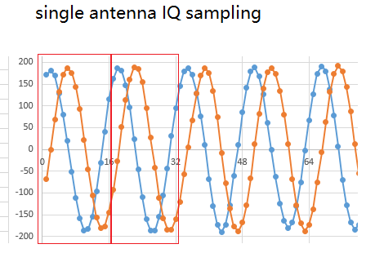
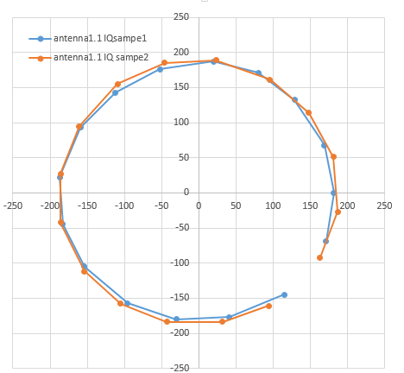
The phase angle difference for each two sample points is not consistent as shown in the following figure

