Slide 1
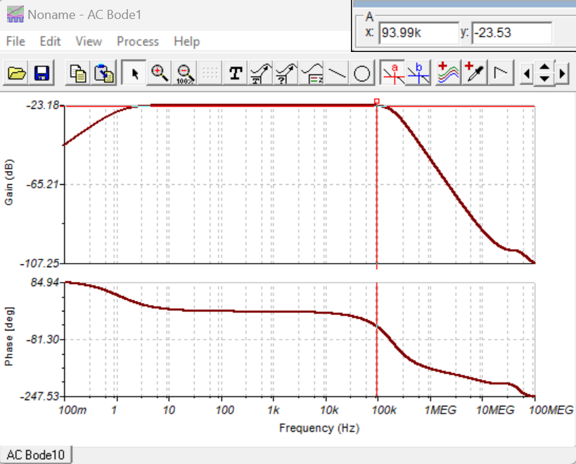
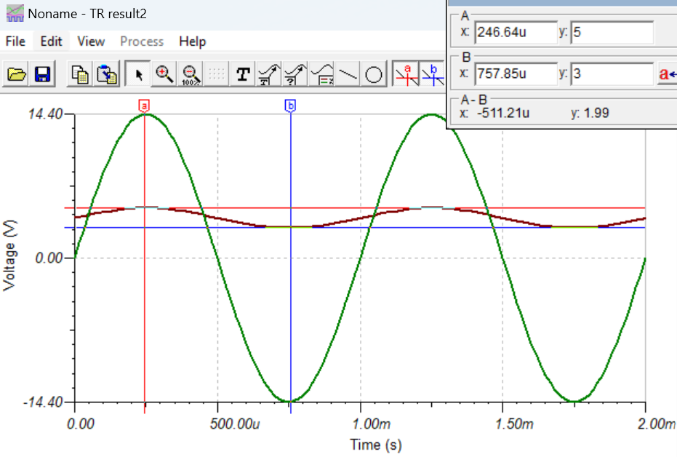
I113
0+/-14.4V
(28.8Vpp)
I113
-23.16dB
4+/-1V
(2Vpp)

Slide 2
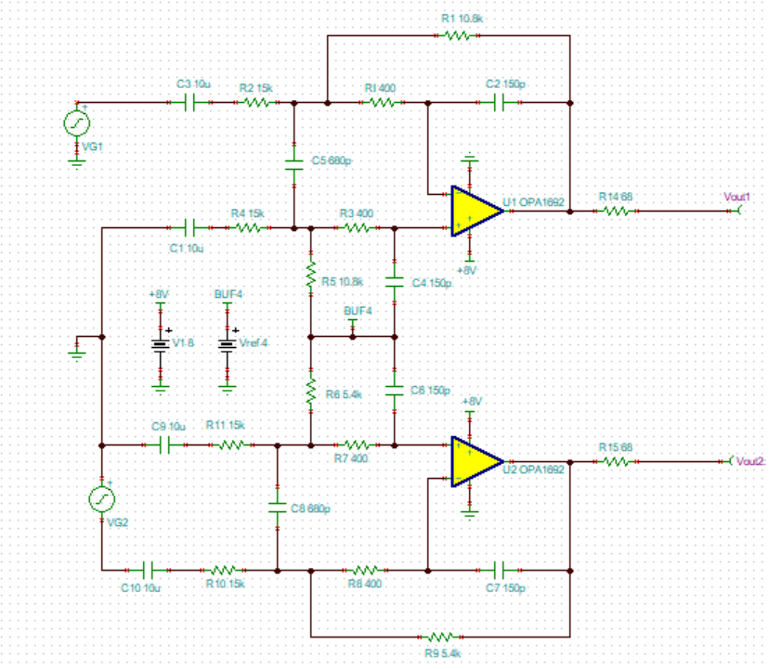
I118
4+/-1V
(2Vpp)
I118 OPA1692
-2.85dB(single)
-8.87dB(differential)
4+/-0.72V
(1.44Vpp)
Single ended
4+/-2V
(4Vpp)
4+/-0.72V
(1.44Vpp)
differential

Slide 3
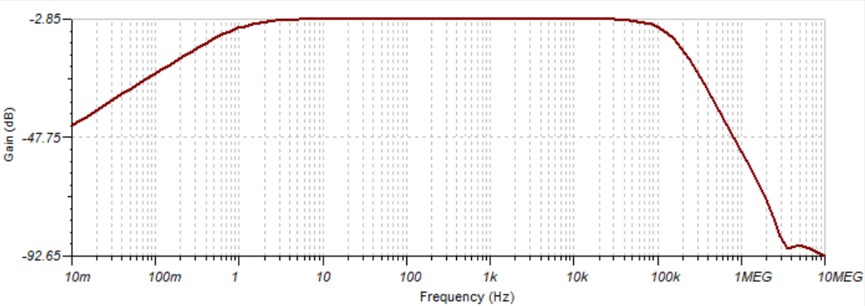
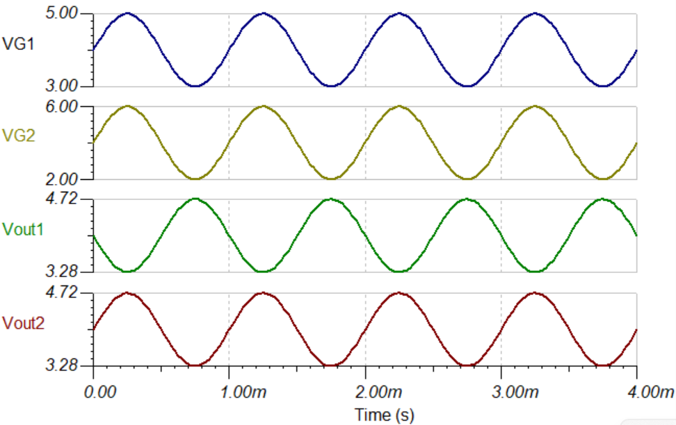
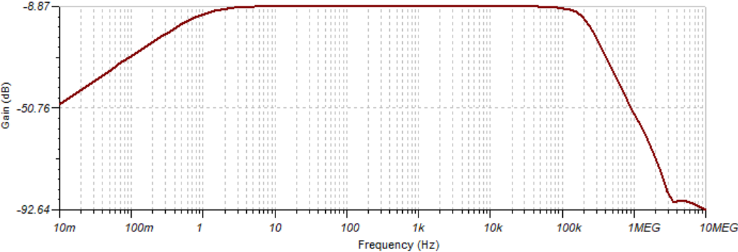
I118

