Slide 1
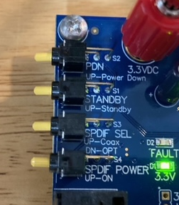
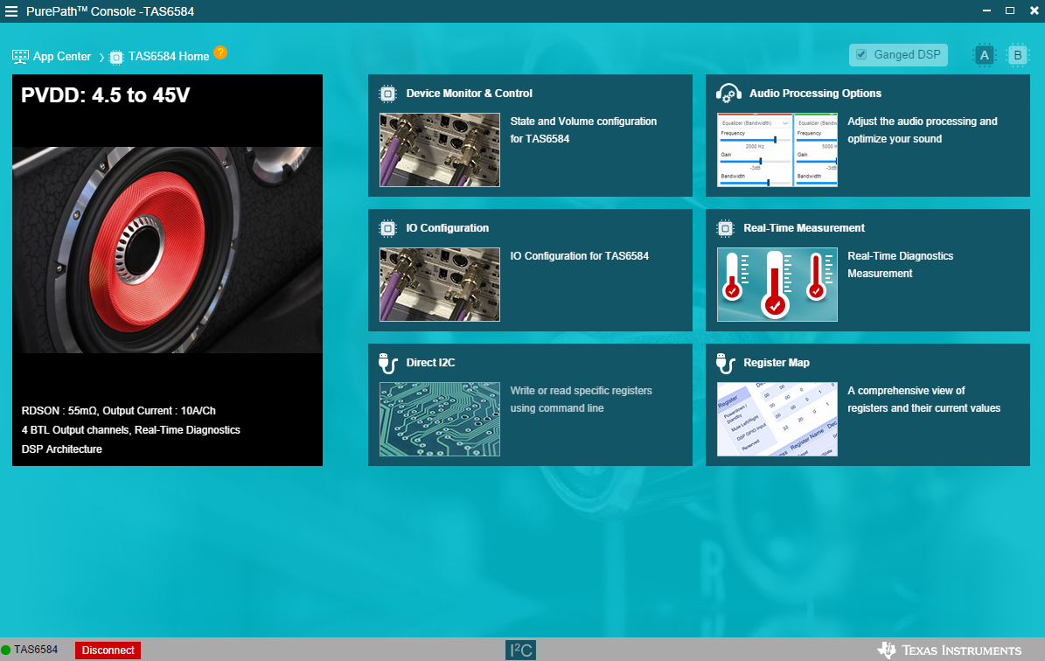
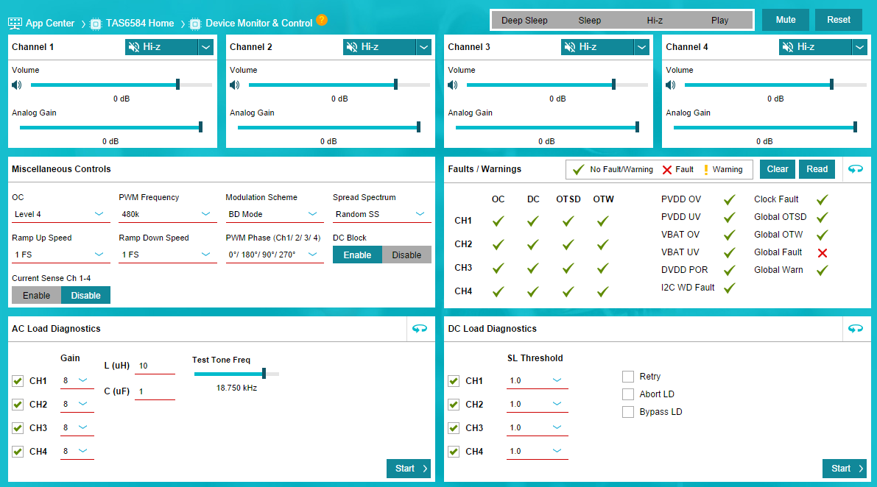
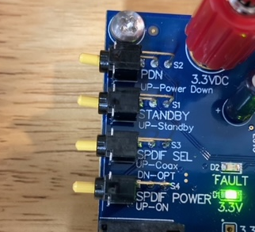
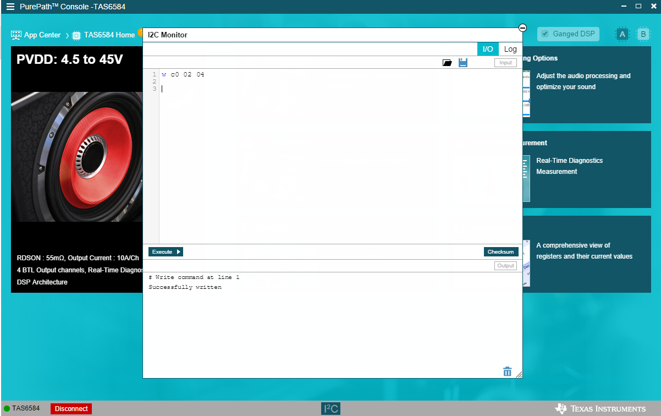
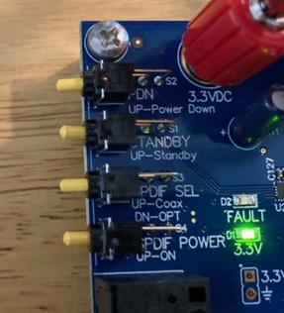
Enter PBTL mode for CH1/2, BTL mode for CH3 and CH4
6. Toggle STBY button, set buttons as below
1. Power up and connect EVM (keep the PDN and STBY button down), goes into Device Monitor & Control First.
4. Click “I2C” button on below, then a window pop up
down
down
down
up
2. Set buttons on EVM as below
up
up
down
5. Run below script, to set CH1/2 into PBTL mode
w c0 02 04
(Note: C0 is device address)
up
3. Toggle PDN button, set buttons on EVM as below
down
2. Write “w c0 02 04”
1. Make sure the blue block is at “IO”
up
down
up
3. Click “Execute” button

