Slide 1
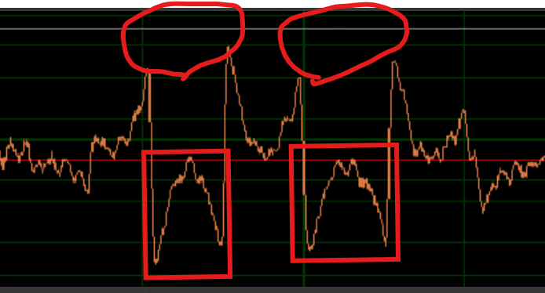
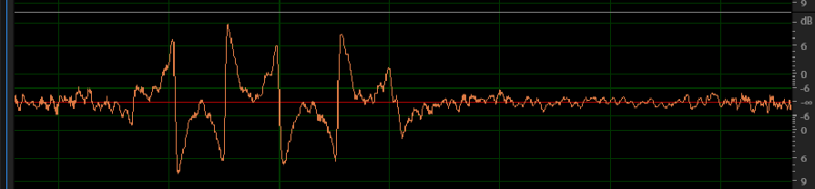
items1
The waveform that should be on the upper side appears to be aligned with the lower side.

Slide 2
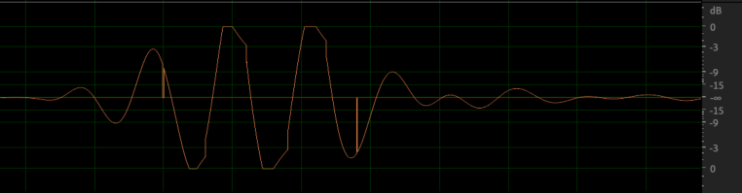
items2
These symptoms have occurred.
We have tried to reproduce.
But symptom did not occur.
So is it possible this symptom would occur with ADC??

