Slide 1
AIC3254 AGC On Volume Control

Slide 2
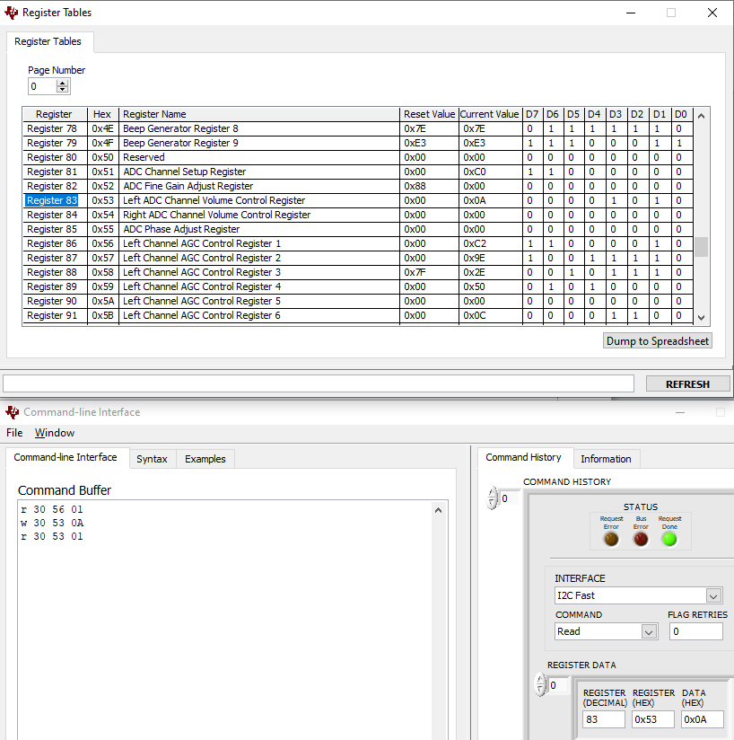
AGC enabled Left ADC Volume Control
Volume Setting
AGC Enabled
Change Volume
Setting

Slide 3
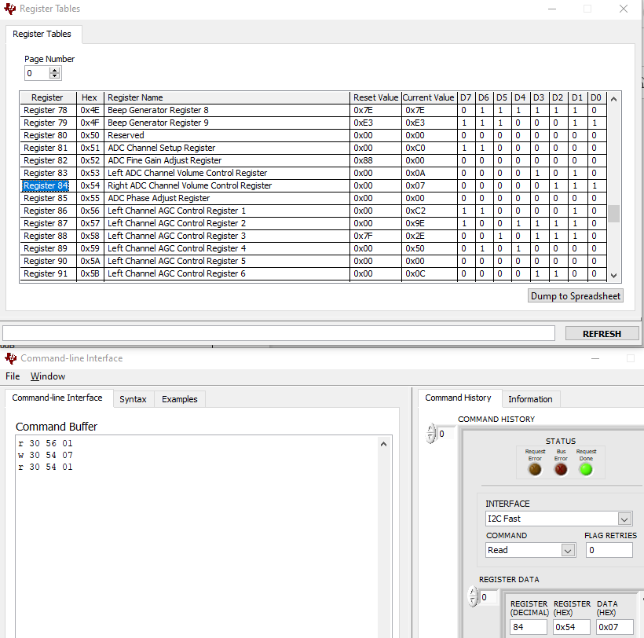
AGC enabled Right ADC Volume Control

Slide 4
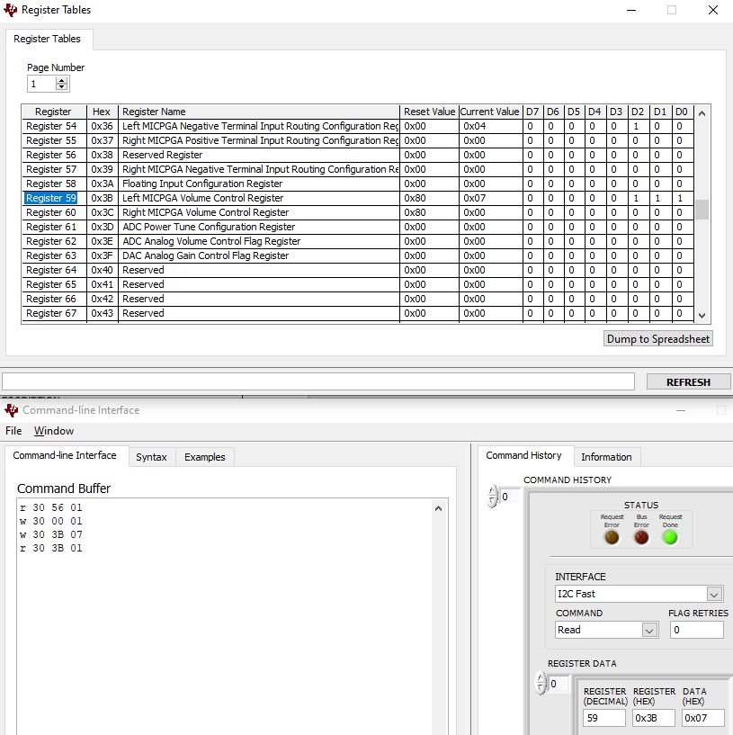
AGC enabled MIC Left Volume Control

Slide 5
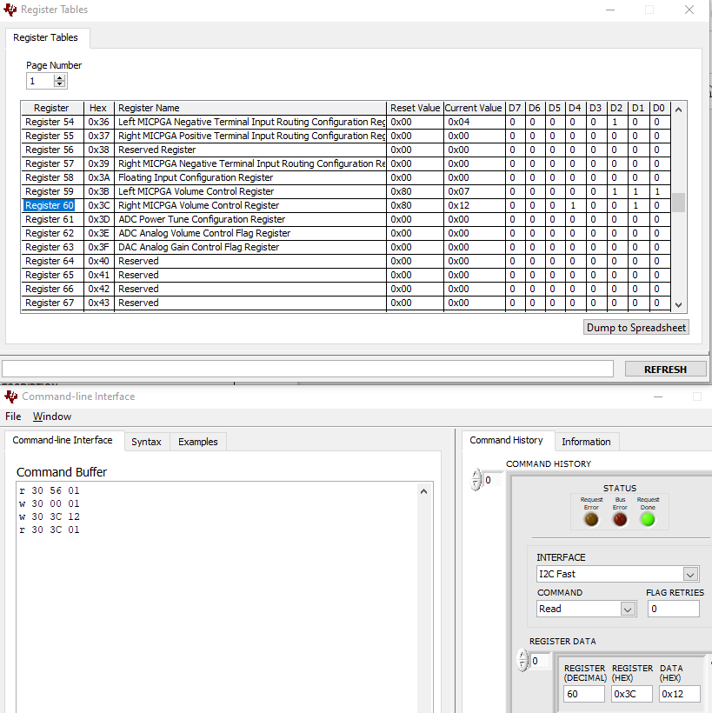
AGC enabled MIC Right Volume Control

