Slide 1
AIC3254 AGC On Volume Control

Slide 2
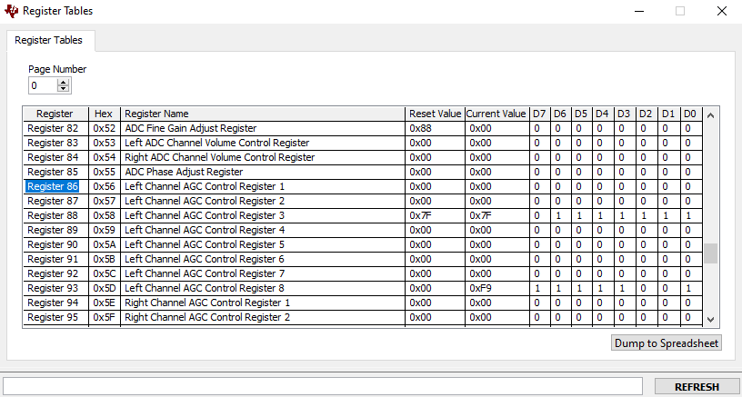
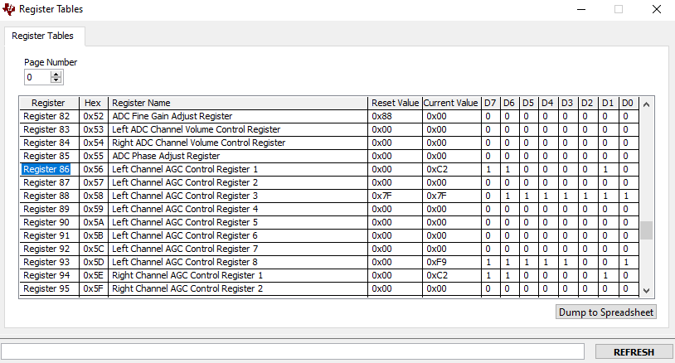
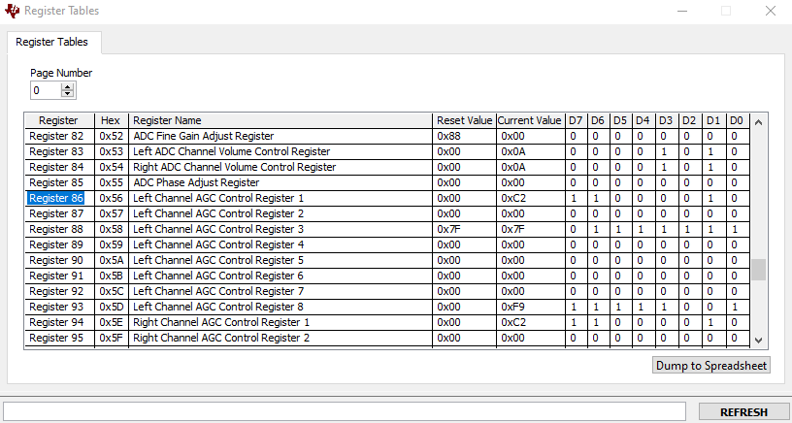
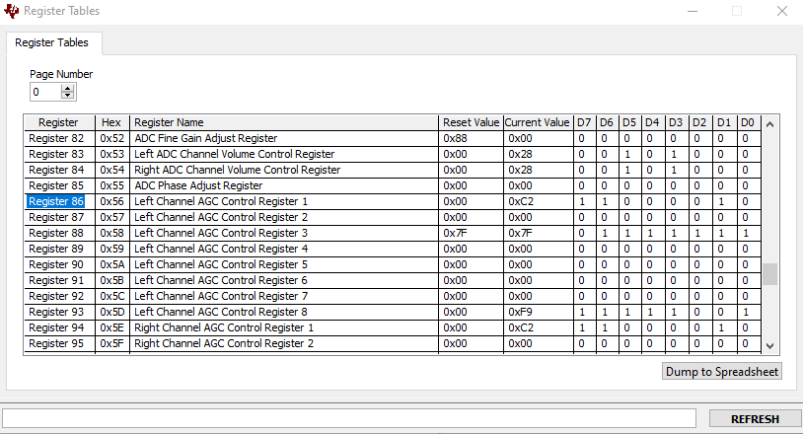
AGC & Volume on both Left and Right
1
2
AGC Disabled
AGC Enabled Volume at 0dB
3
4
AGC Enabled Volume set to +5dB
AGC Enabled Volume set to +20dB

Slide 3
AGC & Volume on both Left and Right
1
2
3
4
Recorded tone with and without AGC and adjusting Volume Control

