Slide 1
AM Avoidance
Kai Nomiyama

Slide 2
AM Avoidance Procedure referred to SLEA040
User selects desired AM station using front panel controls
System Micro writes the selected AM frequency to the AM tuner and also to TAS5508 (Micro also writes the pre-selected AM interference avoidance sequence – register 0xDE)
I picked up below comment from TAS5538 AM AVOIDANCE from E2E
During AM interference avoidance, the TAS5538 receives the sample rate(44.1 or 48kHz) and the Tuned Frequency (typically 540 to 1840kHz) from the system controller. TAS5538 uses these two values to determine what switching rate to use.
⇒TAS5558 works as ASRC so
TAS5558 doesn’t need to receives the sample rate, only receives Tuned Frequency from the system controller. TAS5558 uses Tuned Frequency to determine what switching rate to use.

Slide 3
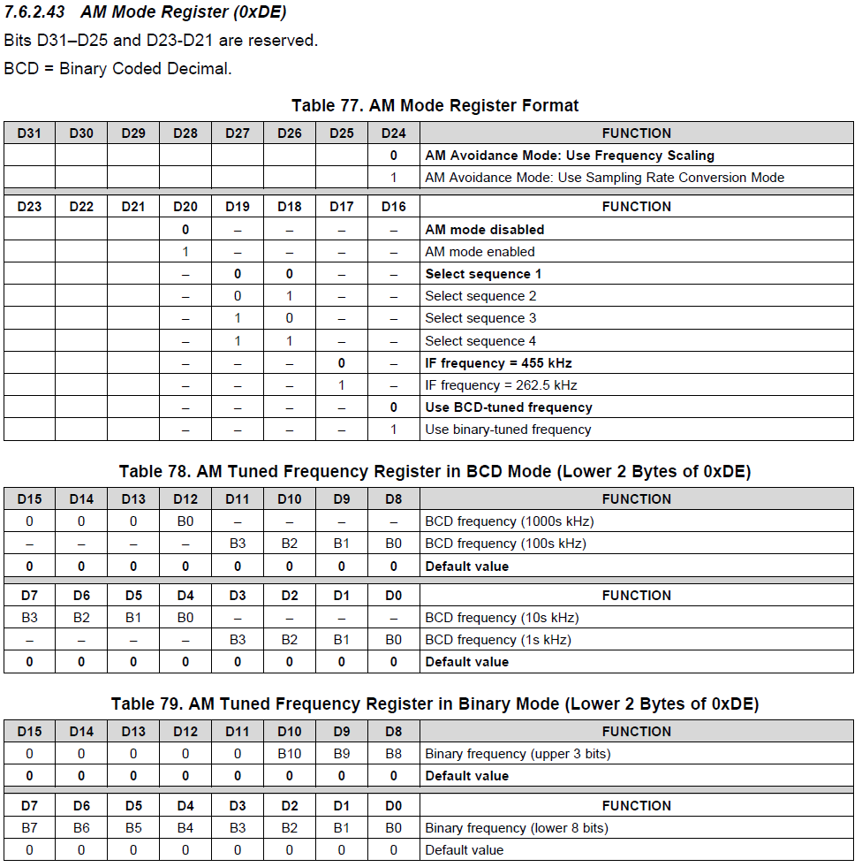
AM AVOIDANCE AT TAS5558
The following shows the details for example:
⇒User select AM station 594kHz using front panel controls
⇒System Micro writes the selected 594kHz to the AM tuner and also TAS5558 (Micro also writes the AM interference avoidance sequence 2 – register 0xDE)
If I follow above information,
0xDE is 0x00 14 05 94
(if reserved registers are all 0)
BTW, There are two type of AM Avoidance mode:
-Use Frequency Scaling
-Use Sampling Rate Conversion Mode
When I use TAS5558 as ASRC, how to set D24 bit and
What is this bit function?

