Slide 1
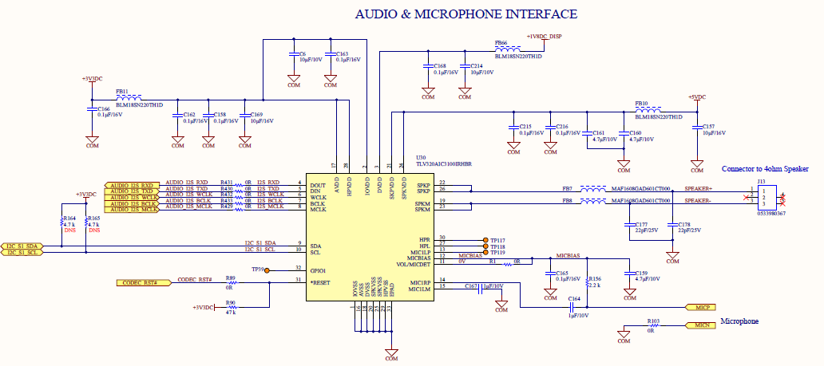
All the lines are interfaced with imx8mq SOC with Audio codec lines.
Using console, am executing the command “gst-play-1.0 Alarm.wav” in the Embedded Linux platform.

