Slide 1
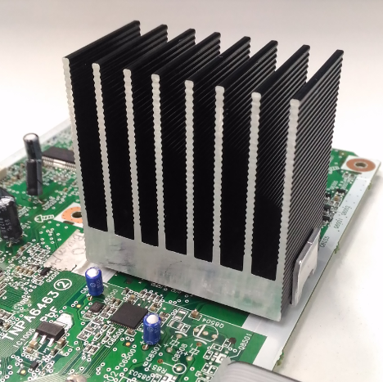
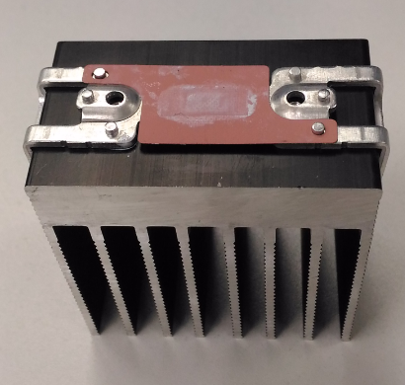
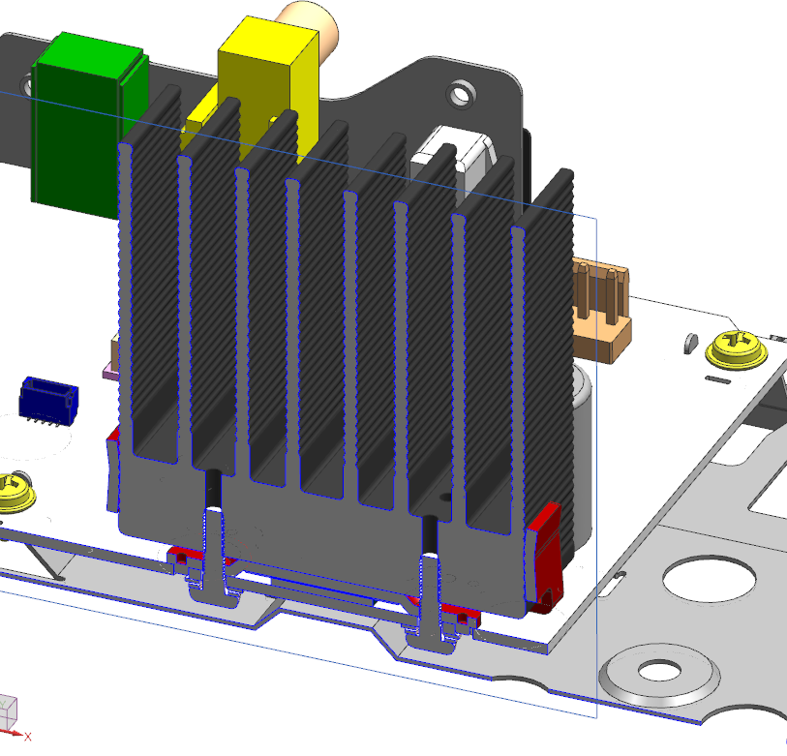
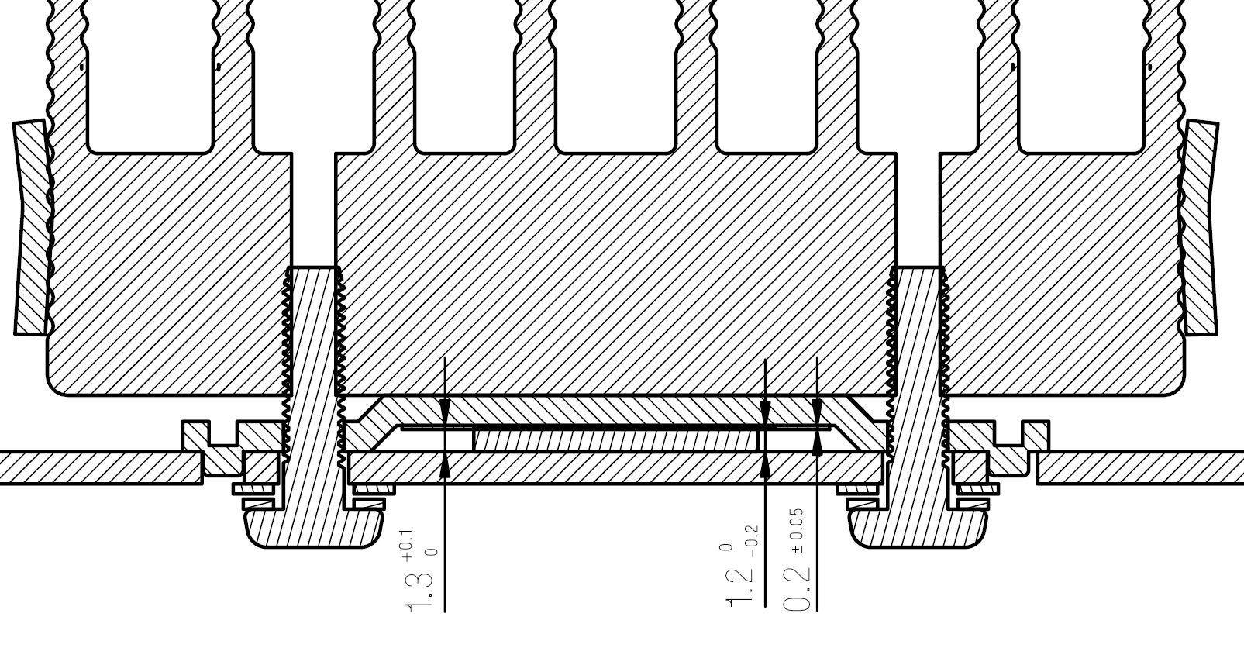
D-Amp Heat Sink construction
Sit on the PCB
For additional
support
Silicone grease applied between Heat Sink <–>Heat Sink Bracket, and Insulator Sheet<–> IC.
Heat Sink
Heat Sink Bracket
PCB
IC
Insulator

Slide 2
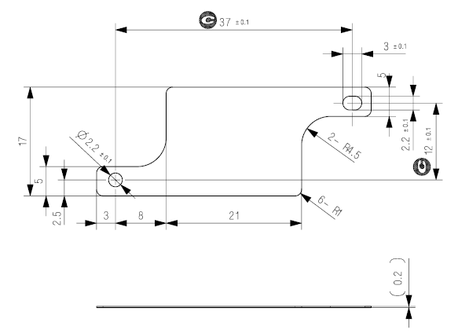
Insulator sheet
Part number Shinetsu TC-20CG
Datasheet:
https://www.silicone.jp/catalog/pdf/tc_j.pdf

Slide 3
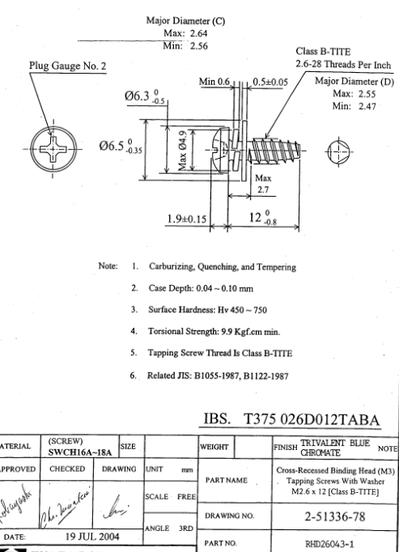
Screw

