Slide 1
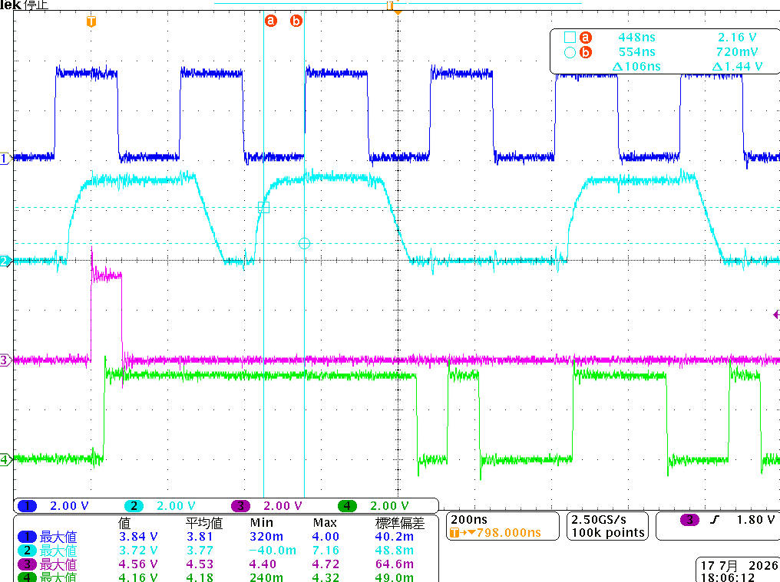
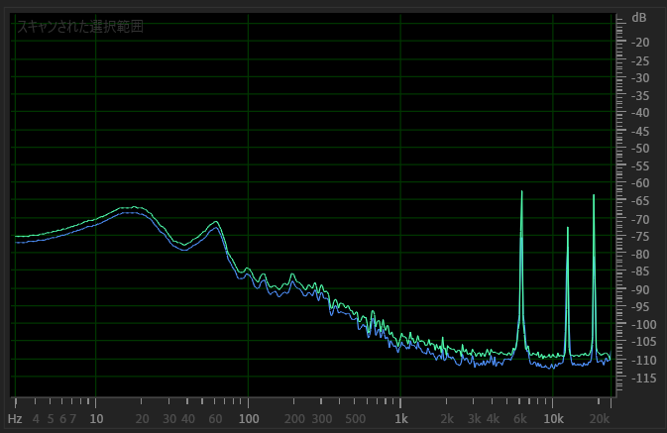
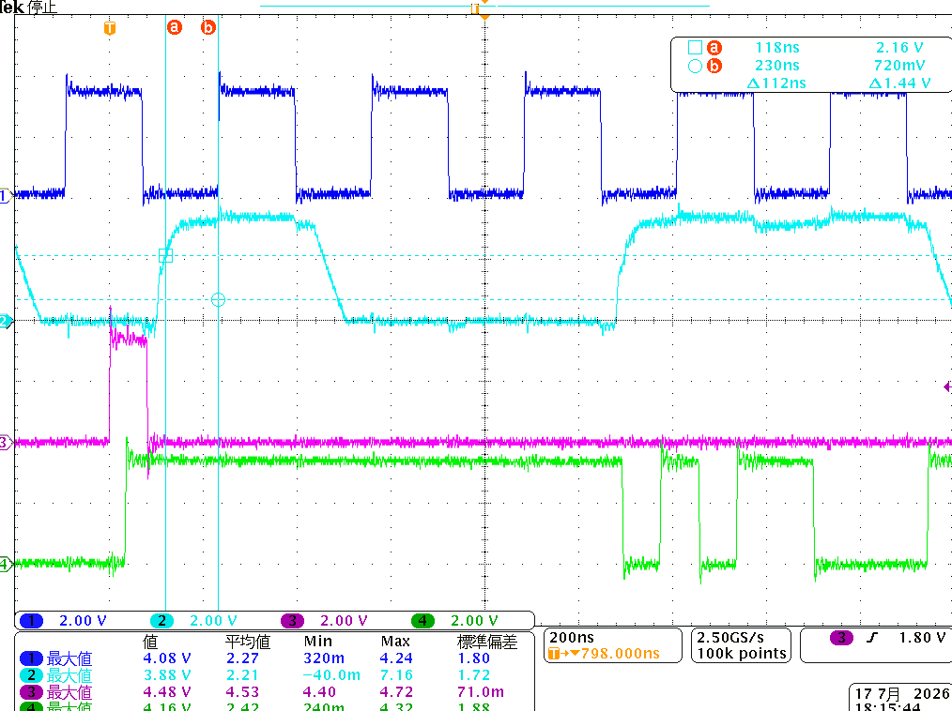
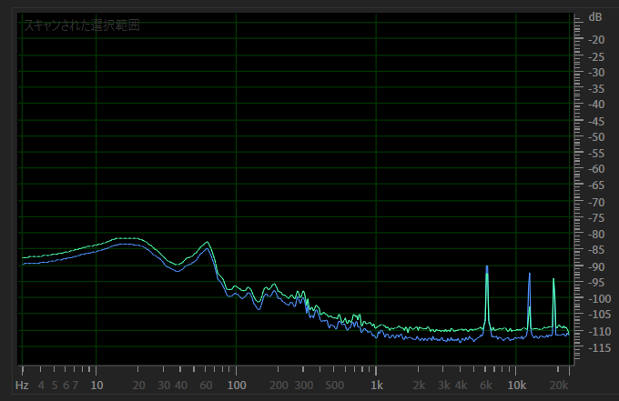
1. DMIC2ch DAT terminated 33ohm
There was no change in noise even after adding a 33Ω termination resistor.
The setup and hold times appear to be fine.
Tsu=106ns, Thld=228ns
2. DMIC1ch (different from No. 1)
The noise has decreased somewhat, but it is still present. What is strange is that noise is also superimposed on the unconnected right channel.
Tsu=112ns, Thld=220ns

