Slide 1
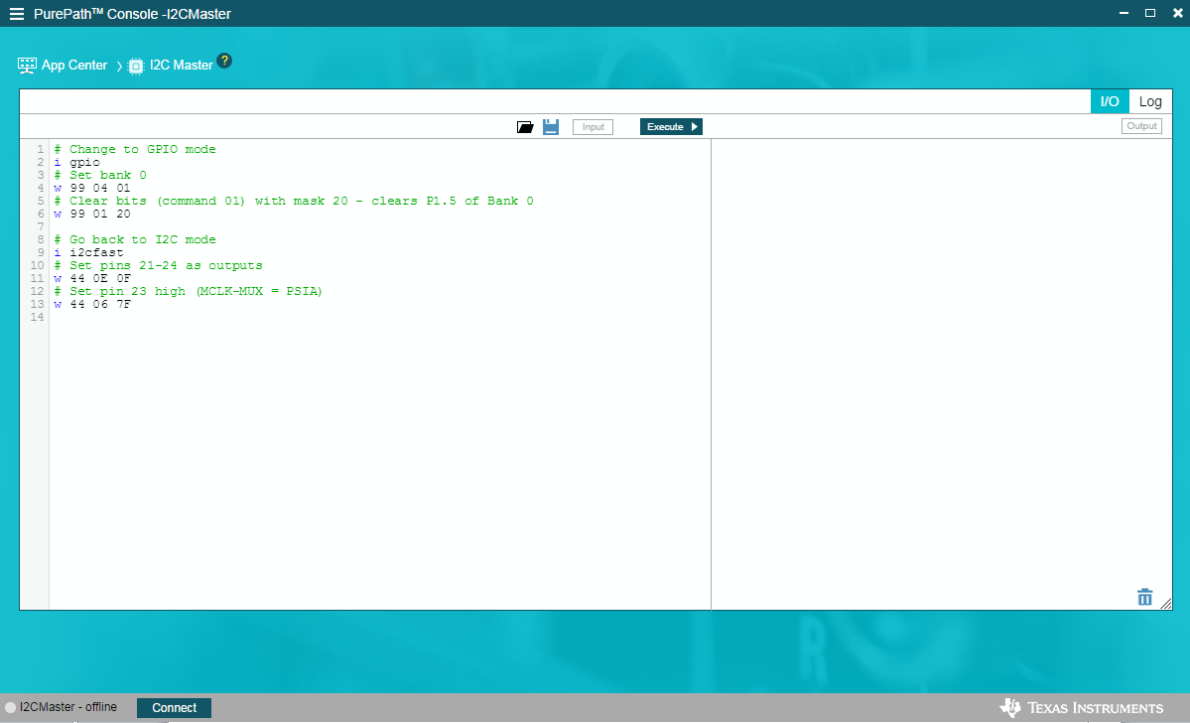
Enable PSIA on PPCMB
Run the attached script at “I2C Master” panel
3. Hit “Execute”
2. Enter the commands. (See attached .txt file )
1. Hit “Connect”

