Slide 1
How to Generate a Header File for TAS5805M in PPC3

Slide 2
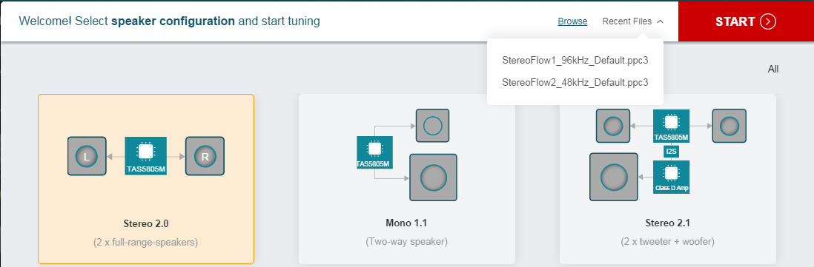
Step 1
Connect a TAS5805MEVM to your PC.
Power on TAS5805MEVM.
Plug in a Micro USB cable from the PC to TAS5805MEVM.
Launch PPC3 and go to TAS5805M app.
Load your tuning file(.ppc3).
Click the START button.
6
5

Slide 3

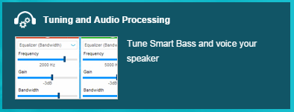

Step 2
Click the Connect button on the bottom.
Open Tuning and Audio Processing. This will load tuning settings to the target TAS5805M device on the EVM.
Select the desired Snapshot if any has been saved before.
Make sure your tuning settings are all good.

Slide 4
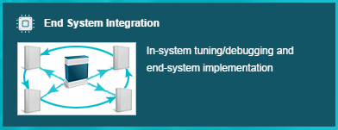
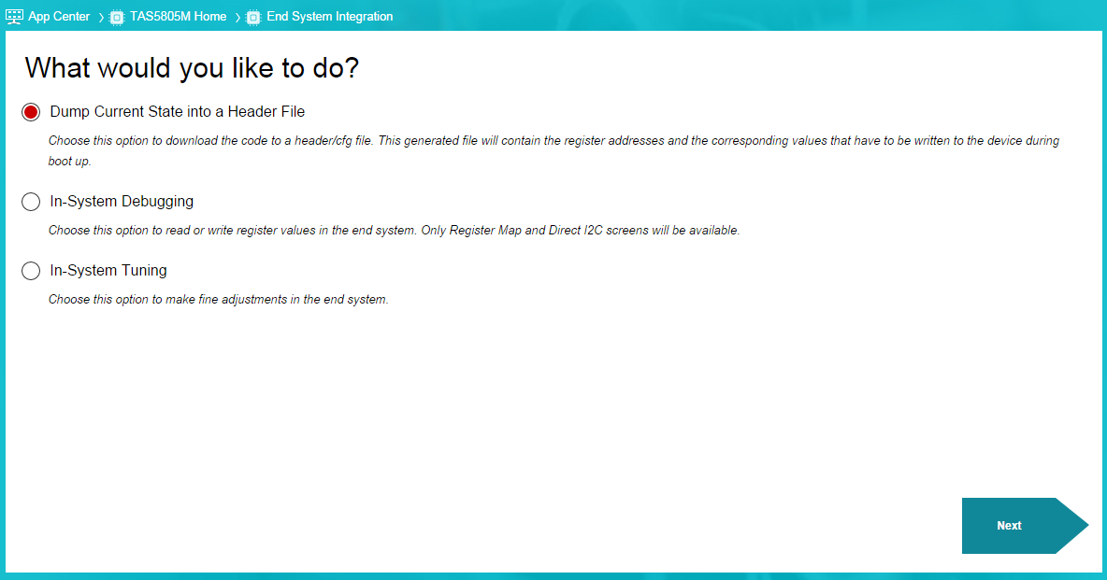
Step 3 (1 / 3)
Go into End System Integration.
Select Dump Current State into a Header File and click the Next button.

Slide 5
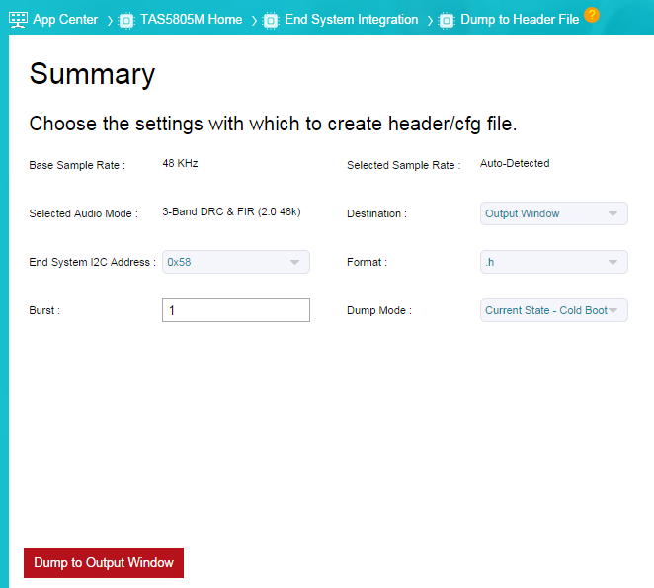
Step 3 (2 / 3)
Make sure the right Destination, Format and Dump Mode are selected. Click the Dump to Output Window button, as shown below.

Slide 6
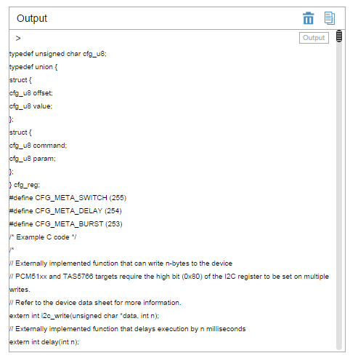
Step 3 (3 / 3)
Click the icon on the top right corner of the Output window and paste all the contents to a blank header file.

Slide 7
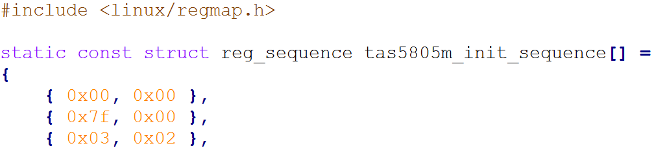
Step 4
Make a few necessary changes so that the header file can be used with the driver code. Se the example below.

