Slide 1
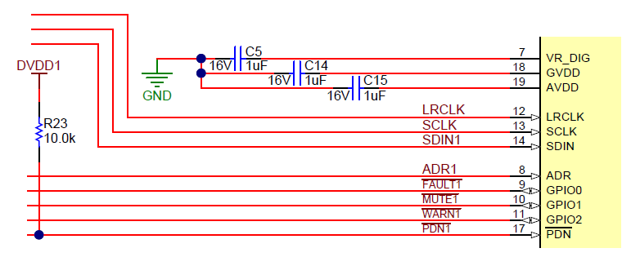
TAS5825MEVM Rework
Remove the 10kΩ pull-up resistor (R23) on the /PDN pin and add a 20kΩ pull-down resistor to GND.

Slide 2
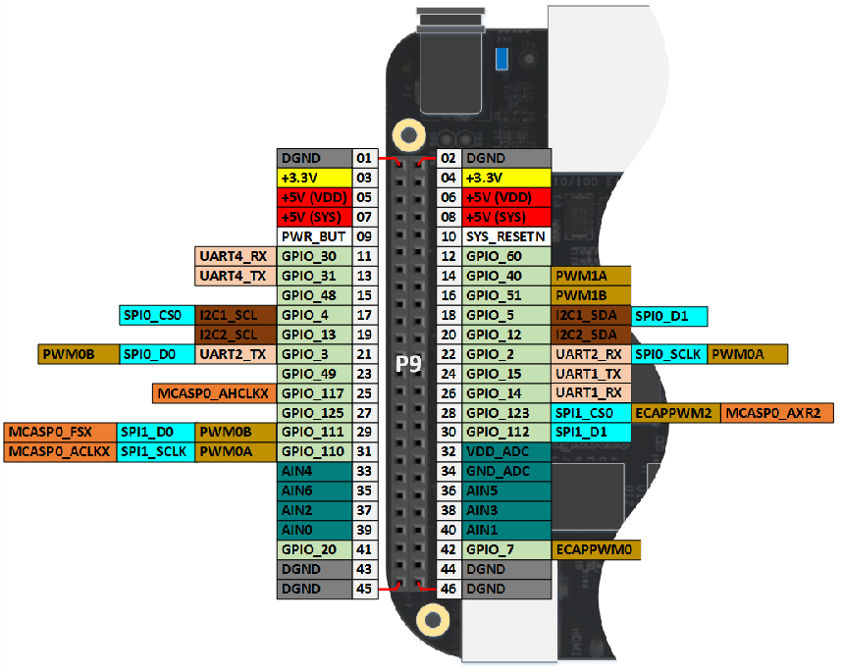
Hardware Connections
/PDN : P9.12
TAS5825M I2C
SDA : P9.20
SCL : P9.19
TAS5825M I2S
BCLK : P9.31
LRCLK : P9.29
SDIN : P9.28

Slide 3
Step 1
Launch VM VirtualBox and start the Linux Server.
Make sure there is NO folder titled as “tas5825_jessie” in the folder /home/mpaa/nfs/bbb/project. Delete that folder if it does exist.
Copy tas5825_jessie.zip to the folder /home/mpaa/nfs/bbb/project and unzip it.
Navigate to the /home/mpaa/nfs/bbb/project/tas5825_jessie and compile the driver code by typing the follow command line.
make ARCH=arm CROSS_COMPILE=arm-linux-gnueabihf-

Slide 4
Step 2
Connect to Beaglebone Black with Tera Term
In /boot/uEnv.txt, change the following line
to
Connect to Bealebone Black with WinSCP. Remember to log in with a username of “root”.
Navigate to /boot/dtbs/4.4.9-ti-r25, replace the dtb file am335x-boneblack.dtb with the one of the same file name provided.
Reboot Beagleblone Black by typing the following command line in Tera Term.
sudo reboot

Slide 5
Step 3
Execute the following script in PPC3 I2C Master to enable the external I2S (J4) on the PPCMB.

Slide 6
Step 4
Mount the shared NFS folder from the Linux Server onto the Beaglebone Black. See the command below. Please note that the IP address highlighted needs to be replaced by the real IP address of the Linux Server.
sudo mount -t nfs 10.8.45.250:/home/mpaa/nfs /mnt
Navigate to the folder /mnt/bbb/project/tas5825_jessie.
cd /mnt/bbb/project/tas5825_jessie/
Type the following command line to load the driver.
sudo ./lmod.sh
Check whether the driver is successfully loaded.
cat /proc/asound/cards

Slide 7
Step 5
Play audio files to test whether playback can be performed correctly. Audio files with different sample rates can be used. See a few examples below.
#48kHz audio file
mpg123 ../media/hotel_48k.mp3
#44.1kHz audio file
mpg123 ../media/butterfly_44k.mp3
#96kHz audio file
mplayer -ao alsa:device=hw=0.0 ../media/beyond_96k.wav

