Slide 1
How to enable Record Volume Control on PCM290x devices in Linux
Apply to PCM2900C, PCM2901, PCM2902C, PCM2903C, PCM2904 and PCM2906C Audio USB Converter devices

Slide 2
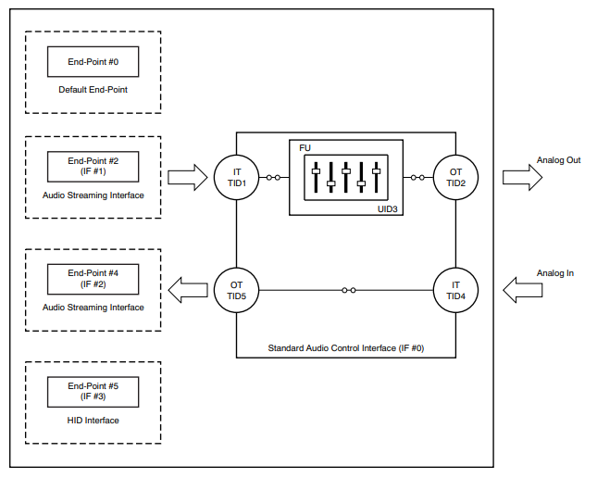
PCM290x Devices USB Audio Topology
Volume control which resides in USB Feature Unit (FU) only available in Data-Out path (Playback)
This feature is not supported for Data-In path (Record) in the device, a software implementation is normally used to enable this ability
In Windows OS this record volume control was implemented in software and user can adjust the volume through its sound setting

Slide 3
In Linux: Summary of enabling Record Volume Control
Use ALSA Softvol plugin to add a new volume control when this control is not available in device/hardware
Softvol creates a new device which is connected to the sound card
User creates a new configuration file (asoundrc) for the new device
Place the asoundrc config file into the user directory (~/)
Run arecord to load the configuration of the new device
Check the newly added device in the sound list
Check the newly added control with ALSA mixer contents
Check the component in ALSA mixer capture view
Test the volume control feature

Slide 4
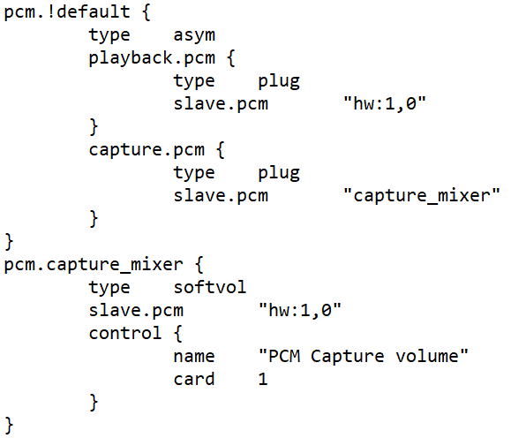
Step 1: Creating and loading asoundrc config file
Run “cat /proc/asound/cards” command to determine the correct card id number for USB AUDIO CODEC to add to the new control device e.g. card 1
Create asoundrc file for the new device of the correct card number and control as shown or modify and rename the attached file
Place this config in ~/.asoundrc
Run arecord command to load with the new device:
#arecord -D capture_mixer -d 1

Slide 5
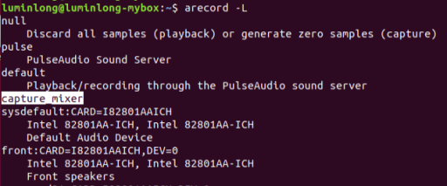
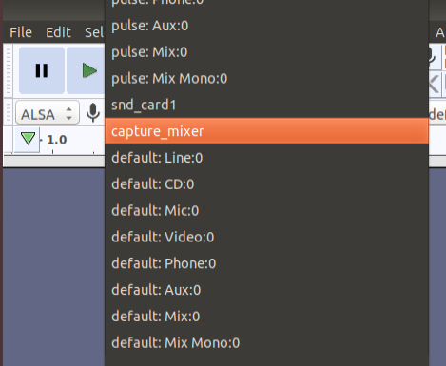
Step 2: Check the new device
Execute arecord –L command to view device names
#arecord –L
In Application like Audacity, the recording device will show the new device
If SW developer wants to reference the recording device in the code:
#include <alsa/asoundlib.h> snd_pcm_t *snd_handle; err = snd_pcm_open(&snd_handle, “capture_mixer", SND_PCM_STREAM_CAPTURE, 0)

Slide 6
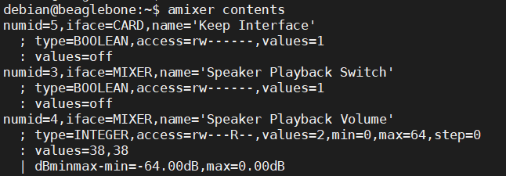
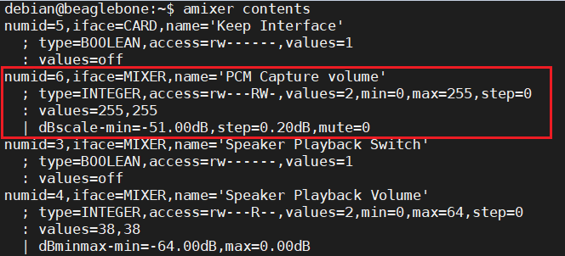
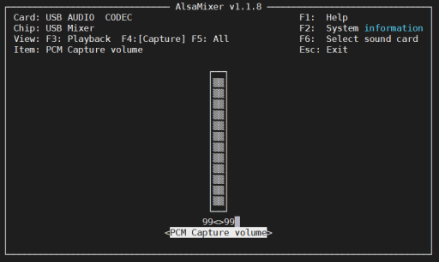
Step 3: Check the new control
Before
Execute amixer contents command to display list of the card controls with their contents
#amixer contents
If the corresponding sound card id is 1, add -c 1 behind amixer:
#amixer -c 1 contents
Verify with ALSA GUI
#alsamixer --view=capture
or #alsamixer --view=capture -c 1 (card id)
After

Slide 7
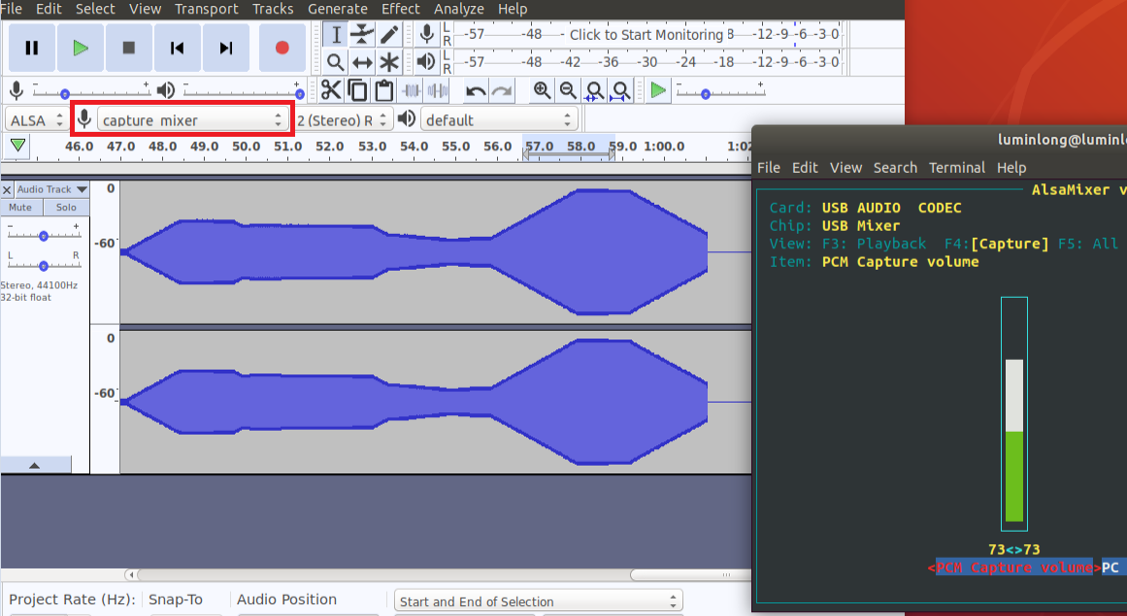
Step 4a: Test the new device and control
Test with ALSA GUI and Audacity:
Select capture_mixer as recording device in Audacity
Record the incoming signal with Audacity
Adjust PCM Capture volume in alsamixer
Capture volume changes as control volume was adjusted
Adjust Capture volume

Slide 8
Step 4b: Test with #arecord & #amixer commands
Create shell script as follow (see attachment)
Device in arecord changed to capture_mixer
If the corresponding sound card id is 1, add -c 1 after amixer
arecord -D capture_mixer -c 2 -r 48000 -f S16_LE -d 50 cap.wav & for((i=0;i<5;i++))
do
amixer -c 1 set “PCM Capture Volume” 25+
sleep 10
Done
Open cap.wav and verify the capture volume level changes per the script volume setting
Capture volume changes as control volume was adjusted

