Slide 1
Presentation title here
Subhead here
Presenter’s Name

Slide 2
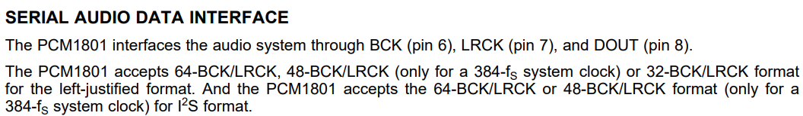
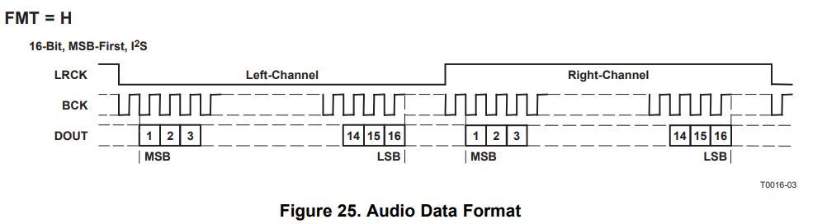
I2S format
64BCK → 16BCK for DOUT + additional 16BCK/ L-ch and for DOUT + additional 16BCK/ R-ch?

Slide 3
I2S format
#1 : Datasheet describes PCM1801 accepts 64BCK/LRCK for I2S format.
Does it mean when we use 16bit I2S data, additional 16bit is needed like below?
LRCLK
Left-channel
Right-channel
BCK
DOUT
1 2 3
14 15 16
31 32
1 2 3
14 15 16
31 32
1 2 3
16bit I2S data
16bit no data
16bit I2S data
16bit no data

Slide 4
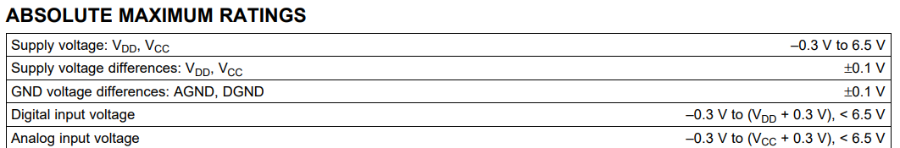
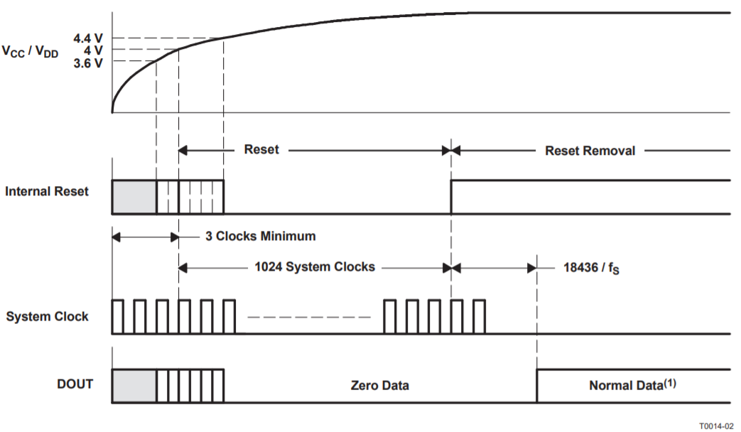
Question #2~4
Digital input voltage of datasheet absolute maximum ratings is -0.3V to (VDD+0.3V) < 6.5V.
As you mentioned, if we provide 3.3V or 5V clocks before power-up, we violate abso max spec.
#2: is it ok to provide 3.3V or 5V clock before VCC/VDD < 3.3V or 5V?
#3: is it ok to think that above “clock” includes “system clock/ BCK/ LRCK/ FMT”?
#4: if we don’t follow power-up sequence, what’s issue we face?

Slide 5
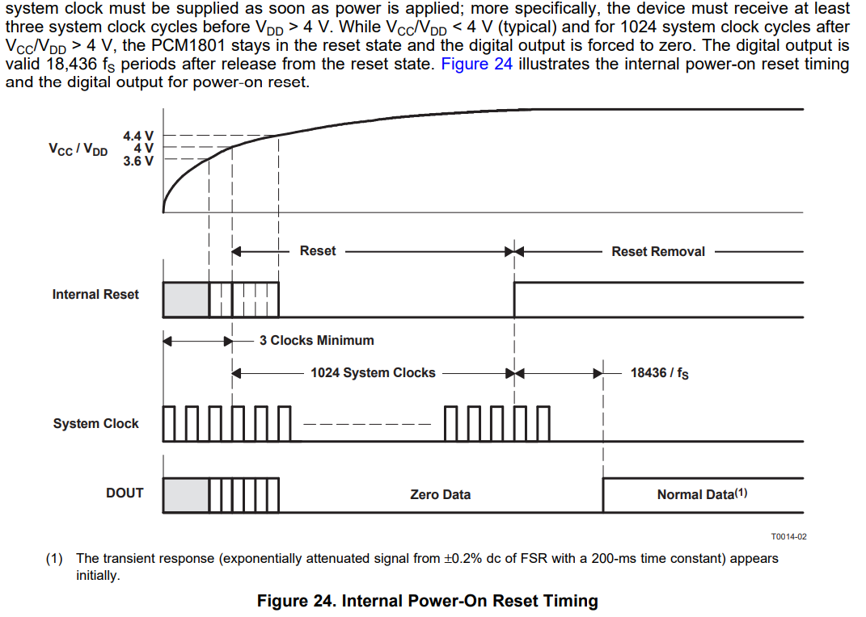
Question #5
#5: To meet “at least three system clock cycles before VDD > 4V”, powerup the VDD before VCC.
Therefore powerup sequence becomes VDD → VCC but are there any timing requirement from VDD to VCC?
I think if we meets 1024 system clocks after VCC/VDD > 4V, it should be no problem

Slide 6
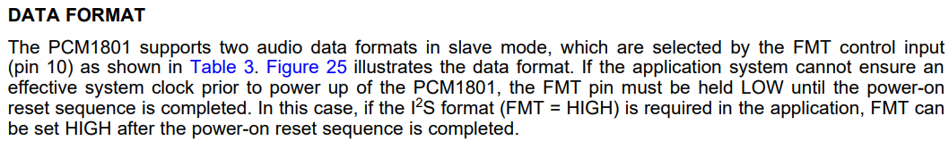
Question #6
#6: DATA FORMAT section mentions “if the application system cannot ensure an effective system clock prior to power up of the PCM1801, the FMT pin must be held LOW until the power-on reset sequence is completed” but what does “if the application system cannot ensure an effective system clock prior to power up of the PCM1801” mean?
In power-on reset section, datasheet said at least three system clock cycles are needed but in DATA FORMAT session, it said “if the application system cannot ensure an effective system clock prior to power up of the PCM1801.”

