Slide 1
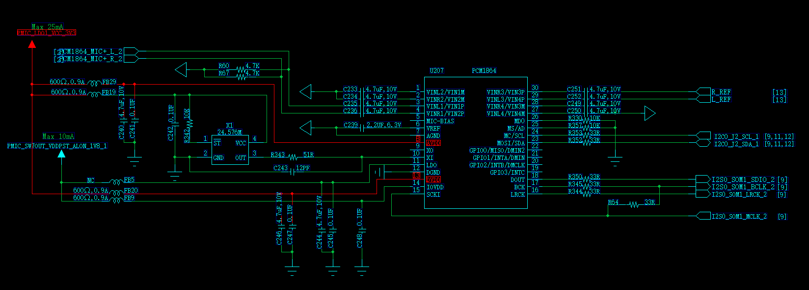
PCM1864 work in Salve mode.
Ignore the connection between SCI and BCK. In actual, the R64 is a level shift to generate 3.3V for SCKI.
write reg 0x20 =0xA1 to selec XI as clock.

Slide 2
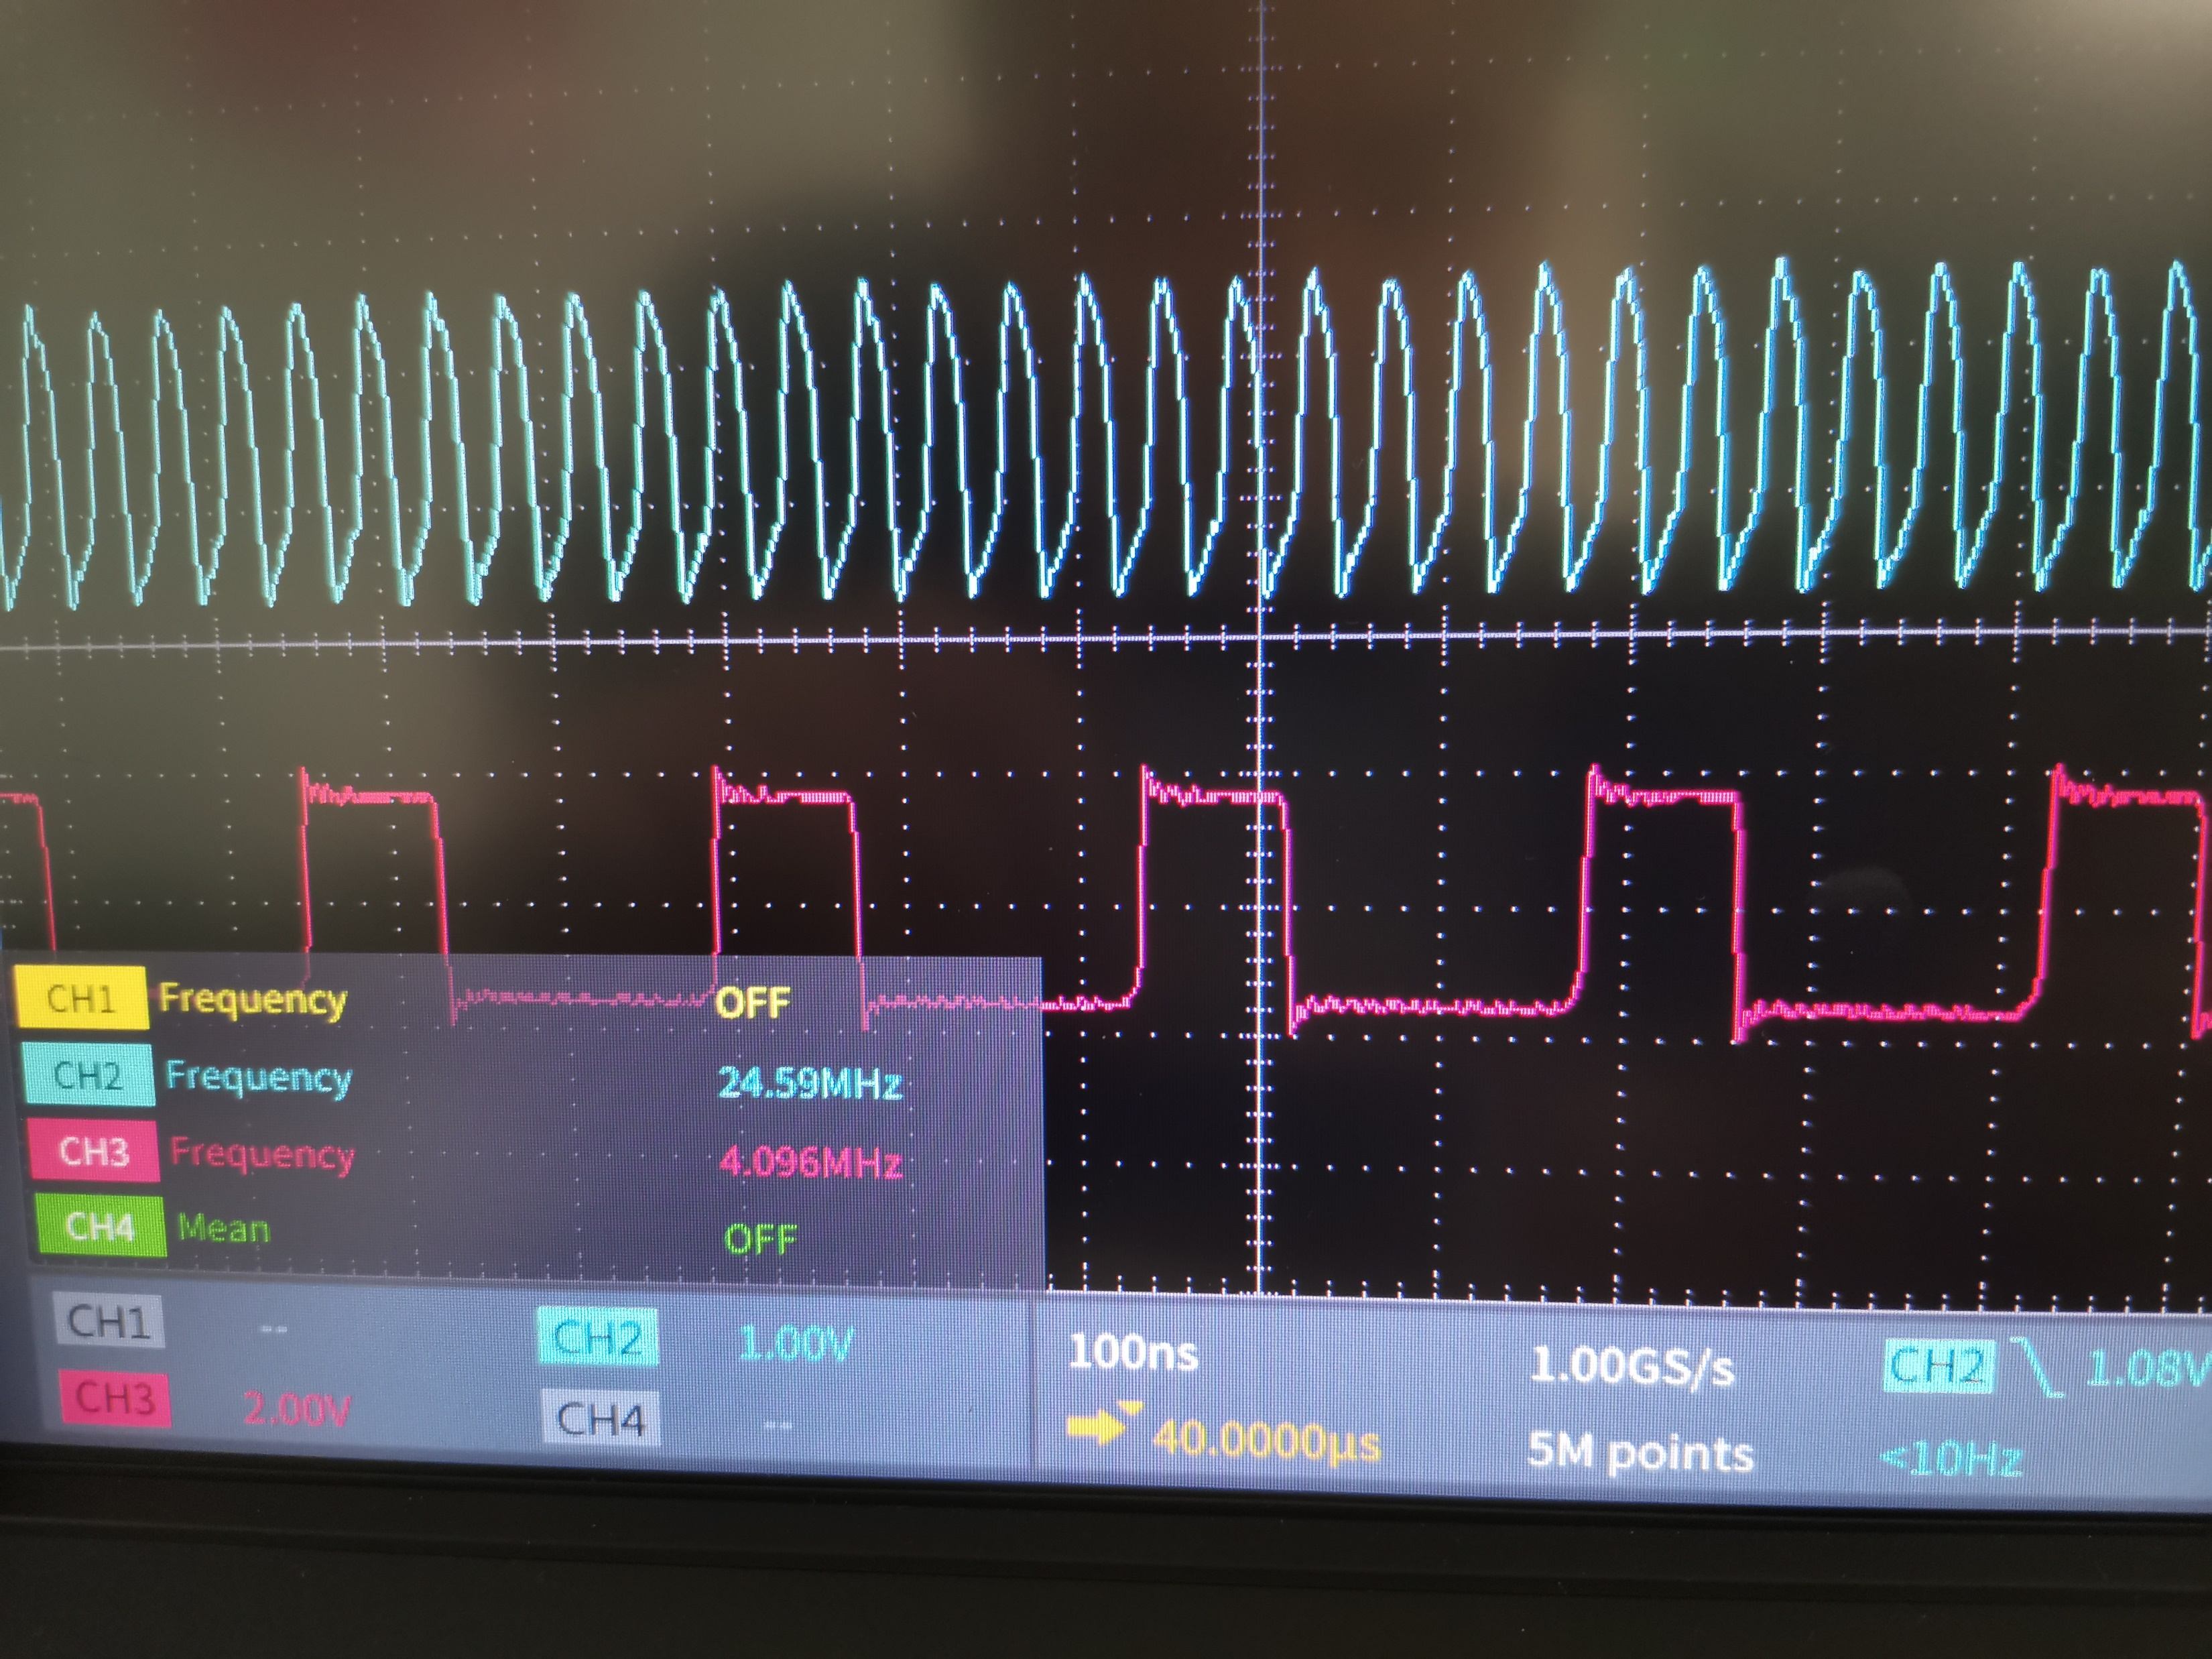
Blue is XI
Pink is BCK

Slide 3
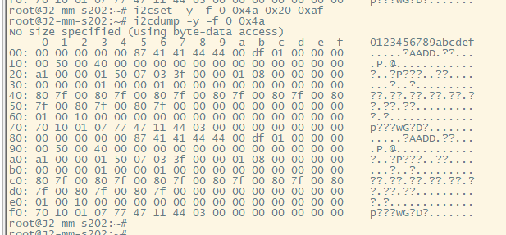
Dump reg value
It report DVDD bad and wait clock stable

