Slide 1
Schematics
This is an excerpt of the schematics. Please check pdf attached on my reply if you need.

Slide 2
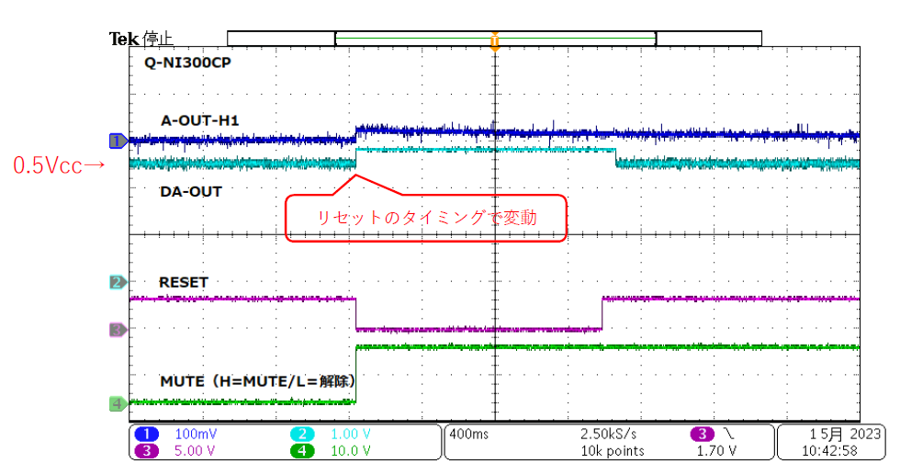
Issue
Reset timing

