Slide 1
Back Ground
Customer had been used PCM5101A for several models of their portable audio recorder from 2012.
Anyway, customer is evaluating their new product (using PCM5101A) for EMI (emission from their board)
test , and they have found rise time of BCLK should be slower in order to pass EMI test in their board.
Problem
If BCK rise time is slow in order to satisfy EMI , white noise is heard from headphone easily.
Question
Customer just only keep the criteria for tBCY >16ns , tBCL > 16ns in the slas859a table7? ( page 3 of this document)
That is to say, customer use tBCY=162.7ns (BCK=6.144MHz), no need to keep BCK duty=50%?
We don’t find spec. of rise time and fall time about BCK in the data sheet.
However, do you have advice ( any criteria ) about rise/fall time for BCK?
Do you think the white noise increase is due to BCK rise time?
If so, would you advise the any criteria of mamxim rise time for BCK?
4. We doubt independent master clock* may be the cause but no problem if master clock rise time
had been changed. Also, they had used this scheme from past. Do you think this should be considered?
*
http://www.tij.co.jp/jp/lit/an/slaa469/slaa469.pdf

Slide 2
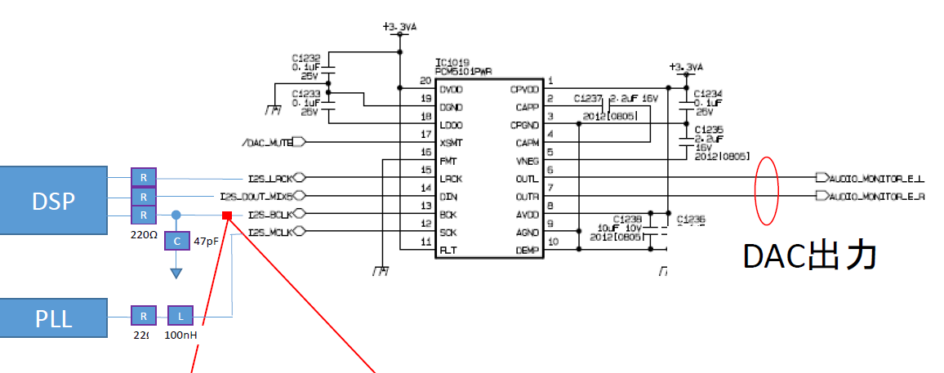
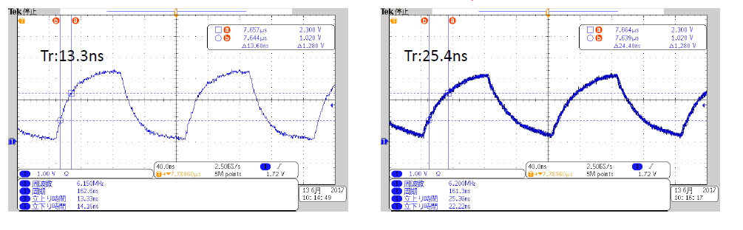
4-wire I2Sslave mode
LRCK=96KHz
BCK=6.144MHz
MCK=24.576MHz
220Ω
independent
220Ω
DAC Output were
connected to OP amp
and 16 ohm headphone to
hear the noise.
Minimize EMI
From BCK rise time
R=220Ω C=None
R=220Ω C=47pF
EMI OK
70%
30%
DAC output White noise small
DAC output White noise Big (heard)

Slide 3
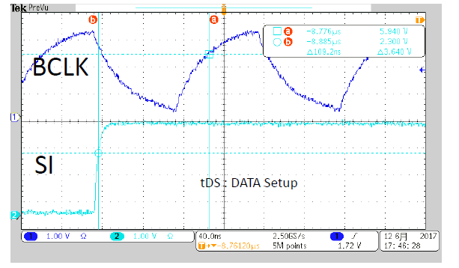
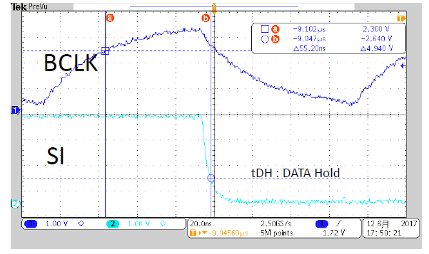
DATA
tDS=109nsec
(more than 8ns)
DATA
tDH=55nsec
( more than 8ns)

Slide 4
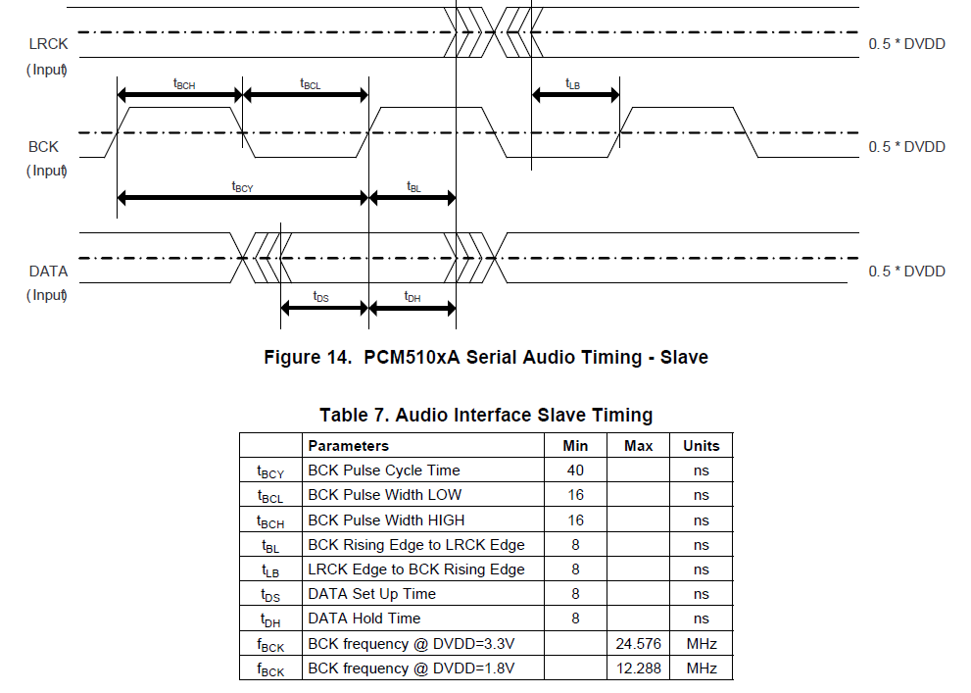
*slas859a specifies the timing. ⬅ customer follow this and all spec of Table 7 satisfied
*BTW, latest(c) version ( slas859c) also(b) version(slas859b) :has NO timing chart)

