Slide 1
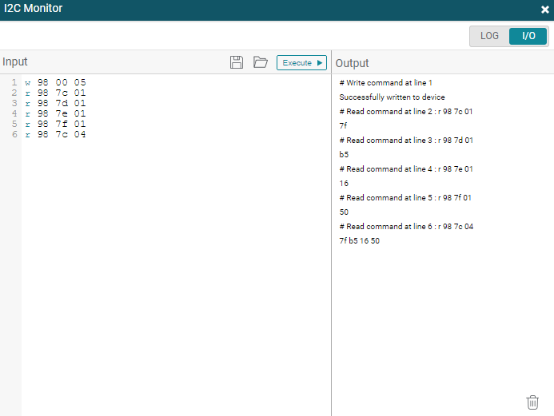

1. Read the initial value
First, when I read the initial value of page.5
as 1 byte and 4 byte, I was able to read the expected value.

Slide 2
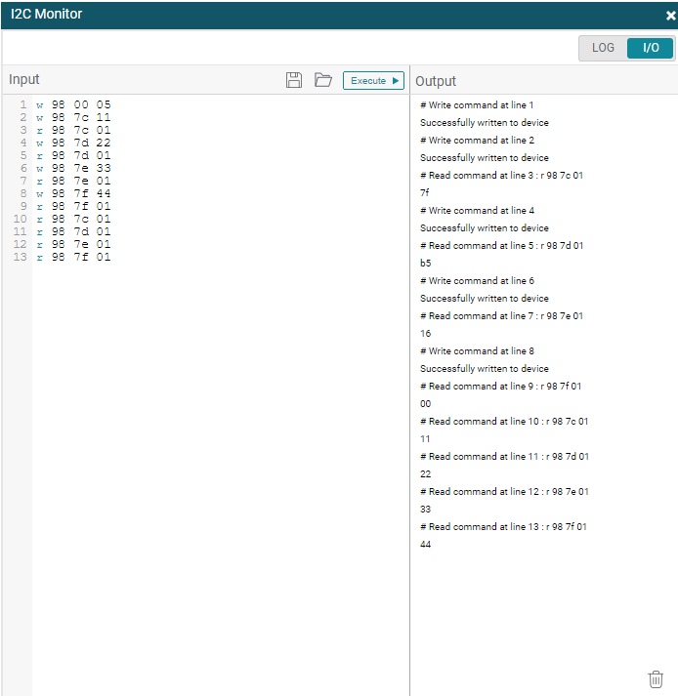
2. Write 1byte then red 1byte
The initial value could be read even when reading 1 byte or 4 bytes.
When writing 1 byte at a time, the initial value could be read from 0x7c to 0x7d.
However, at 0x7f, 0x00 could be read.
write 0x7c to 0x11, but read 0x7f (0x11 expected)
write 0x7d to 0x22, but read 0xb5 (0x22 expected)
write 0x7e to 0x33, but read 0x16 (0x33 expected)
write 0x7f to 0x44, but read 0x00 (0x44 expected)
After that, when reading 0x7c to 0x7f again, the written values can be read.

Slide 3
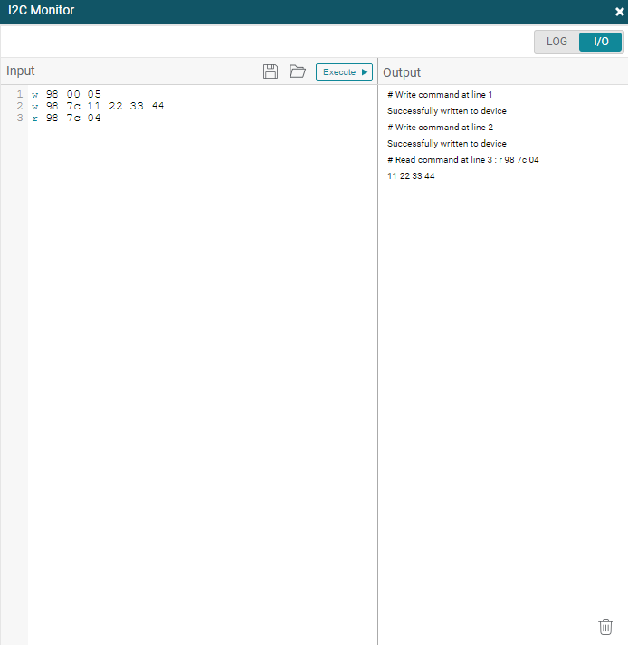
3. Write 4byte then red 4byte
After resetting and confirming that it returned to the initial value, I wrote and read the same value in 4 bytes, and the expected value was read.

