Slide 1
TAS2563-VQFN32S-peaker distortion problem
1、 Connect the TAS2563-QFN32 Demo board to the PC, and enter the PPC-QFN settings, set the gain to 0DB, (as shown in the left picture below), play a 1K signal, and the load is 4R, (the output voltage is 1.5V=0.56W) When testing the power amplifier PVDD power supply is 5V; use the oscilloscope to detect the waveform (as shown in the right picture below) without distortion
Demo-PPC tool is set to 0DB
Speaker output is normal waveform

Slide 2
2、 Connect the TAS2563-QFN32 Demo board to the PC, and enter the PPC-QFN settings, set the gain to 3DB, (as shown in the left picture below), play a 1K signal, and the load is 4R, (the output voltage is 1.5V=0.56W) When testing the power amplifier's PVDD power supply is 5V; use an oscilloscope to detect the distortion of the waveform (as shown in the right picture below) (Note: the power becomes larger, but it is a distortion phenomenon)
Demo-PPC tool is set to 3DB
The speaker output is a distorted waveform

Slide 3
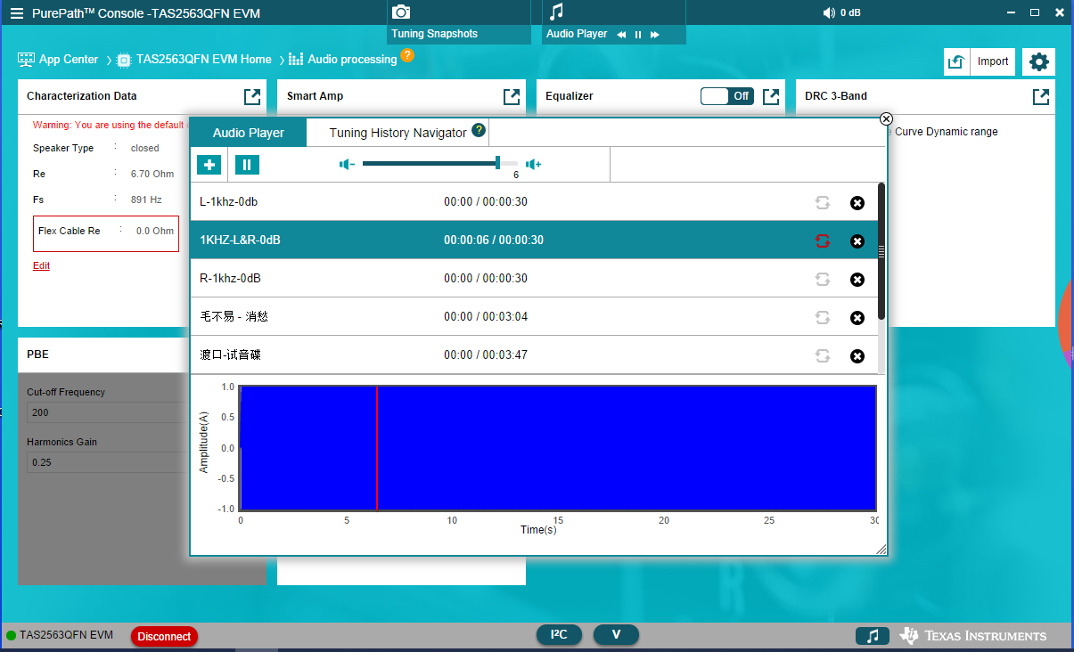
3、 Connect the TAS2563-QFN32 Demo board to the PC, and enter the PPC-QFN settings, set the gain to 6DB, (as shown in the left picture below), play a 1K signal, and the load is 4R, (the output voltage is 1.5V=0.56W) When testing the power amplifier PVDD power supply is 5V; use an oscilloscope to detect the distortion of the waveform (as shown on the right)
Demo-PPC tool is set to 6DB
The speaker output is a distorted waveform
4、 Note: If the internal gain of PPC-QFN is changed to 24DB, the output power of the speaker will not be much different. Compared with the gain of 0DB and 24DB, the output power of the speaker, 24DB is greater than 0DB by 0.2V voltage. As long as the gain is greater, The distortion becomes more serious!

Slide 4
5、 TAS2563-QFN power amplifier: When playing music, there is sound from the speaker, but the 10th pin of 563-QFN does not use signal output? Does the master control need to send any commands to the amplifier in order to have output? Is it related to the configuration file? How to solve it?
6、 TAS2563-QFN power amplifier: The speaker has sound output when playing L signal, but there is no sound output when playing R signal! Should be related to the configuration file? However, the configuration file was repeatedly made, and there was also a mono configuration. When the software was up, it still became a sound when playing the L signal, and there was no sound when playing the R signal. It seemed that it became a stereo mode! How to solve it?
7、 TAS2560-BGA package: There are two sets of signal output when recording and detecting data collected! How can I solve this problem? Which parameters are related to configuration or software? Does the master control need to send any instructions to the amplifier to solve this problem?

