Slide 1
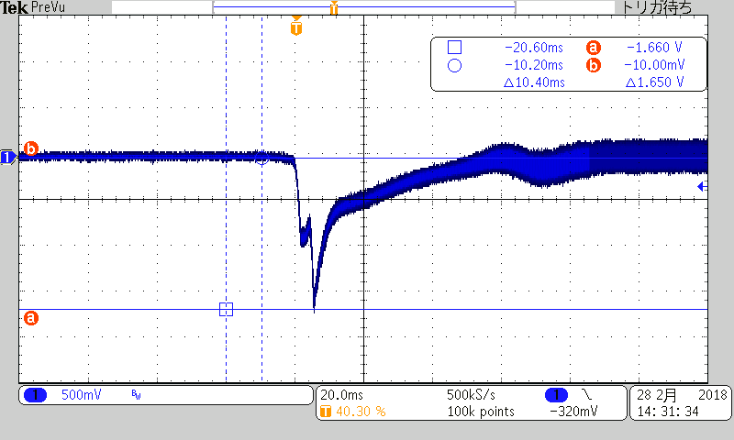
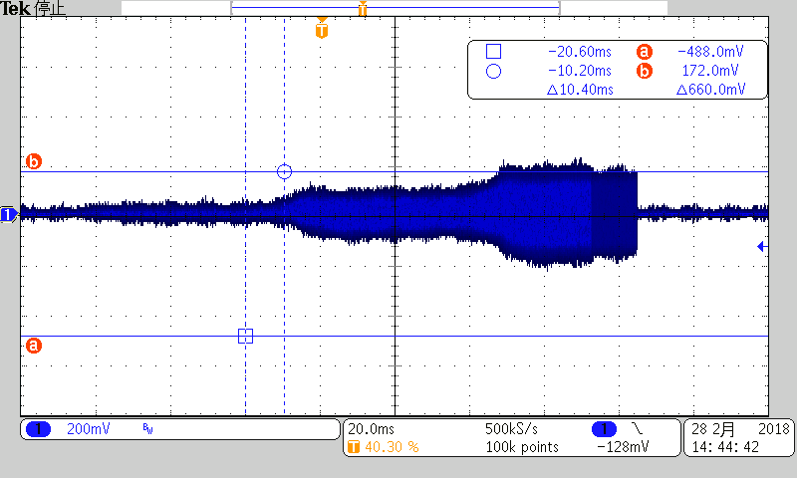
SE_A terminal ( J2 connector in TAS5755EVM)
0x1A=0A
(bit D7=0)
0x1A=88
(bit D7=1)

Slide 2
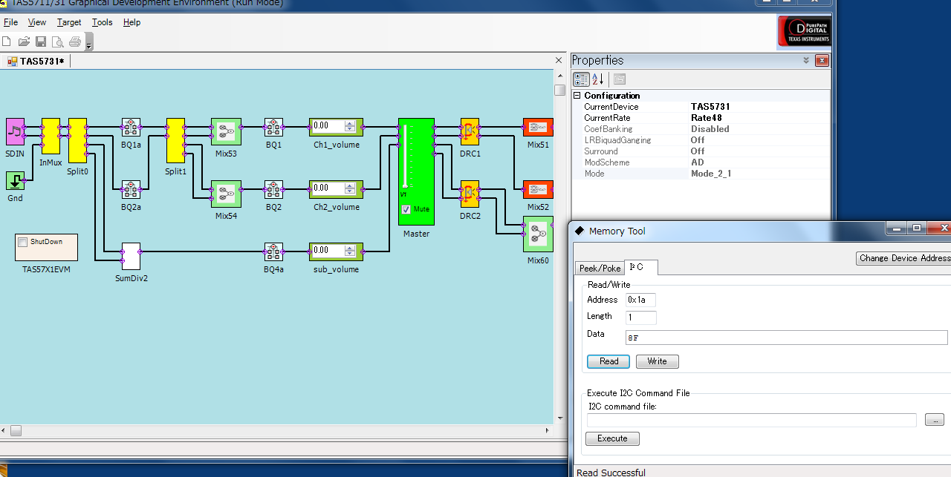
Mode Scheme AD mode
Mode 2.1ch
2.2nF is between SS_TIMER pin and GND ( as EVM default )
We should bit D7 of 0x1A should be 1 ( SS-Timer disabled ) if 2.2nF are
Inserted in case 2.1ch mode?

Slide 3
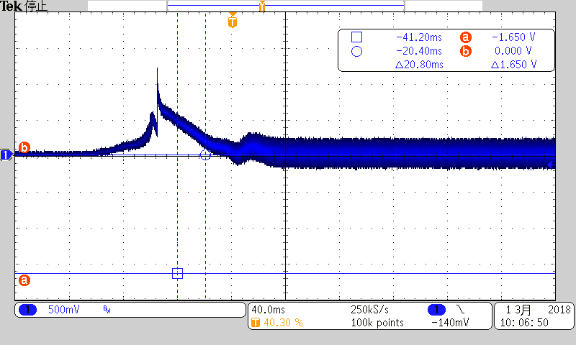
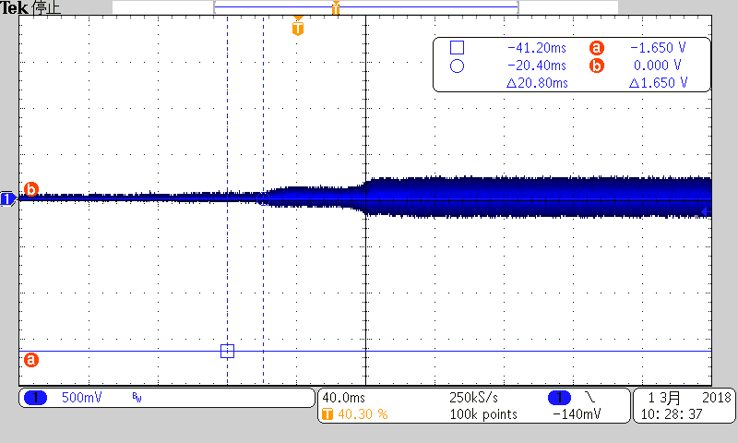
Cap C17 ( 2.2nF on SSTIMER)
were removed.
0x1A=0A
(bit D7=0)
0x1A=9A ,88 ( same result)
(bit D7=1)
I believe 0x1A D7 should be 1. Please advise.

