Slide 1
TAS5805 Address Detection
Alix Wan
2019/06/12

Slide 2
Outline
Address Detect Table
Digital Decoder Expected for Detection.
Digital Feedback to Analog Schematic hook ups.
Flow Chart of the Algorithm.
Concerns/Assumptions for Address Detect.

Slide 3
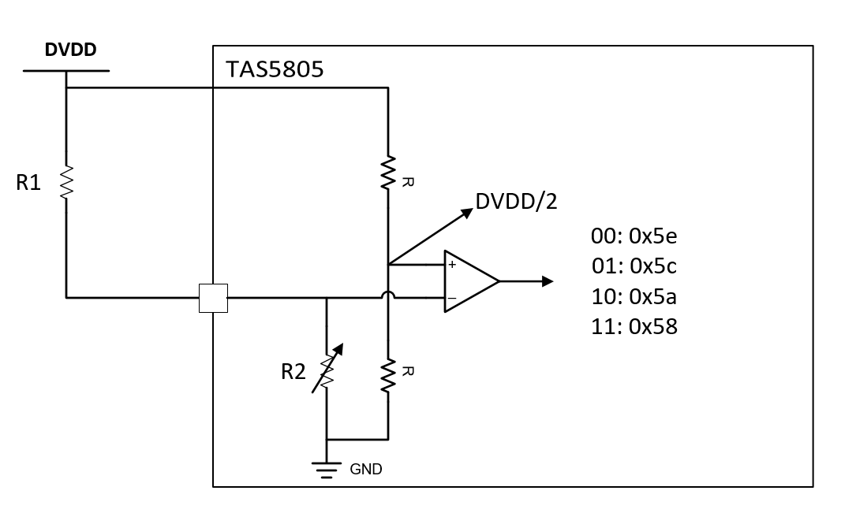
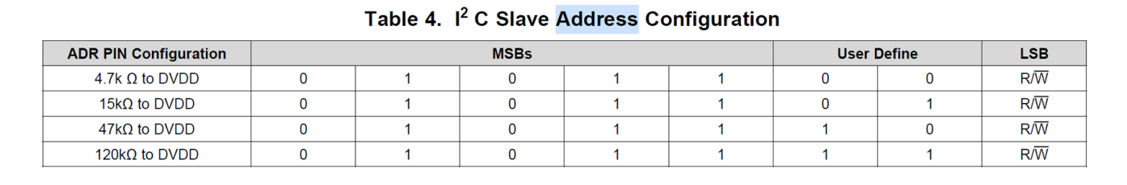
Internal circuit analysis
Circuit
  Voltage of ADR pin is divided by R1 and R2;
  Voltage of ADR in compared with DVDD/2
Analysis:
  ADR PIN Resistor R1:
    4.7K : 15K : 47K : 120K~=1:3:9:27
  R2 is internal variable resistor for ADR detection
ADR pin detection
  TAS5805 set R2 twice
  Comparator outputs a 2-bit code to determine Address in table 4
    00/01/10/11
Reverse

Slide 4
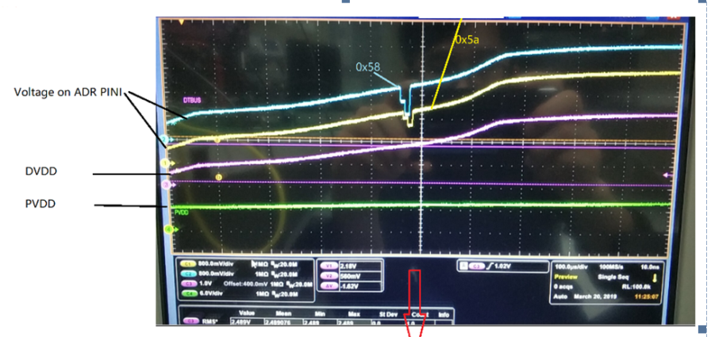

Procedure of ADR Detection
Example: 0x5a with R1=15K
Detailed procedures:
TAS5805 operation: R1=15K | Vadr>DVDD/2? | Output
Set R2=27K | Y (R1<27K) | 1
Set R2= 9K | N (R1>9K ) | 0
Output Address |  | 10: 0x5a
Set R2 = 27K to gnd , Compare ADDR with DVDD/2
(PIN_DET_RES_CTL<1:0>=01)
0
1
V_ADR>DVDD/2?
Set R2 = 81K to gnd, Compare ADDR with DVDD/2
(PIN_DET_RES_CTL<1:0>=00)
Short ADDR with 9K to gnd, Compare ADDR with DVDD/2
(PIN_DET_RES_CTL<1:0>=11)
0
V_ADR>DVDD/2?
1
0
V_ADR>DVDD/2?
1
120K to DVDD
47K to DVDD
15K to DVDD
4.7K to DVDD

Slide 5
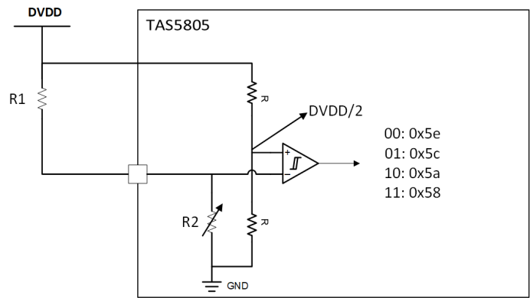
Principles of choice of R1
R2: 20% variation
R1: 10% variation
120K ohm:11
97.2k ohm
64.8k ohm
Make sure no overlap between R2 and R1
47K ohm:10
32.4k ohm
21.6k ohm
15K ohm:01
10.8k ohm
7.2k ohm
4.7K ohm:00

Slide 6
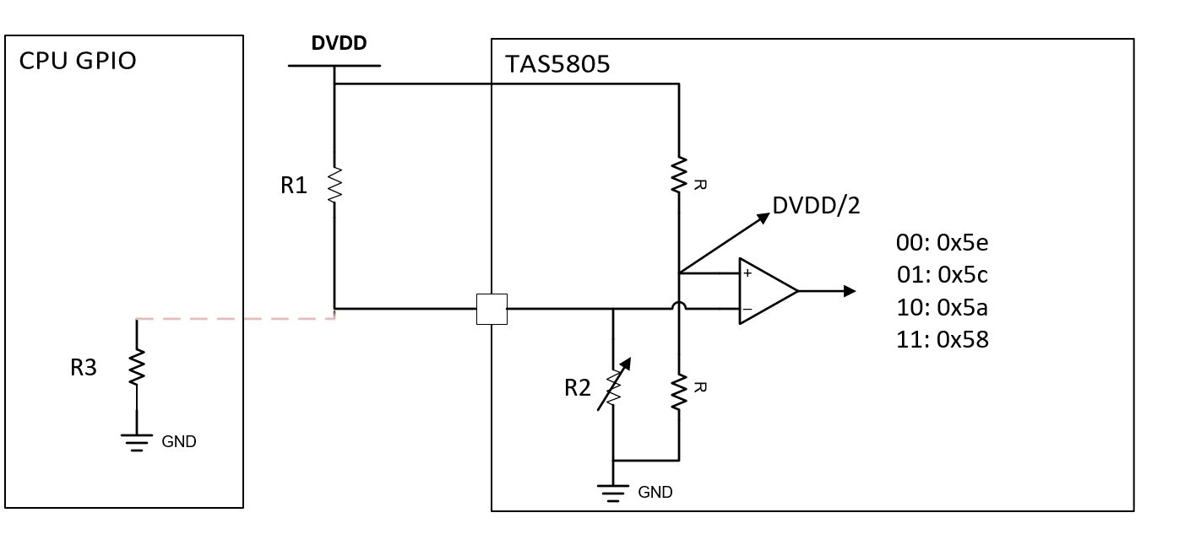
Sagemcom case analysis
Equivalent circuit
ADR detection analysis
  R3=50K, R1=15K
  If R2=21.6K and R3=40K, then R2||R3=14K.
TAS5805 operation: R1=15K | R3 || R2 | Vadr>DVDD/2? | Output
Set R2=27K | 17.5 | Y (R1<17.5K) | 1
Set R2= 9K | 7.6 | N (R1 > 7.6 ) | 0
Output Address |  |  | 10: 0x5a
TAS5805 operation: R1=15K | R3=40k || R2 | Vadr>DVDD/2? | Output
Set R2=21.6K | 14 | Y (R1>14K) | 0
Set R2= 81K * 0.8 | 24.7 | N (R1 < 24.7 ) | 1
Output Address |  |  | 10: 0x5C

Slide 7
Variation analysis
In order to make sure the address is 0x5a, worse case strategy:
We need to make sure that: R2||R3>R1, Hence:
  R2||R3_min= 14.026K @ R2_min=27*0.8=21.6K, R3_min= 40K
    R1_max < 14.026. Considering variation of R1=10%, then:
      R1_max<=14.026/1.1=12.8kohm
We need to make sure that : R2|| R3 < R1, hence
  R2||R3_max= 9.2K @ R2_max=9K*1.2=10.8K; R3_max=60K
    R2=9K*1.2=10.8K; R3=60K; then R2||R3=9.2K
      R1_min=R1*0.9>9.2K, hence, R1_min>10.2K
Hence, R1 can be set as [10.2K, 12.8K] with 10% variation

