Slide 1
TAS58x5M 1.1 Configuration
Alix Wan

Slide 2
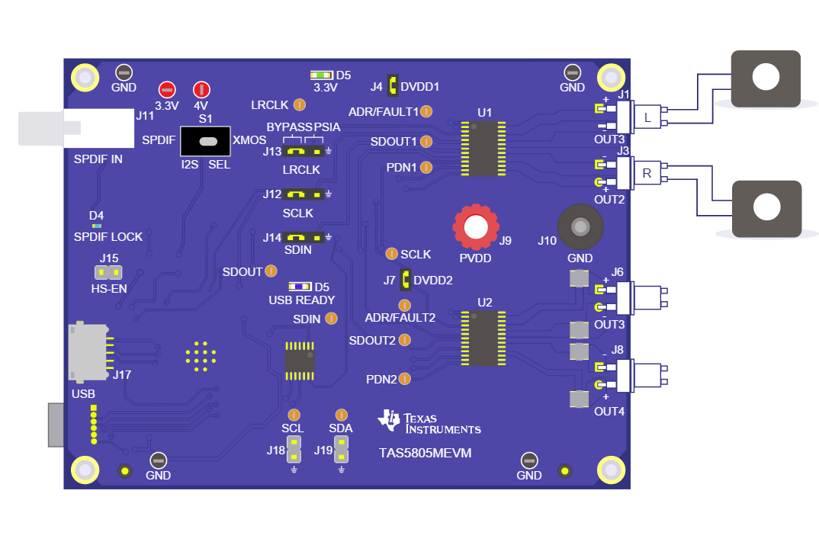
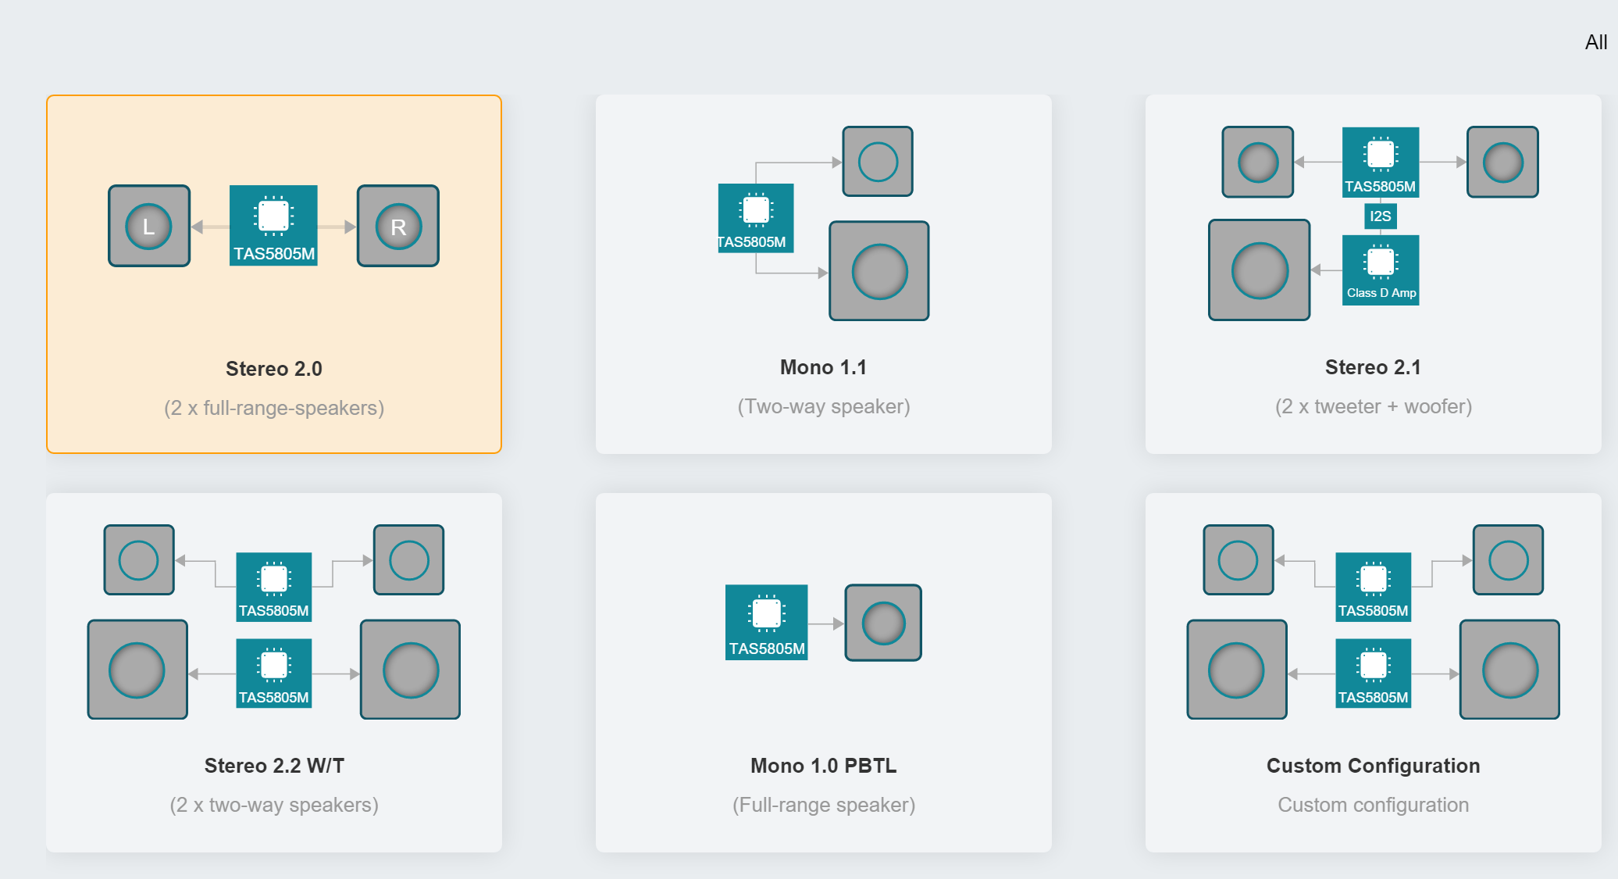
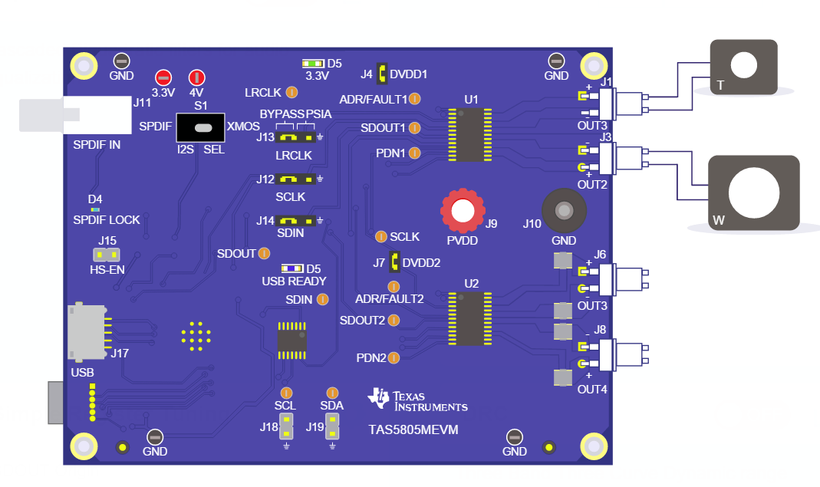
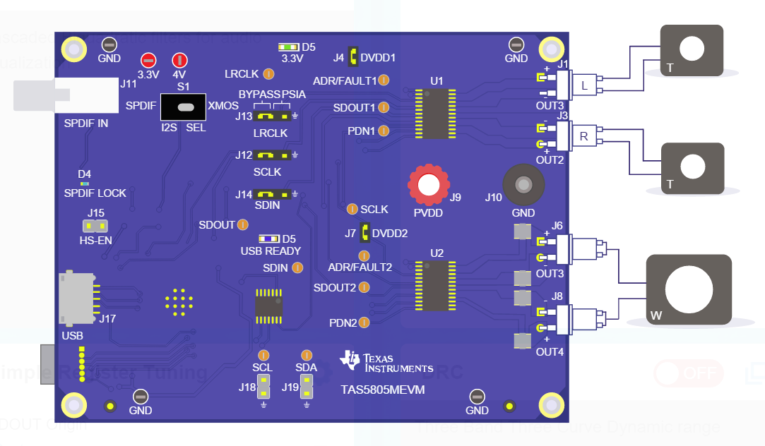
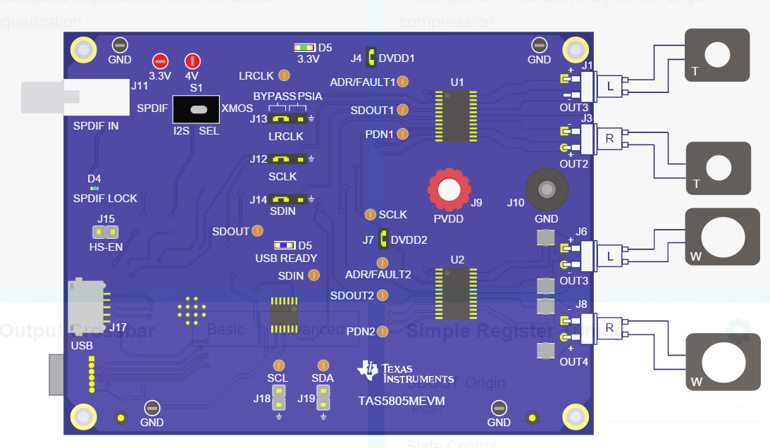
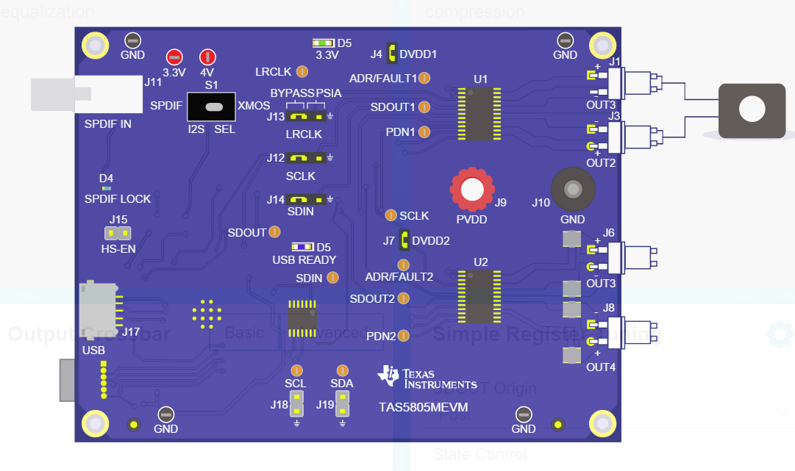
Speaker Configuration
Stereo 2.0
Mono 1.1
Stereo 2.1
Stereo 2.2
AppNote: TAS5805M, TAS5806M, and TAS5806MD Process Flows (Rev. A)
Mono 1.0

Slide 3
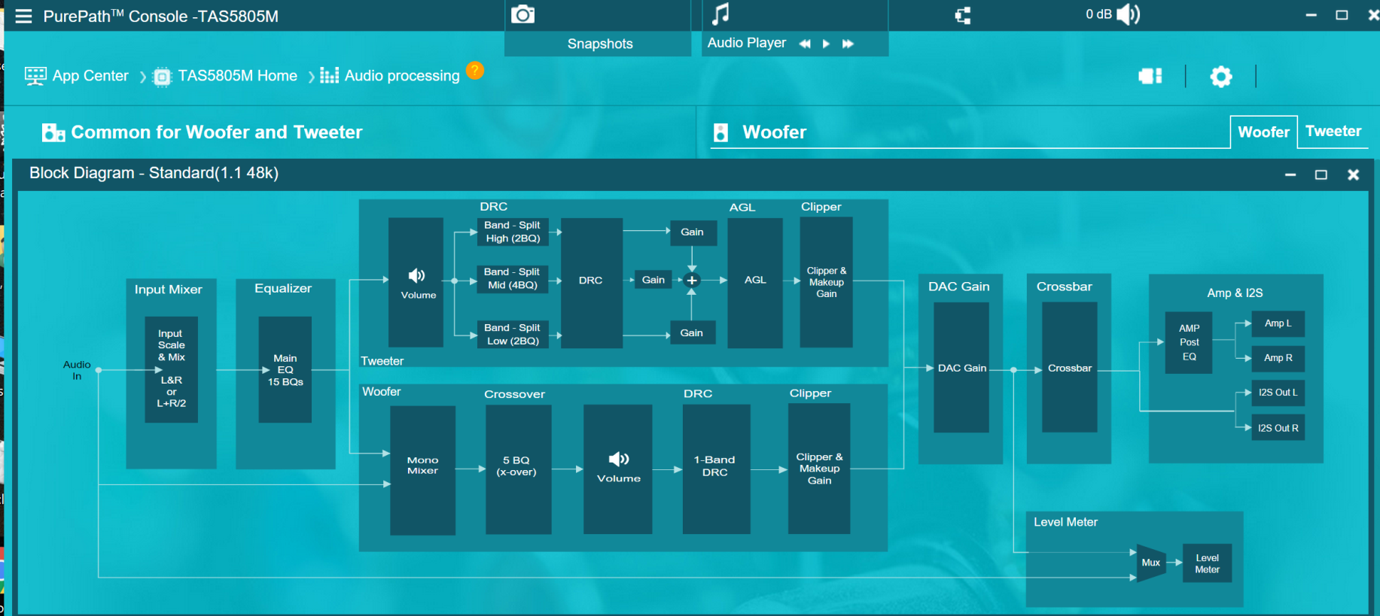
Internal Signal Path
Click here to understand the signal path

Slide 4
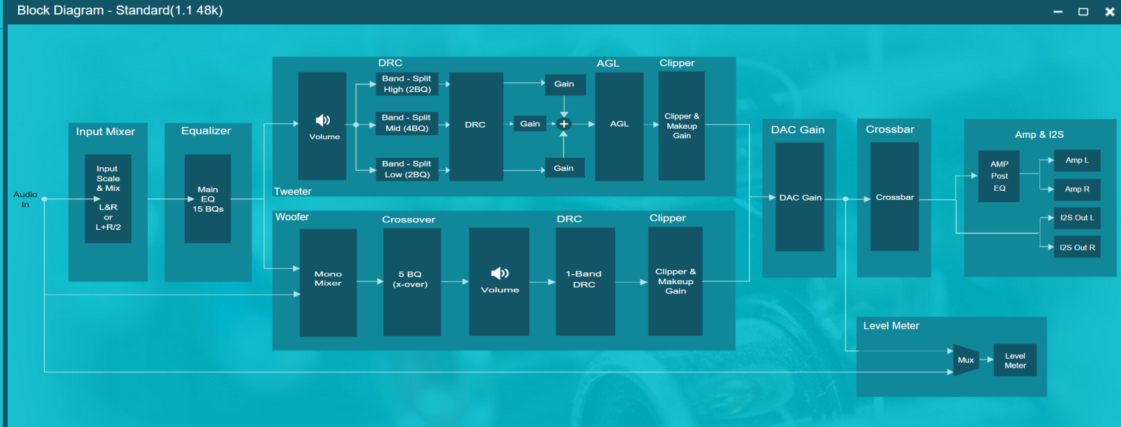
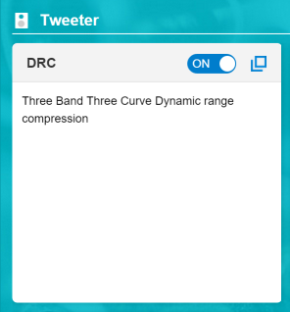
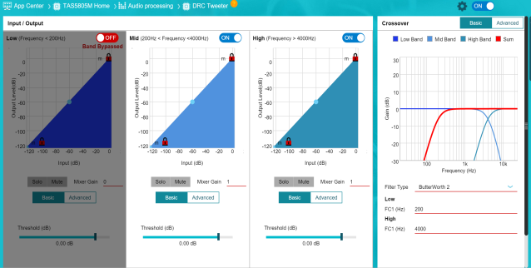
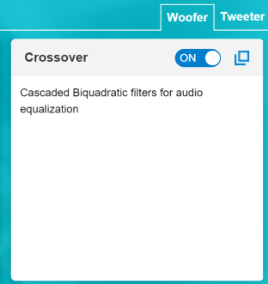
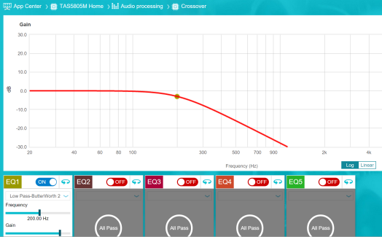
Crossover Configuration for Woofer and Tweeter
Example: 200Hz crossover point for woofer and tweeter.
Tweeter
Woofer
Filter type match

Slide 5
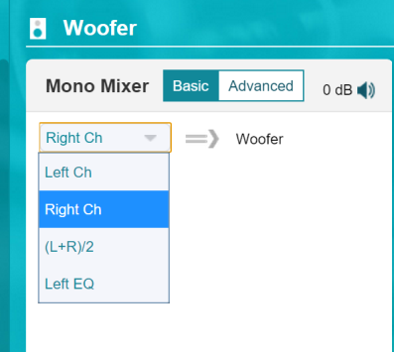
EQ for both woofer and Tweeter
Example: 200Hz crossover point for woofer and tweeter.
EQ Resources:
Tweeter: 15 EQs can be for tweeter
Woofer : Need to choose Left EQ in Mono Mixer. Then woofer has 15 Eqs + additional EQ in X-over
Come from Input mixer not from 15 EQs
After 15 EQs

