Slide 1
TAS6584 RTLDG SW Flow and Script
TI-Audio-MPA

Slide 2
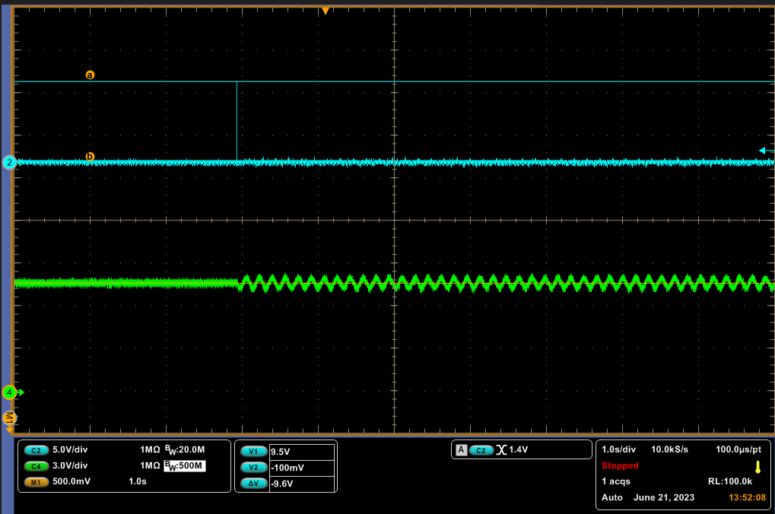
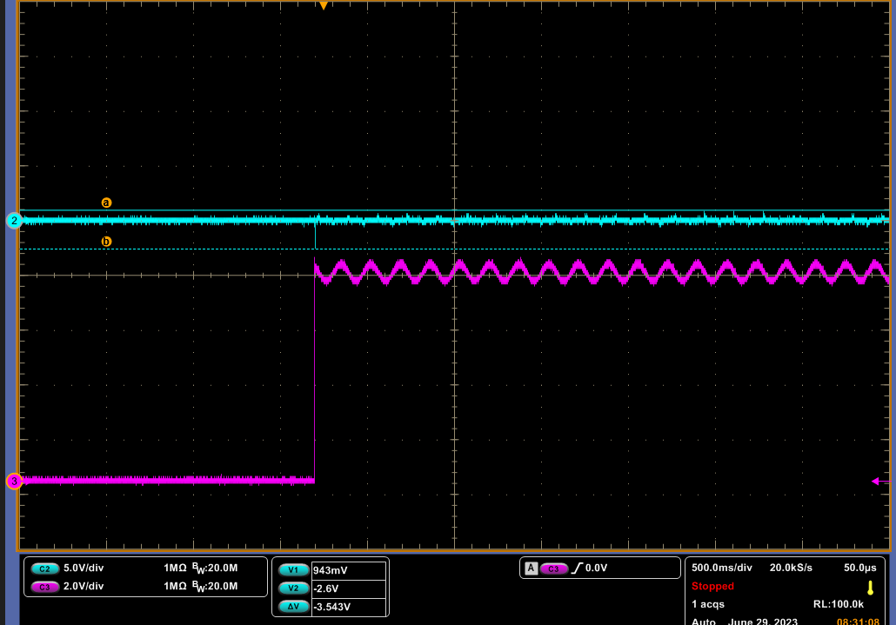
Revision History
Improve pop noise when enable pilot tone.
Enable pilot tone before enter play mode.
Pop noise improvement: from 95mV to 26mV.
Clear RTLDG fault script improvement.
Pop noise: 95mV
Pop noise: 26mV
Vcp
Vcp
OUT_P
OUT_P

Slide 3
Realtime diagnostic flow
Initialization script is on page #4. The setting is basic configuration, could be updated according to application.
Before enable Real-time diag, DC diag detection should have no error. DC diagnostic script is on page #5.
Read 0x72, 0x73 channels state registers and 0x8B, 0x8C RTLDG fault registers to confirm RTLDG fault triggered.
Once fault is triggered, Real-time should be disabled clear RTLDG fault firstly. Then run DC diag to check load connection. Set channels to play mode, release DSP buffer and re-enable RTLDG. The script is on page #7.
The reference scripts are attached, please see below scripts.
Initialization(page #4)
Run DC load diagnostic(page #5)
(DC diag fail count++)
Y
DC diag fail count > N
Notify end user
Check 0x72, 0x73 channel state and 0x8B, 0x8C RTLDG fault.
Fault reported?
N
N
Check 0x072, 0x73
channels status.
Is in DC diag?
Y
Y
N
N
Disable RTLDG
RTLDG Clear fault(page #7)
Read DC diag result,
Is load status good?
RTLDG fail count ++
Y
N
Y
RTLDG diag fail count > N
Initiation of pilot tone and RTLDG(page #6)
Notify end user
End

Slide 4
Initialization
w C0 00 00 # Page switching (1st 00) to page 0 (2nd 00)
w C0 7F 00 # Change to book 00. It's required to be in page 0 before changing a book
w C0 00 00 # Go to the page 0 in book 00
w c0 01 01 #Clear reg
d 100
## Set Channels to SLEEP state ##
w C0 03 22 # Set Channel 1#2 to SLEEP state
w C0 04 22 # Set Channel 3#4 to SLEEP state
w C0 9F 10 # Configure GPIO_1 to become SDIN2
w C0 05 00 # Current Sense disabled on all channels
w C0 61 02 # Enable Random Spread Spectrum
w C0 1D 00 # Sample rate: Auto detect
w C0 AA 04 # Disable Dynamic Range Boost (DRBoost)
w C0 4E 80 # Enable Analog gain ramp up#down, set 60us#step
w C0 93 4F # Enable Clip detect
w C0 54 00 # Disable CBC Warn and CBC Fault
w C0 52 01 # Set Fsw to 480 KHz
w C0 02 01 # Set 1SPW Modulation
################## Set bandwidth depending on Fsw
w C0 6D 19 # Use for 480 kHz Fsw, Bandwidth setting to 150K.
##################
## Set Channels to Hi-Z state ##
w C0 03 33 # Set Channel 1#2 to Hi-Z state
w C0 04 33 # Set Channel 3#4 to Hi-Z state

Slide 5
DC diagnostic
## Run channels DC diag ##
w C0 03 11 # Channel 1#2 run DC diag
w C0 04 11 # Channel 3#4 run DC diag
d 300 #delay 300ms and read 0x72 and 0x73 register to confirm DC diag finish
r C0 72 01 # read channel 1#2 state till channels are Sleep mode.
r C0 73 01 # read channel 1#2 state till channels are Sleep mode.
r C0 C0 01 # read channel 1#2 DC diag result.
r C0 C1 01 # read channel 3#4 DC diag result.
## Set Channels to Hi-Z state ##
w C0 03 33 # Set Channel 1#2 to Hi-Z state
w C0 04 33 # Set Channel 3#4 to Hi-Z state

Slide 6
Initiation of pilot tone and RTLDG
### Enable pilot tone ###
w C0 00 00 # Page switching (1st 00) to page 0 (2nd 00)
w C0 7F 8C # Change to book 8C. It's required to be in page 0 before changing a book
w C0 00 03 # Go to the page 03 in book 8C
w C0 48 00 00 00 00 # 32-bit value: 0x0 = Enable; 0x1 = Disable
### Enable Current Sense ###
w C0 00 00 # Page switching (1st 00) to page 0 (2nd 00)
w C0 7F 00 # Change to book 0. It's required to be in page 0 before
w C0 D0 00 # RTLDG off
w C0 05 0F # Enable Current Sense on all 4 channels
w C0 5B 08 # Optimize for 4 x BTL configuration, leave RTLDG report disabled
w C0 5C 40 # Optimize for 4 x BTL configuration
w c0 39 01 # Turn off DC blocking
w C0 03 44 # # Set Channel 1#2 to play state
w C0 04 44 # # Set Channel 3#4 to play state
### Set Thresholds for OL and SL ###
w C0 00 00 # Page switching (1st 00) to page 0 (2nd 00)
w C0 7F 78 # Change to book 78. It's required to be in page 0 before changing a book
w C0 00 19 # Go to the page 19 in book 78
w C0 3C 10 00 00 00 # Write to offset 3C, 32-bit wide, to set Re init value
w C0 48 10 00 00 00 # Write to offset 48, 32-bit wide, to set Re init value
w C0 00 00 # Return to page 0 of book 78
w C0 7F 8C # Change to book 8C. It's required to be in page 0 before changing a book
w C0 00 02 # Go to the page 02 in book 8C
w C0 88 1D 00 00 00 # Write to offset 88, 32-bit wide, set Open load threshold e.g. ~40ohm
w C0 8C 00 C5 00 00 # Write to offset 8C, 32-bit wide, set Short load threshold e.g. ~1ohm
### Set Thresholds for S2P and S2G ###
w C0 00 04 # Go to the page 04 in book 8C
w C0 58 00 00 00 01 # Enable S2P#S2G detection
w C0 64 04 2E D9 84 # Set S2P current threshold to ~1A (configurable)
w C0 00 05 # Go to the page 05 in book 8C
w C0 90 04 2E D9 84 # Set S2G current threshold to ~1A (configurable)
### Enable RTLDG ###
w C0 00 00 # Page switching (1st 00) to page 0 (2nd 00)
w C0 7F 00 # Change to book 0. It's required to be in page 0 before
w C0 5B 0A # Enable RTLDG Report, 4 x BTL configuration

Slide 7
Disable RTLDG, clear fault and Re-enable RTLDG
## read channel state and RTLDG fault registers ##
w C0 00 00 # Page switching (1st 00) to page 0 (2nd 00)
w C0 7F 00 # Change to book 0. It's required to be in page 0 before
r C0 0x72 01 # read CH1 and CH2 state to confirm fault triggered
r C0 0x73 01 # read CH3 and CH4 state to confirm fault triggered
r C0 0x8B 01 # read RTLDG fault register to confirm fault type
r C0 0x8C 01 # read RTLDG fault register to confirm fault type
## Disable RTLDG and clear fault ##
w C0 00 00 # Page switching (1st 00) to page 0 (2nd 00)
w C0 7F 00 # Change to book 0. It's required to be in page 0 before
w C0 5B 08 # Disable RTLDG report (4 x BTL configuration)
w C0 01 08 # Clear Fault
d 100 #delay 100ms
## Run channels DC diag ##
w C0 00 00 # Page switching (1st 00) to page 0 (2nd 00)
w C0 7F 00 # Change to book 0. It's required to be in page 0 before
w C0 03 11 # Channel 1#2 run DC diag
w C0 04 11 # Channel 3#4 run DC diag
d 300 #delay 300ms and read 0x72 and 0x73 register to confirm DC diag finish
r C0 72 01 # read channel 1#2 state till channels are Sleep mode.
r C0 73 01 # read channel 1#2 state till channels are Sleep mode.
r C0 C0 01 # read channel 1#2 DC diag result.
r C0 C1 01 # read channel 3#4 DC diag result.
w C0 03 44 # Set channels 1#2 to PLAY state
w C0 04 44 # Set channels 3#4 to PLAY state
### Release DSP buffer ###
w c0 00 00
w c0 7f 8c
w c0 00 04
w c0 5c 00 01 5d 85 #s2ps2g smooth 0.5s
w c0 00 00
w C0 7F 78 # Change to book 78. It's required to be in page 0 before changing a book
w C0 00 19 # Go to the page 19 in book 78
w C0 3C 10 00 00 00 # Write to offset 3C, 32-bit wide, to set Re init value
w C0 48 10 00 00 00 # Write to offset 48, 32-bit wide, to set Re init value
w C0 00 10 #Move to page 16
w C0 78 00 00 00 00 #CH1 Pside offset current
w C0 7C 00 00 00 00 #CH2 Pside offset current
w C0 58 00 00 00 00 #CH1 Nside offset current
w C0 5C 00 00 00 00 #CH2 Nside offset current
### delay 500ms ###
d 100
d 100
d 100
d 100
d 100
### Enable RTLDG ###
w C0 00 00 # Return to page 0 of book 8C
w C0 7F 00 # Return to book 0, page 0
w C0 5B 0A # Enable RTLDG Report, 4 x BTL configuration

