Slide 1
TEST SYSTEM
Main
MCU
/
Function Genertor
TLV320ADC3101EVM-K
PC
ADC3101 CS
&
Recorder
MCLK : 12Mhz
MIC
MIC
WCLK : 16Khz
BCLK : 512Khz or 1.024Mhz
DOUT
SCL
SDA

Slide 2
ADC3101 CS_Setting
Command line
w 30 00 00
w 30 01 01
w 30 00 00
w 30 06 0A
w 30 00 00
w 30 07 09 60
w 30 00 00
w 30 05 91
w 30 00 00
w 30 04 03
w 30 00 00
w 30 12 99
w 30 00 00
w 30 13 81
w 30 00 00
w 30 1E 84
w 30 00 00
w 30 1B 0C
w 30 00 00
w 30 3D 01
w 30 00 01
w 30 33 50
w 30 34 FC
w 30 37 FC
w 30 3B 32
w 30 3C 32
w 30 00 00
w 30 51 C2
w 30 52 00
Register Dump

Slide 3
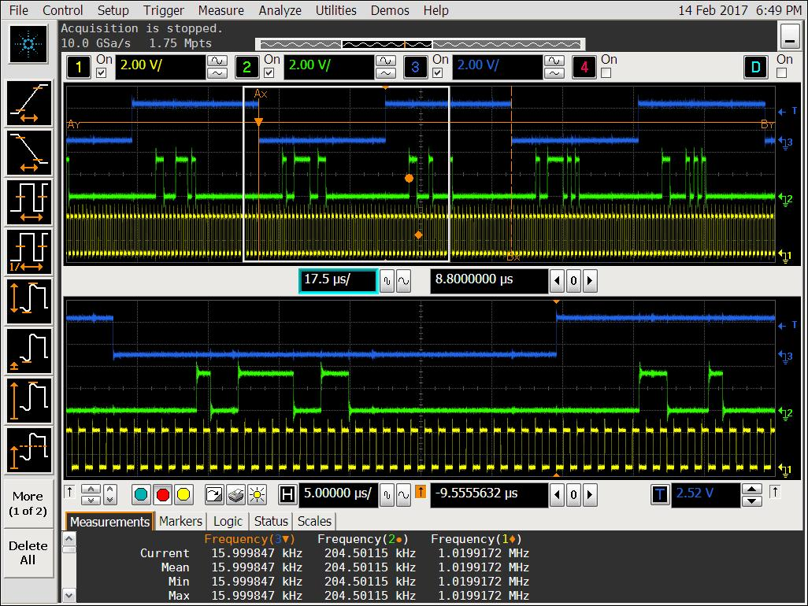
Wave Screenshort
WCLK
DOUT
BCLK
WCLK
DOUT
BCLK

Slide 4

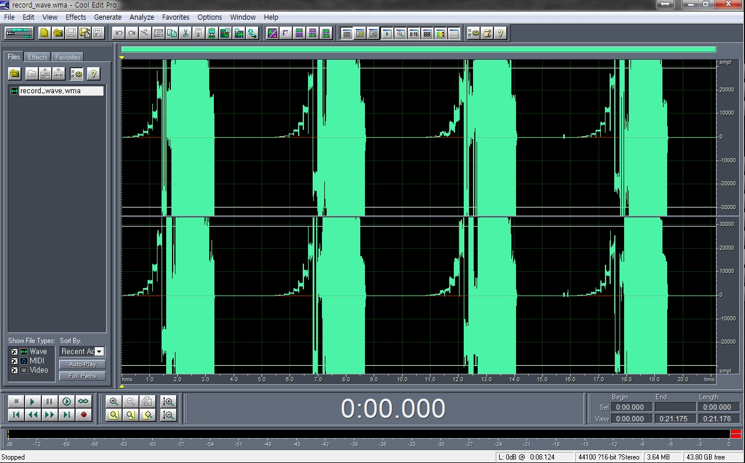
ISSUE
Mic input X
Cool Edit Wave

Slide 5
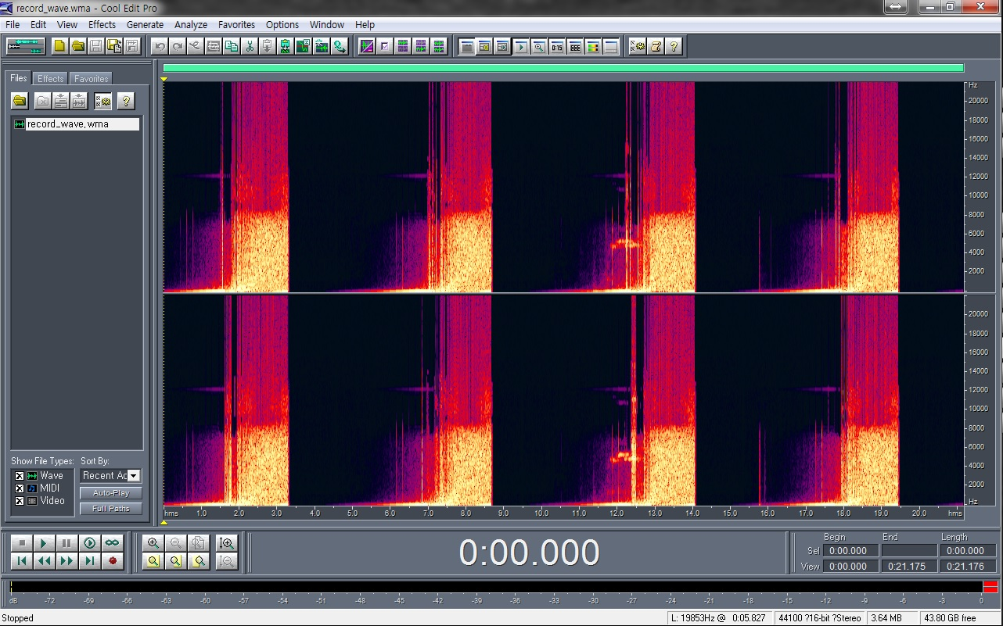
ISSUE
Cool Edit Wave

