Slide 1
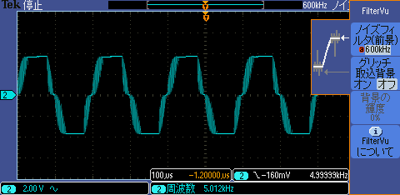
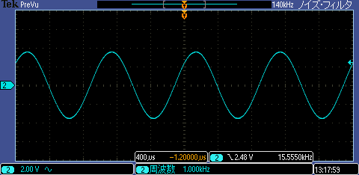
Problem Distortion above 5KHz, but cause unknown. ( Headphone output is Okay even 5KHz)
f=5KHz
f=1KHz ( no problem)

Slide 2
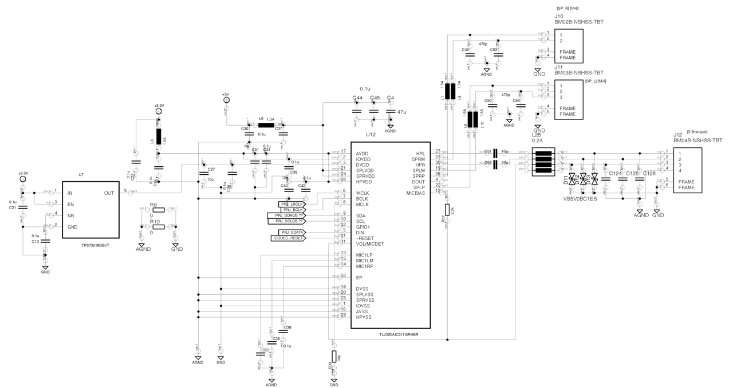
Murata chip capacitor 420pF
Murata
Ferrite bead
BLM15EG121SN1 120ohm at 100MHz rating 1500mA
Speaker
terminal
SPLVDD=SPRVDD=5V

Slide 3
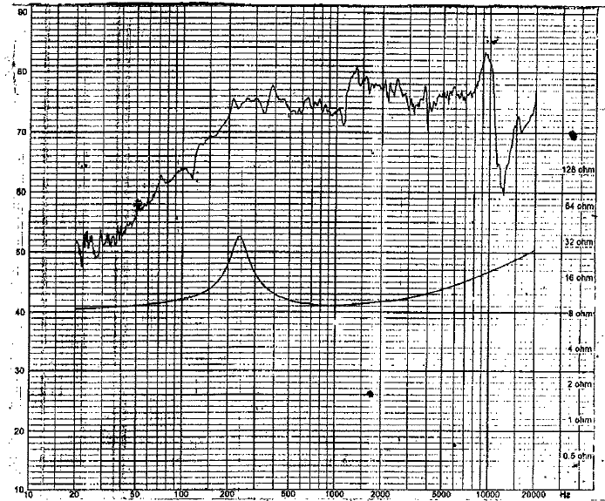
S.P.L
Speaker which customer use
Impedance
f0=220Hz
8ohm

