Slide 1
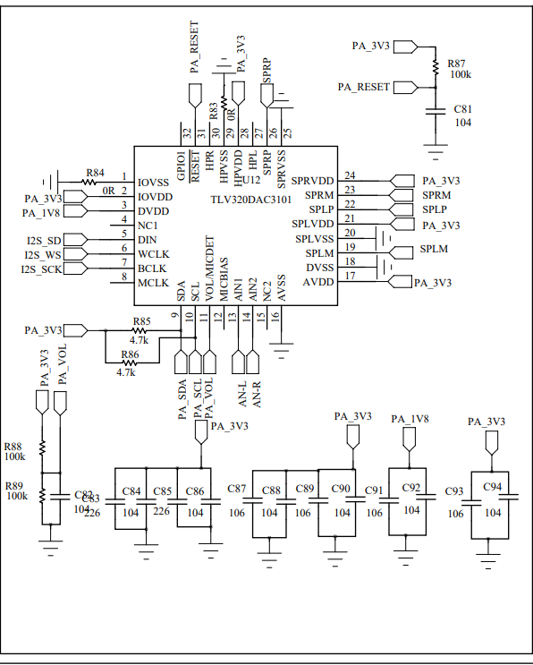
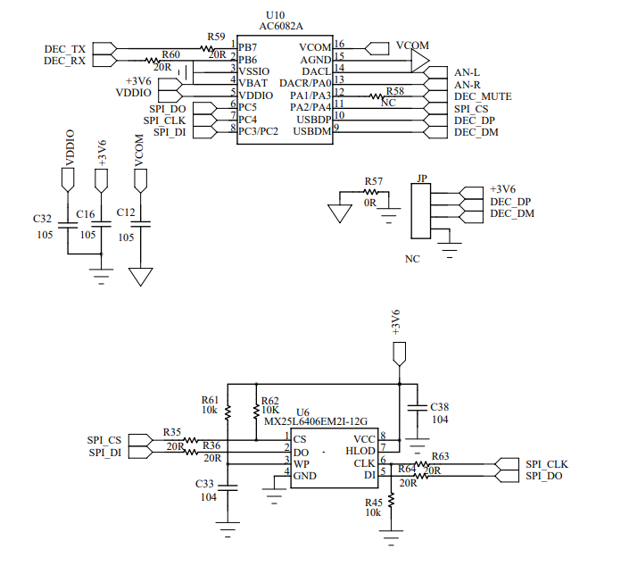
AC6082A is an audio decoder chip used to
decode mobile phone audio signals and local music
Switching AN1/AN2 will have POP sound and playing music will also have POP sound

