Slide 1
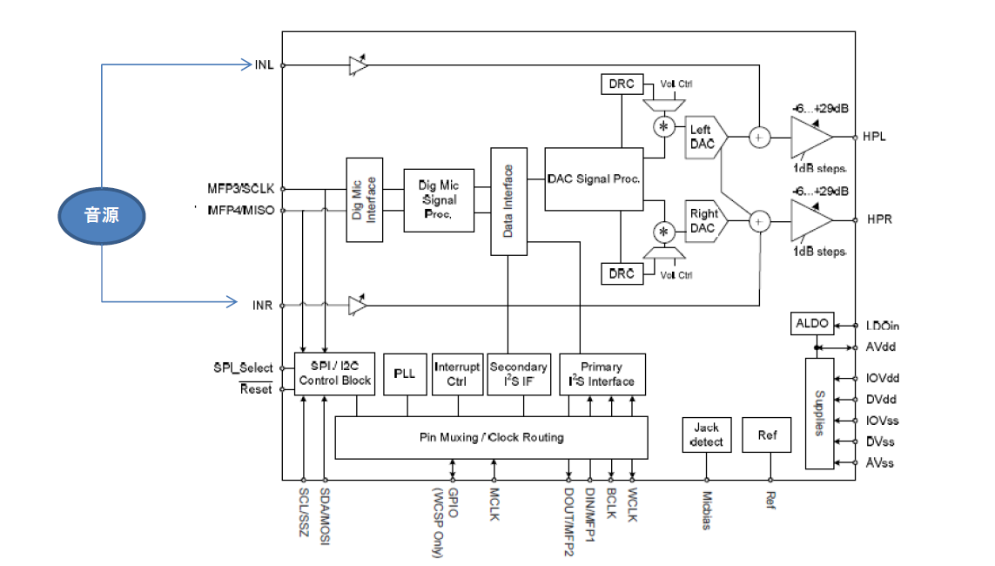
Configuration
Sound source
The same sound source applied on both INL and INR

Slide 2
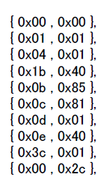
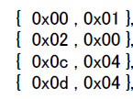
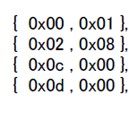
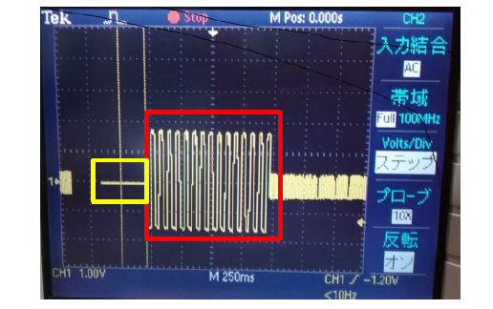
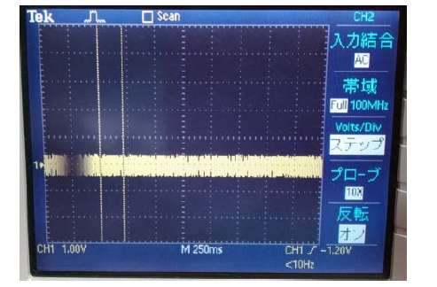
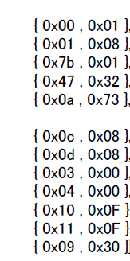
Waveform remaining even though invalid analog block and path to analog block
Register write
Register write
Register write
(DAC biquad filter setting)
HPL waveform
HPL waveform
Waveform remaining(not become 0)

