Slide 1
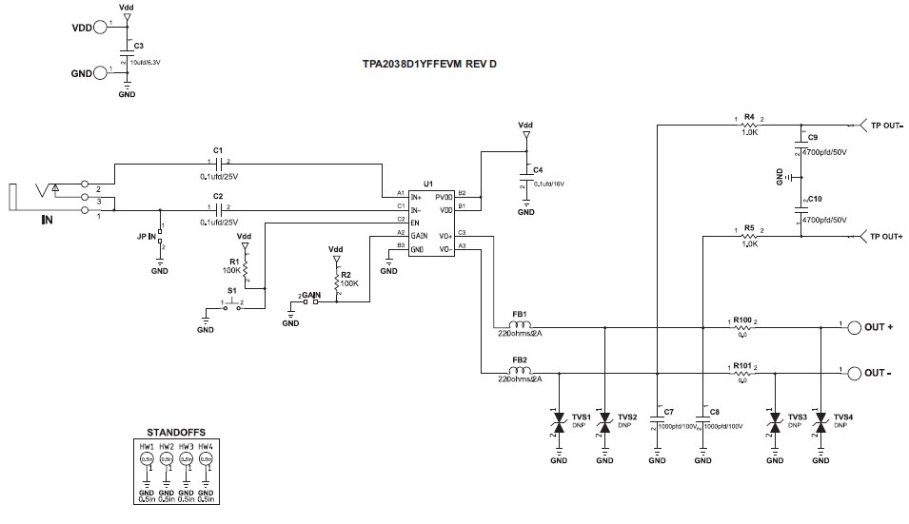
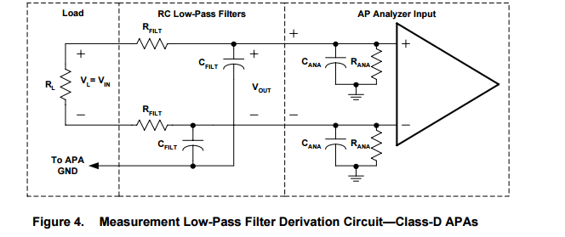
Customer’s Test Setup
TPA2038D1EVM
(use FB Not 33uH)
8 ohm
RC filter
AP
RC filter
(Rflt=100
, Cflt=47nF)
SYS2722 filter
20Hz~22kHz
sloa068
Q1 Anything wrong?

Slide 2
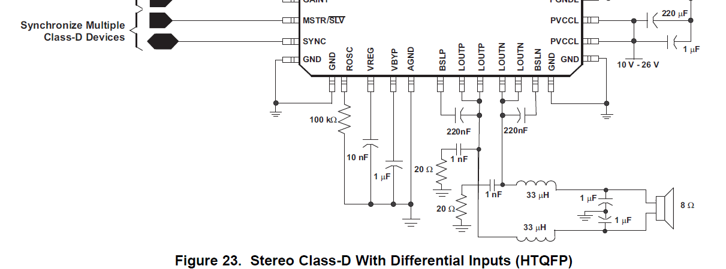
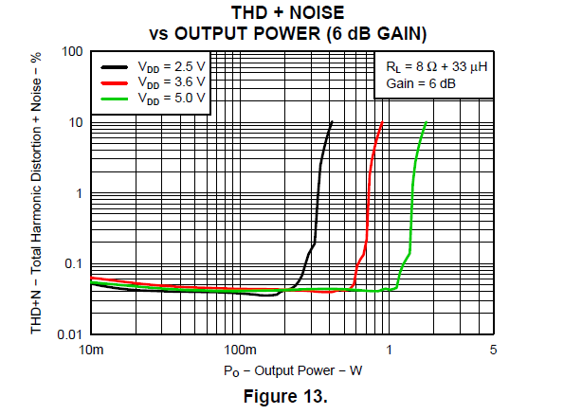
TPA2038D1 data sheet Fig 13
Q2 What is the C value?

