Slide 1
TPA3123 start & shutdown

Slide 2
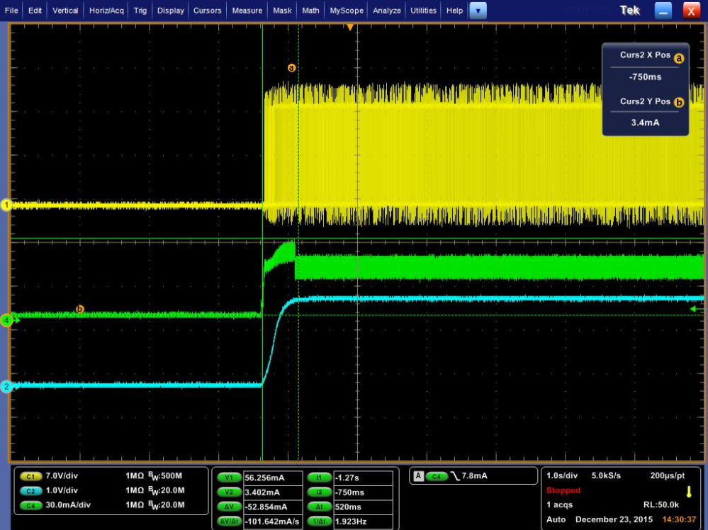
Start (SDZ=High, BYPASS capacitor=1uF)
Internal circuit guarantee the reference for
Pre-amplifier rise to proper level
0.5s
PWM
Current of PVDD
BYPASS

Slide 3
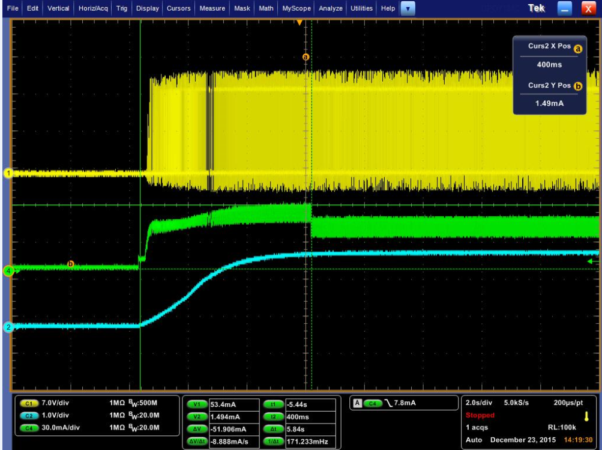
Start (SDZ: High. BYPASS capacitor=10uF)
Internal circuit guarantee the reference for
Pre-amplifier rise to proper level
5.84s
PWM
Current of PVDD
BYPASS

