Slide 1
TPA32xx Grounding Notes

Slide 2
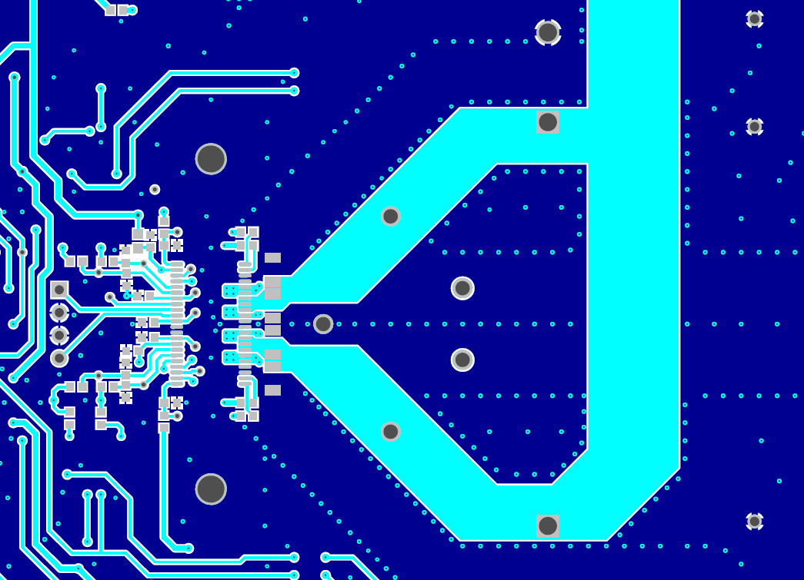
High Power Class-D PCB Layout- TPA3255 EVM
Strong Ground path from Output side of Board

Slide 3
High Power Class-D PCB Layout- TPA3255 EVM
All power Gnd pins are tightly coupled

Slide 4
High Power Class-D PCB Layout- TPA3255 EVM
Top and Bottom traces do not overlap
Ground plane is not isolated!
Top and Bottom Ground pour are inter-connected

Slide 5
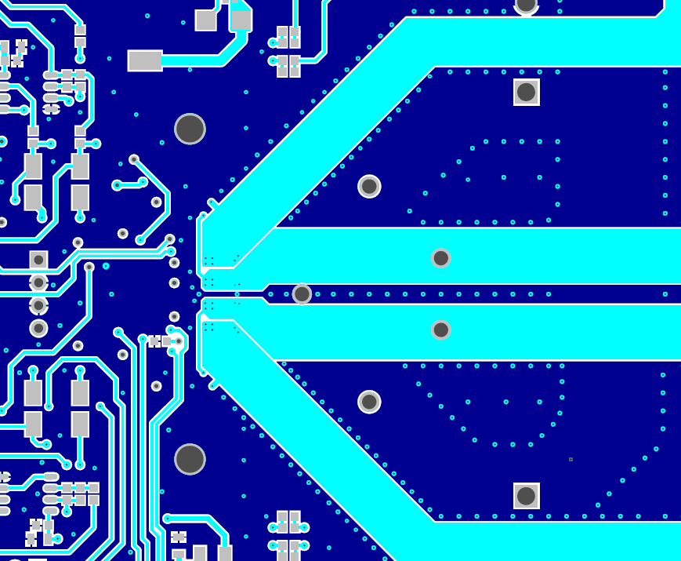
High Power Class-D PCB Layout- TPA3255 EVM

