Slide 1
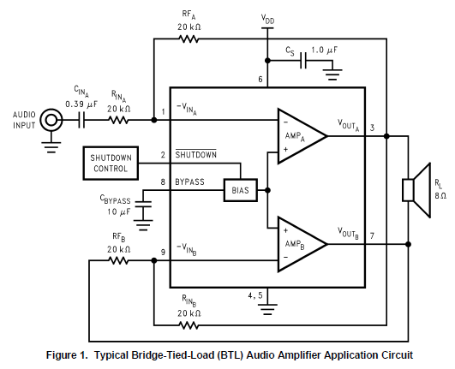
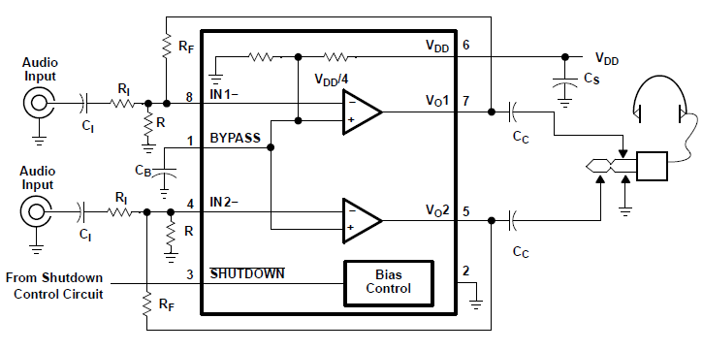
LM4950
BTL mode
TPA6100A2
BTL mode
68K
10K
10K
10K

