Slide 1
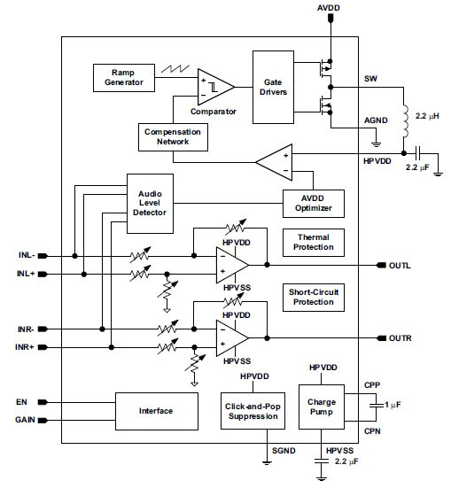

Current schematic
RF 150MHz
Earphone
16Ω～32Ω
Cable length:
approximately 60cm
1000pF capacitors are set to reduce RF noise(150MHz)

Slide 2
Proposal schematic
RF 150MHz
Earphone
16Ω～32Ω
Cable length:
approximately 60cm
Is it better than only capacitor to insert Snubber filter(C and R) for reducing RF noise?

