Slide 1
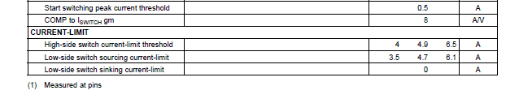
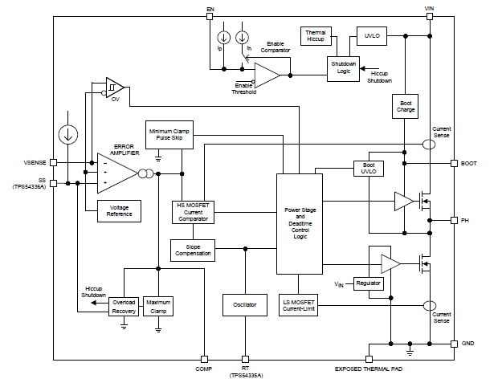
Q1
The meaning of current limit about
Low side FET sinking over current 0A
is, ..” for the Low side FET ,current sinking is
Prohibited” … is it correct?
Q2
The reason why of 0A is, current
sense in the low side FET sinking
is not available( sourcing cab be detected..)
… is it correct?
〇 4.9A typ
〇 4.7A typ
×
０A
Current sense

