Slide 1
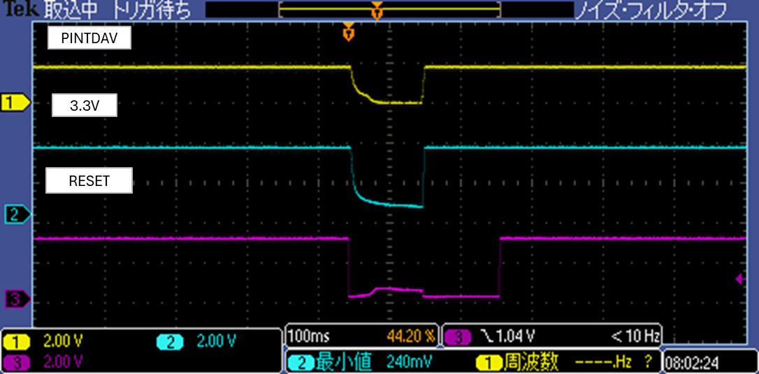
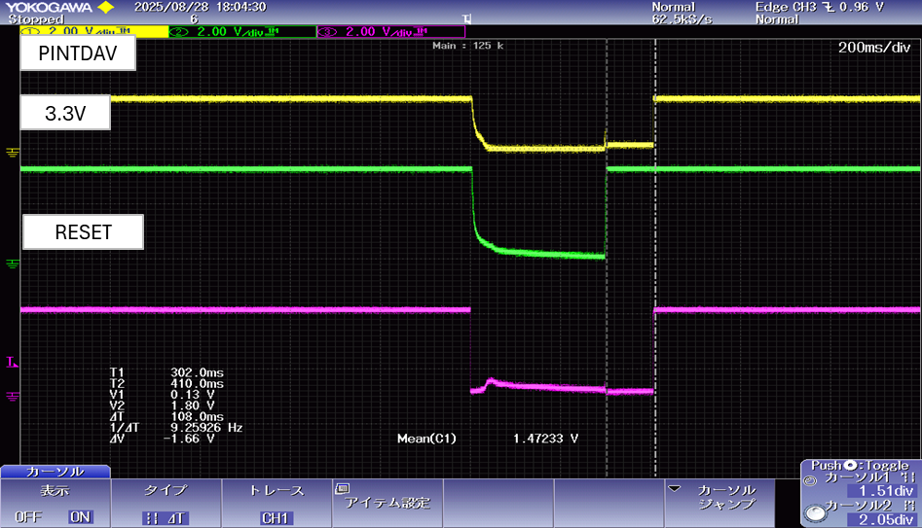
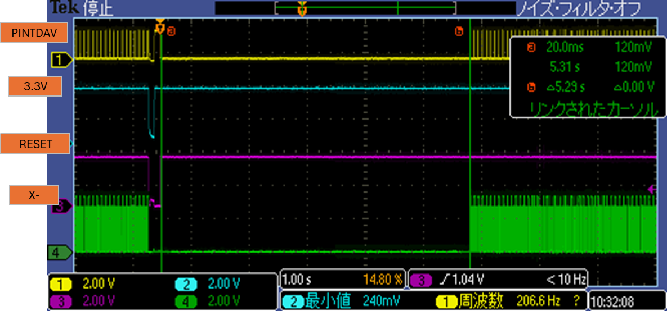
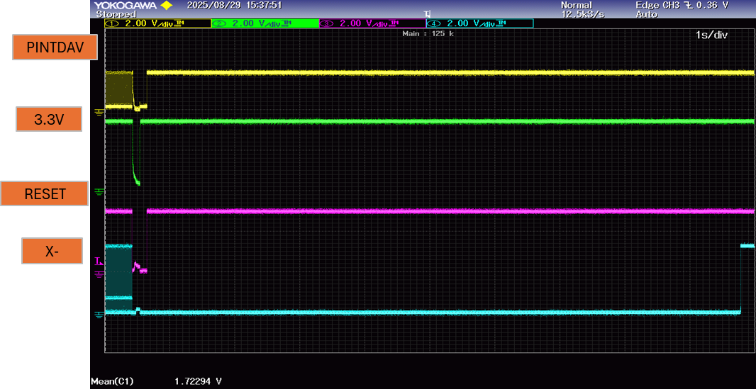
Normal operation
Abnormal operation
High when normal
Low when abnormal
About 300ms
About 100ms
Start of operation
Does not operate
In this waveform, the power off time is 300ms, but the problem also occurs at 100ms.
The problem does not occur if the power off time is 1s or longer.

Slide 2
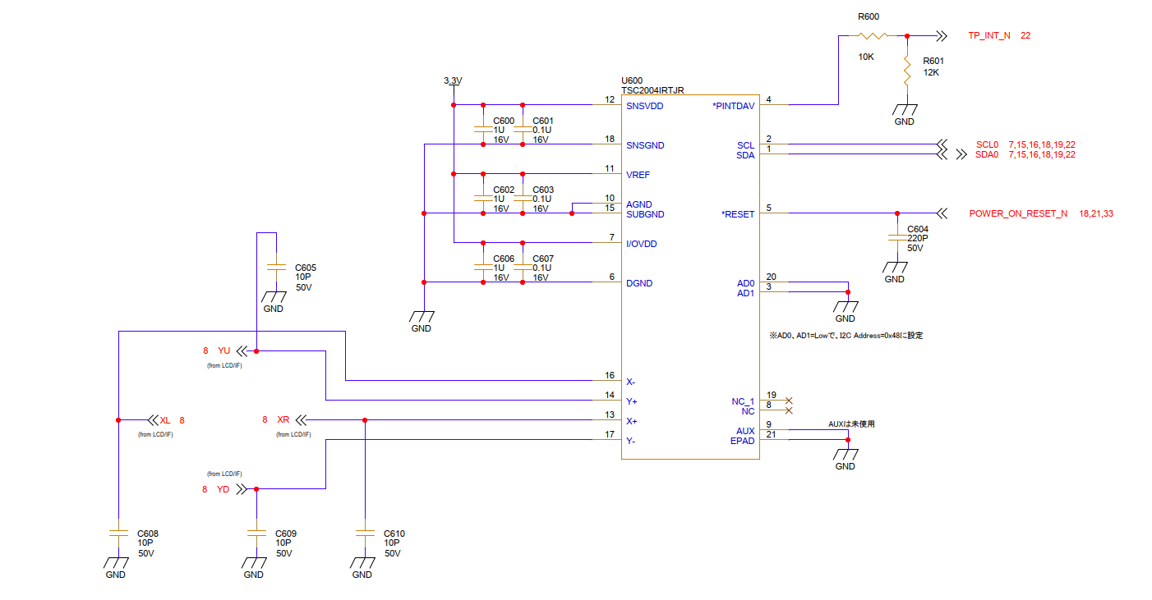
Circuit
It has a 1kΩ pull-up resistor.

