Slide 1
TLV320AIC3204 Gain Error Test on EVM
9/14/2021

Slide 2
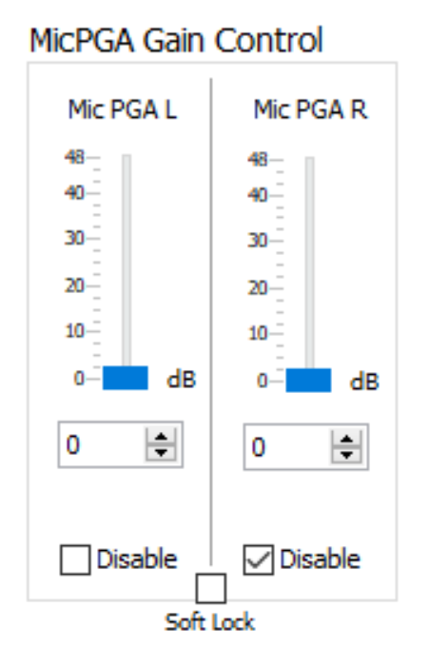
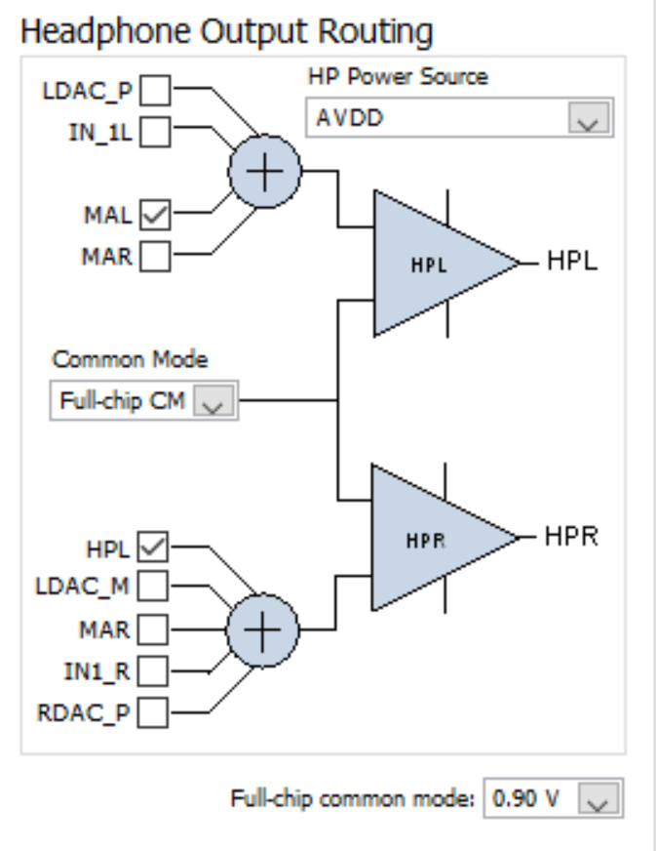
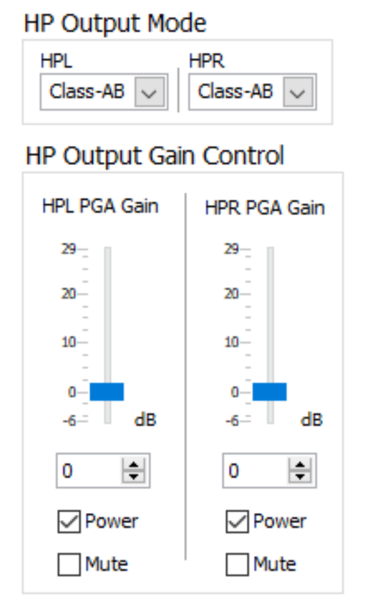
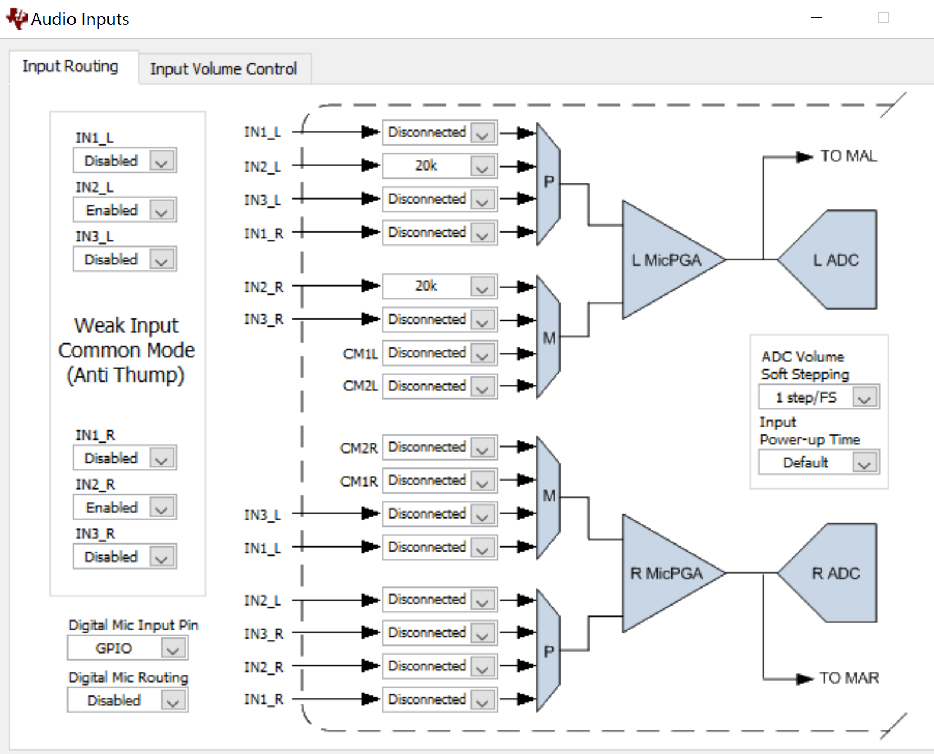
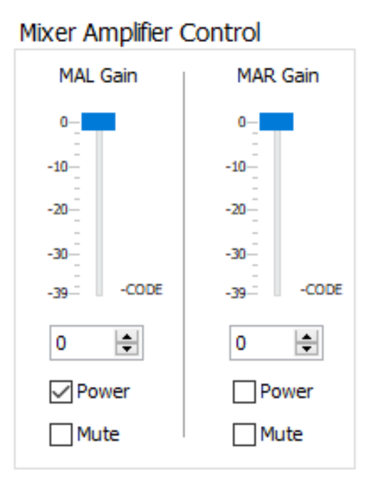
Path B: IN2L + IN2R to HP Configuration

Slide 3
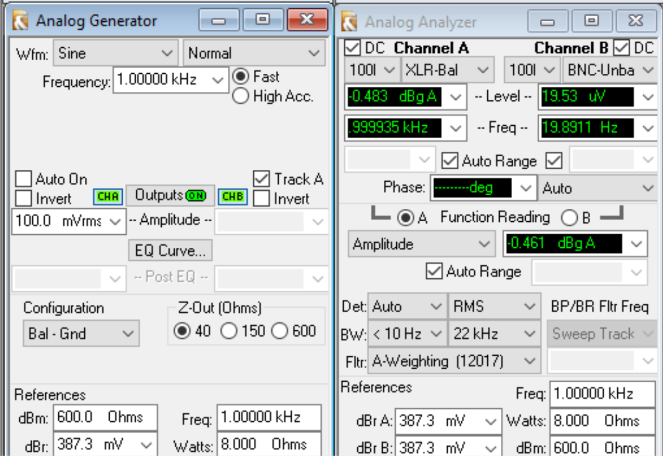
Path B IN2L + IN2R to HP Output
Output = 0.461 dB

Slide 4
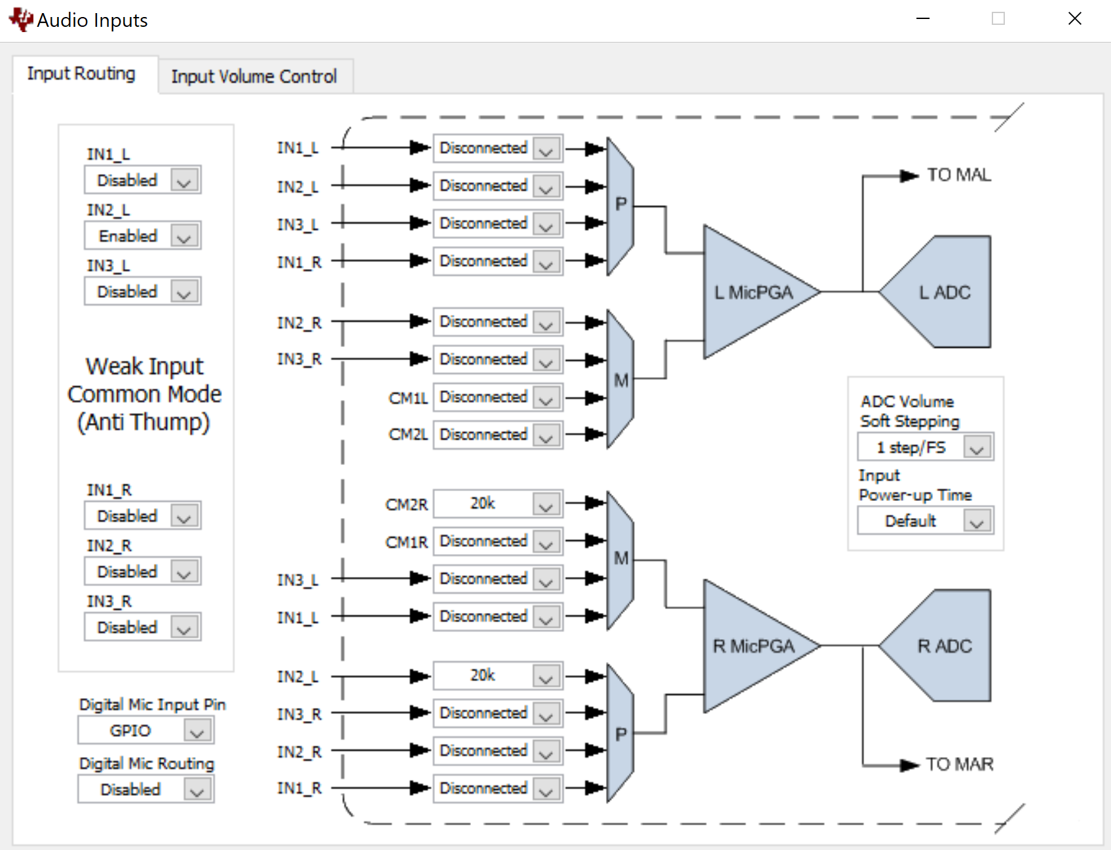
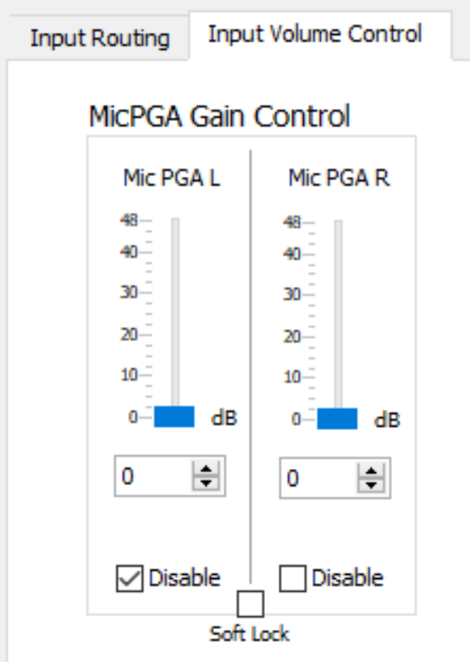
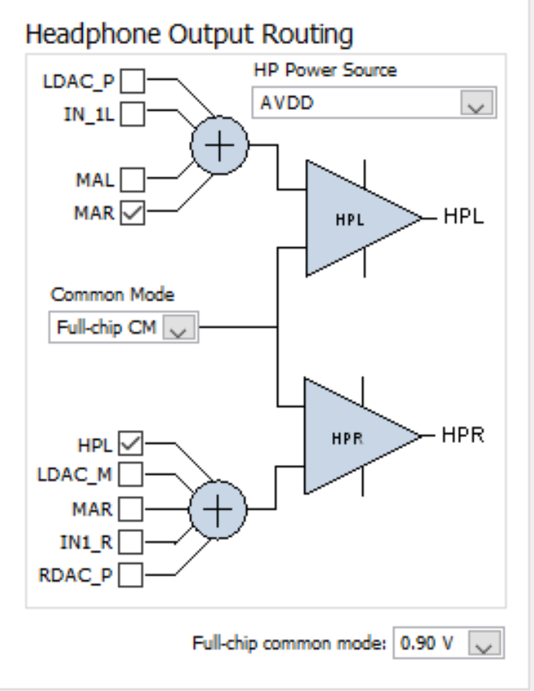
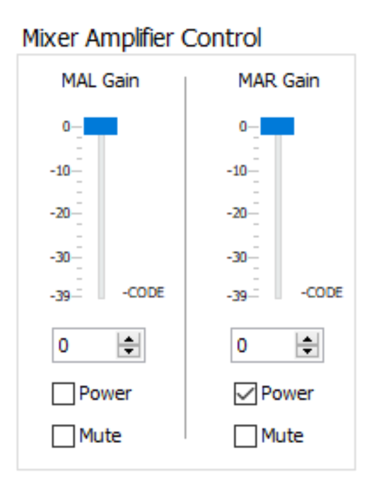
Path A: IN2L + CM2R to HP Configuration

Slide 5
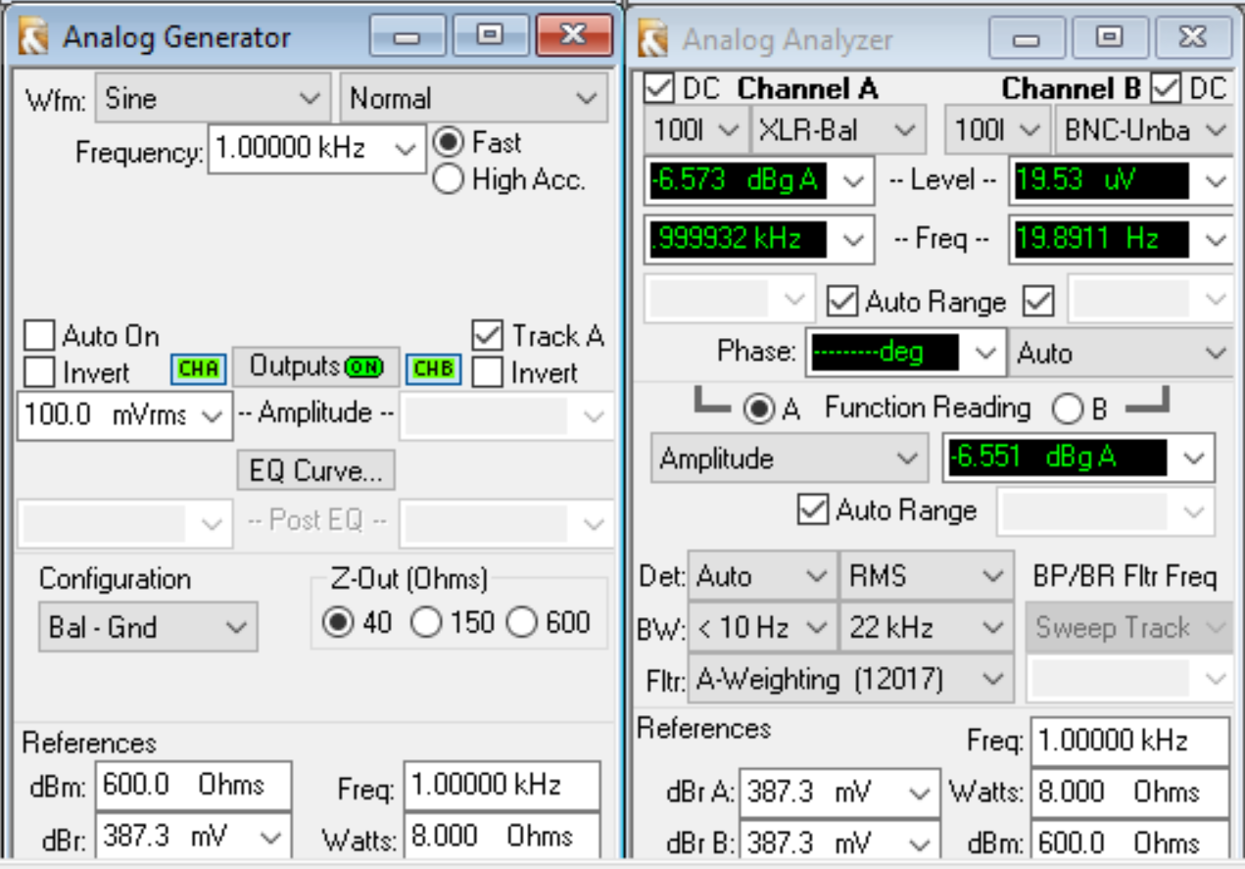
Path A IN2L+CM2R to HP Output
Change to path A
Output = -6.551 dB

Slide 6
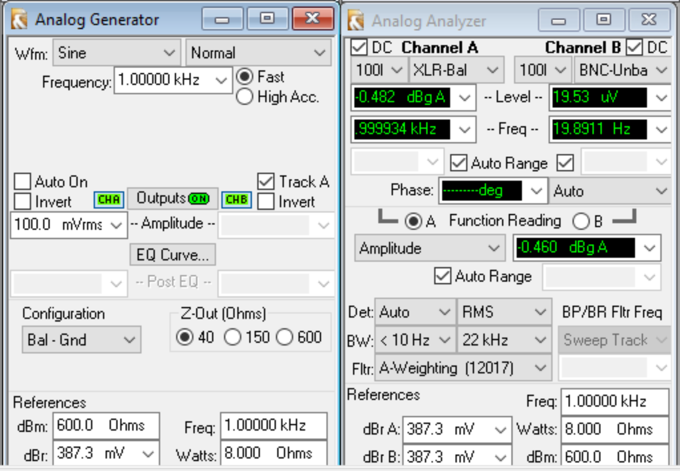
Back to Path B IN2L+IN2R to HP
Switch back to path B
Output = 0.460 dB

