Slide 1
Guideline for Audio Driver on Linux
BeagleBone Black
Notes:
Accelerating development (versus owning) – needs to be in real time
Prepared to answer why we selected Degreed, benchmarking, capabilities (Air B&B)
Central access point for all things learning at TI to develop yourself professionally
Long-term solution to building skills and owning your development
Mimics the way people natural learn, by facilitating social learning (peer-to-peer knowledge sharing)
Able to search for and access on-demand platforms, including:
LinkedIn Learning, HarvardManage Mentor, IEEE and more
Pulls in self-enrollment and required training (i.e. ECAP)
Engineering Information Exchange on Confluence
Training on training.ti.com
myLearning

Slide 2
Revision history
Ver | Date | Author | Description
1.0 | 2020/3/16 |  | Initial
1.1 | 2021/4/6 |  | Add Firmware download
1.2 | 2022/2/26

Slide 3
Information
PCMdevice Driver | pcm6260
7-bit I²C Address | 0x48/0x49/0x4a/0x4b
Platform | Qualcomm/Mtk/LSI/Hisilicon/BeagleBone Black/AMBA
Architecture | ALSA/Tiny-ALSA
Bus type | I2C
Kernel Version | V4.19 ~ V5.10
Notes:
Accelerating development (versus owning) – needs to be in real time
Prepared to answer why we selected Degreed, benchmarking, capabilities (Air B&B)
Central access point for all things learning at TI to develop yourself professionally
Long-term solution to building skills and owning your development
Mimics the way people natural learn, by facilitating social learning (peer-to-peer knowledge sharing)
Able to search for and access on-demand platforms, including:
LinkedIn Learning, HarvardManage Mentor, IEEE and more
Pulls in self-enrollment and required training (i.e. ECAP)
Engineering Information Exchange on Confluence
Training on training.ti.com
myLearning

Slide 4
Release Package
Driver Package | Source code | .c/.h/makefile/KCONFIG files
 | Regbin file | pcmreg.bin
 | Jason file stored the detail information of regbin | Pcmreg.json
Notes:
Accelerating development (versus owning) – needs to be in real time
Prepared to answer why we selected Degreed, benchmarking, capabilities (Air B&B)
Central access point for all things learning at TI to develop yourself professionally
Long-term solution to building skills and owning your development
Mimics the way people natural learn, by facilitating social learning (peer-to-peer knowledge sharing)
Able to search for and access on-demand platforms, including:
LinkedIn Learning, HarvardManage Mentor, IEEE and more
Pulls in self-enrollment and required training (i.e. ECAP)
Engineering Information Exchange on Confluence
Training on training.ti.com
myLearning

Slide 5
Kernel Driver compiling I
Extract driver package to the folder “sound/soc/codecs”:
Add some pcmdevice compiling info into the Kconfig and Makefile in the sound/soc/codecs. For detail, kindly go to next page and the highlighted item.
File in sound/soc/codecs | Compiling info
Kconfig | source "sound/soc/codecs/pcmdevice/Kconfig"
Makefile | obj-$(CONFIG_SND_SOC_PCMDEVICE) += pcmdevice/
Notes:
Accelerating development (versus owning) – needs to be in real time
Prepared to answer why we selected Degreed, benchmarking, capabilities (Air B&B)
Central access point for all things learning at TI to develop yourself professionally
Long-term solution to building skills and owning your development
Mimics the way people natural learn, by facilitating social learning (peer-to-peer knowledge sharing)
Able to search for and access on-demand platforms, including:
LinkedIn Learning, HarvardManage Mentor, IEEE and more
Pulls in self-enrollment and required training (i.e. ECAP)
Engineering Information Exchange on Confluence
Training on training.ti.com
myLearning

Slide 6
Kernel Driver compiling II
Kconfig in sound/soc/codecs
Makefile in sound/soc/codecs
Notes:
Accelerating development (versus owning) – needs to be in real time
Prepared to answer why we selected Degreed, benchmarking, capabilities (Air B&B)
Central access point for all things learning at TI to develop yourself professionally
Long-term solution to building skills and owning your development
Mimics the way people natural learn, by facilitating social learning (peer-to-peer knowledge sharing)
Able to search for and access on-demand platforms, including:
LinkedIn Learning, HarvardManage Mentor, IEEE and more
Pulls in self-enrollment and required training (i.e. ECAP)
Engineering Information Exchange on Confluence
Training on training.ti.com
myLearning

Slide 7
Kernel Driver compile III ---- defconfig Setting
Add following two items into defconfig, highlighted part in right picture for detail
CONFIG_SND_SOC_PCMDEVICE=y
CONFIG_PCMDEVICE_CODEC=y
Notes:
Accelerating development (versus owning) – needs to be in real time
Prepared to answer why we selected Degreed, benchmarking, capabilities (Air B&B)
Central access point for all things learning at TI to develop yourself professionally
Long-term solution to building skills and owning your development
Mimics the way people natural learn, by facilitating social learning (peer-to-peer knowledge sharing)
Able to search for and access on-demand platforms, including:
LinkedIn Learning, HarvardManage Mentor, IEEE and more
Pulls in self-enrollment and required training (i.e. ECAP)
Engineering Information Exchange on Confluence
Training on training.ti.com
myLearning

Slide 8
Kernel Driver compile IV | Add pcmreg.bin file into zImage I
Confirm where the firmware file store in the target device
The path storing the bin file is defined in kernel/drivers/base/firmware_class.c, normally /system/vendor/firmware, /system/etc/firmware, or /lib/firmware
static const char * const fw_path[] = {
fw_path_para,
"/system/vendor/firmware",
"/system/etc/firmware",
"/lib/firmware/updates/" UTS_RELEASE,
"/lib/firmware/updates",
"/lib/firmware/" UTS_RELEASE,
"/lib/firmware" };
Compile the bin file into image.
During debug, pushing the bin file into proper folder of the target device is more convenient than compiling into image.

Slide 9
Kernel Driver compile IV | Add pcmreg.bin file into zImage II
Compile the bin file into image.
Add following settings into defconfig file
CONFIG_EXTRA_FIRMWARE_DIR is path where the bin file is stored into the target machine. “firmware” is the relative path in the compiling base path.
CONFIG_EXTRA_FIRMWARE is the name of firmware name.
If this method is enabled, the fw will be loaded during system bootup.
During debug, pushing the bin file into proper folder of the target device is more convenient than compiling into image. Once compiling into zImage, every time the bin file is changed, it should be recompiled into zImage instead of copied into the fw_path

Slide 10
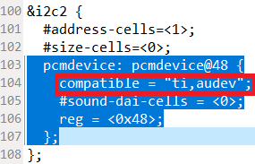
Kernel Driver compile V | DTS config I | Interrupt-free driver
“ti,audev” will bypass all the interrupt handling in the code

Slide 11
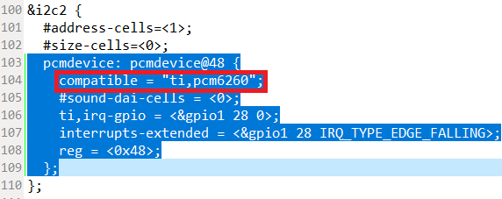
Kernel Driver compile VI | DTS config II | Interruptible driver
The compatible is different from the setting for interrupt-free driver.
Do not forget set the irq-gpio to input mode.

Slide 12
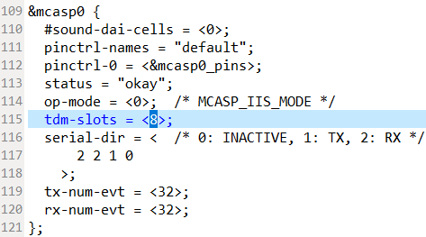
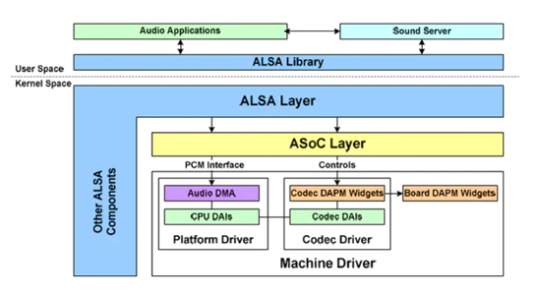
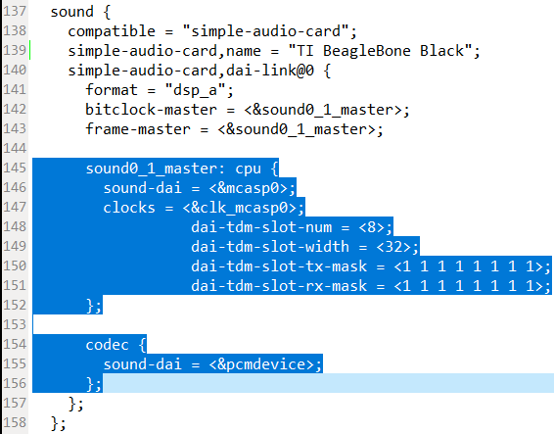
Kernel Driver compile VII | DTS config I | 32-bit 8-slot dsp-a
Notes:
Accelerating development (versus owning) – needs to be in real time
Prepared to answer why we selected Degreed, benchmarking, capabilities (Air B&B)
Central access point for all things learning at TI to develop yourself professionally
Long-term solution to building skills and owning your development
Mimics the way people natural learn, by facilitating social learning (peer-to-peer knowledge sharing)
Able to search for and access on-demand platforms, including:
LinkedIn Learning, HarvardManage Mentor, IEEE and more
Pulls in self-enrollment and required training (i.e. ECAP)
Engineering Information Exchange on Confluence
Training on training.ti.com
myLearning

Slide 13
Kernel Driver compile VIII | DTS config II | 16-bit 8-slot dsp-a
All the settings can follow previous pages, except dai-tdm-slot-width. See the highlighted part in the right picture.

Slide 14
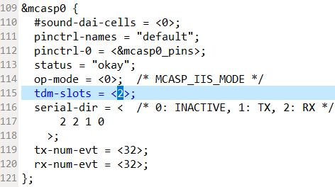
Kernel Driver compile IX | DTS config III | 32-bit 2-slot dsp-a
All the settings can follow previous pages, except dai-tdm-slot-num, dai-tdm-slot-tx-mask, dai-tdm-slot-rx-mask and tdm-slots. See the highlighted part in the right pictures.

Slide 15
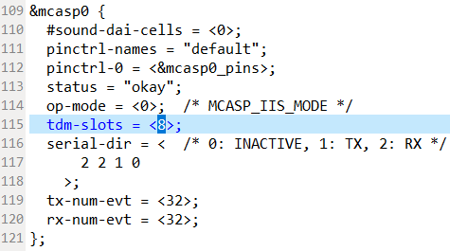
Kernel Driver compile X | DTS config IV | flexible dsp-a
All the settings can follow previous pages, except dai-tdm-slot-num, dai-tdm-slot-tx-mask, dai-tdm-slot-rx-mask and tdm-slots. See the highlighted part in the right pictures.

Slide 16
Kernel Driver compile XI | DTS config V | I2S
All the settings can follow previous pages, except format and cpu settings. See the highlighted part in the right pictures.

Slide 17
How to Check Sound Card register
ls /dev/snd
ls /sys/bus/i2c/devices/2-0048
cat proc/asound/pcm
cat proc/asound/cards

Slide 18
Driver nodes I ---- introduction
In order to debug driver freely, several driver nodes have been defined
reg
regdump
regbininfo_list
regcfg_list
fwload
i2caddr
The location of driver nodes
/sys/bus/i2c/devices/2-0048, /sys/class/i2c-adapter/i2c-2/2-0048 or /sys/bus/i2c/devices/2-0048
the 2 is the i2c bus number where pcmdevice deployed
0048 is the 7-bit i2c address for pcmdevice

Slide 19
Driver nodes II ---- fwload/i2caddr
echo > fwload
Illustration: Use for debug if firmware has not been compiled into rootfs.
How to check firmware load successfully
amixer contents
amixer controls
cat i2caddr
Illustration: show the active i2c address

Slide 20
Driver nodes II ---- reg
echo 0xPG 0xRG 0xXX > reg
Illustration: Write a value to a certain register
PG, RG & XX must be 2-digital HEX
eg: 0x00 0x2 0xE1 > reg
cat reg
Illustration: Read back the value from the register which have been echoed before

Slide 21
Driver nodes III ---- regdump
echo 0xPG > regdump
Illustration: the command dump all the registers of the specific page
PG must be 2-digital HEX
eg: echo 0x00 > reg
cat regdump
Illustration: run the echo command, show the 7-bit i2c address of the chip and dump the registers

Slide 22
Driver nodes IV ---- regbininfo_list
cat regbininfo_list
Illustration: list the regbin version and dump the name of all the audio cases from regbin file
PS: If wanted detailed info from specific audio case, kindly use the drive node regcfg_list

Slide 23
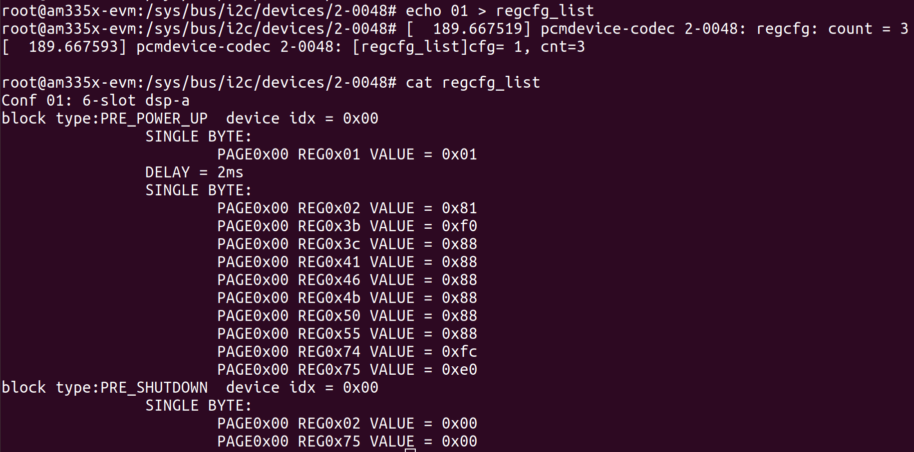
Driver nodes V ---- regcfg_list
echo CG > regcfg_list
CG is conf NO, it should be 2-digital decimal
eg: echo 01 > regcfg_list
cat regcfg_list
Illustration: dump the register setting of the audio case specified by echo command

Slide 24
Test Commands I
If pcmreg.bin file has not been compiled into zImage, DO NOT forget to run:
echo > /sys/bus/i2c/devices/2-0048/fwload
the 2 is the i2c bus number where pcmdevice deployed
0048 is the 7-bit i2c address for pcmdevice
Above two items depends on the hardware connection.
32-bit 8-slot TDM(Use DTS setting for 32-bit 8-slot dsp-a)
amixer cset numid=1,iface=MIXER,name='PCMDEVICE Profile id’ 0
arecord -c 8 -f S32_LE -r 48000 -d 15 --device="hw:0,0" TDM-8slot-32b-test.wav
32-bit 2-slot TDM(Use DTS setting for 32-bit 2-slot dsp-a)
amixer cset numid=1,iface=MIXER,name='PCMDEVICE Profile id’ 2
arecord -c 2 -f S32_LE -r 48000 -d 15 --device="hw:0,0" TDM-2slot-32b-test.wav
DTS setting Flexible DSP-A
Aobve commands are all available, the fsync-clk and bck will will be different due to the different commands.

Slide 25
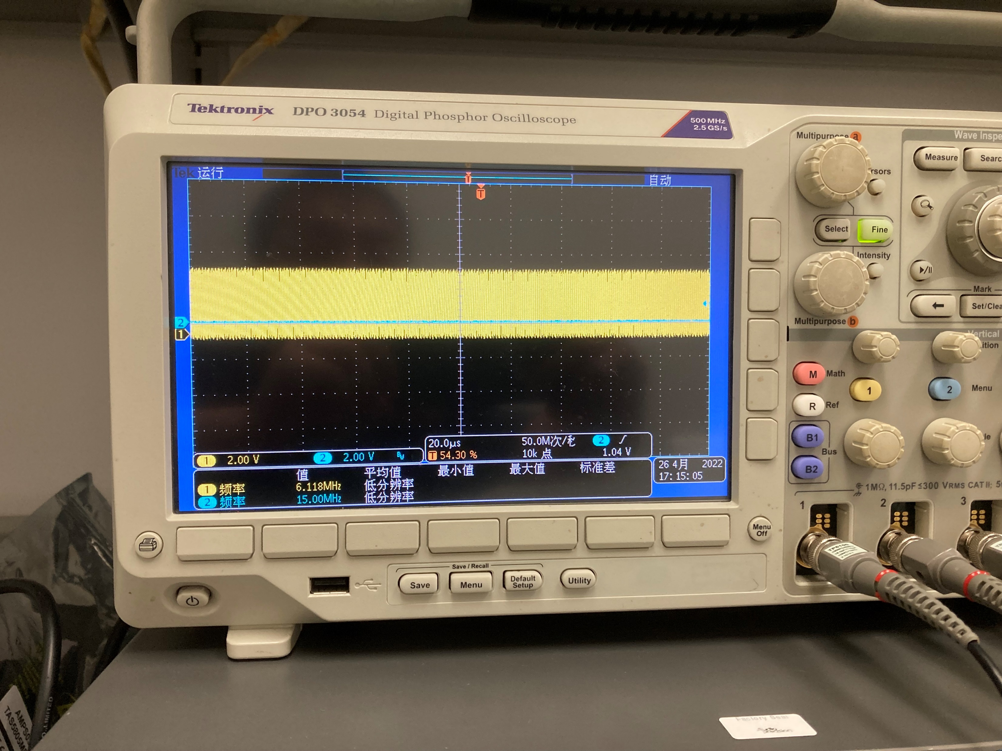
Test Commands II
16-bit 8-slot TDM(Use DTS setting for 16-bit 8-slot dsp-a)
amixer cset numid=1,iface=MIXER,name='PCMDEVICE Profile id’ 1
arecord -c 8 -f S16_LE -r 48000 -d 15 --device="hw:0,0" TDM-8slot-16b-test.wav

Slide 26
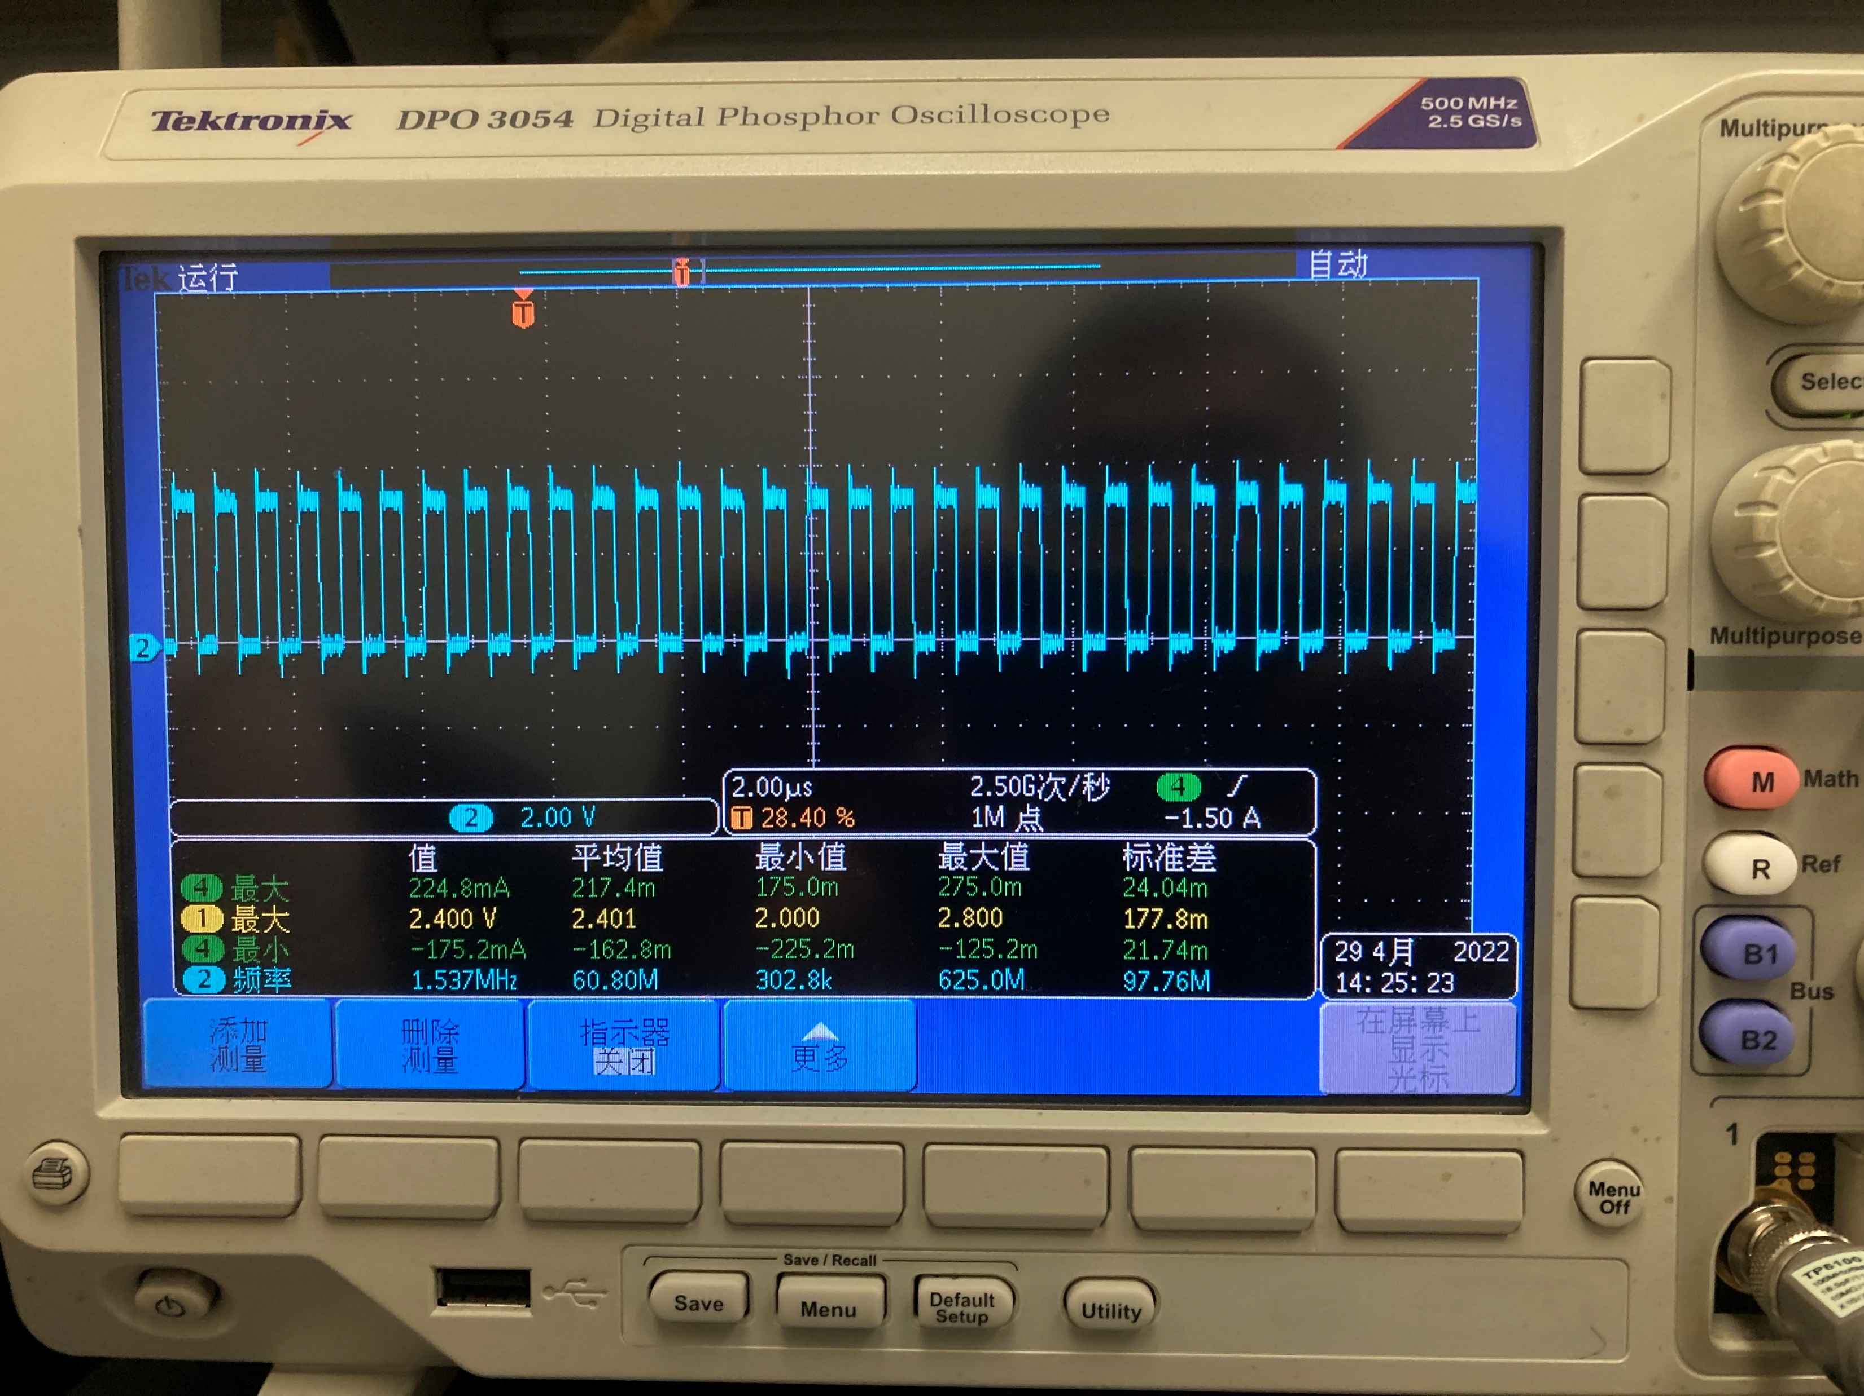
Test Commands III
16-bit I2S (Use DTS setting for I2S)
amixer cset numid=1,iface=MIXER,name='PCMDEVICE Profile id’ 3
arecord -c 2 -f S16_LE -r 48000 -d 15 --device="hw:0,0" i2s-16b-test.wav

Slide 27
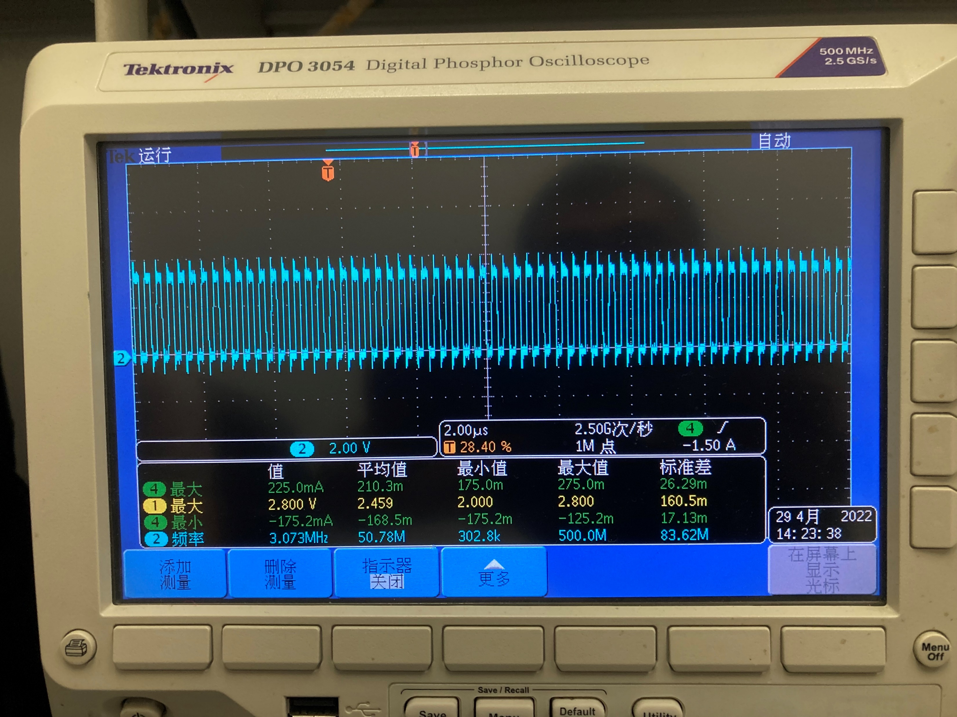
Test Commands IV
32-bit I2S (Use DTS setting for I2S)
amixer cset numid=1,iface=MIXER,name='PCMDEVICE Profile id’ 6
arecord -c 2 -f S32_LE -r 48000 -d 15 --device="hw:0,0" i2s-16b-test.wav

Slide 28
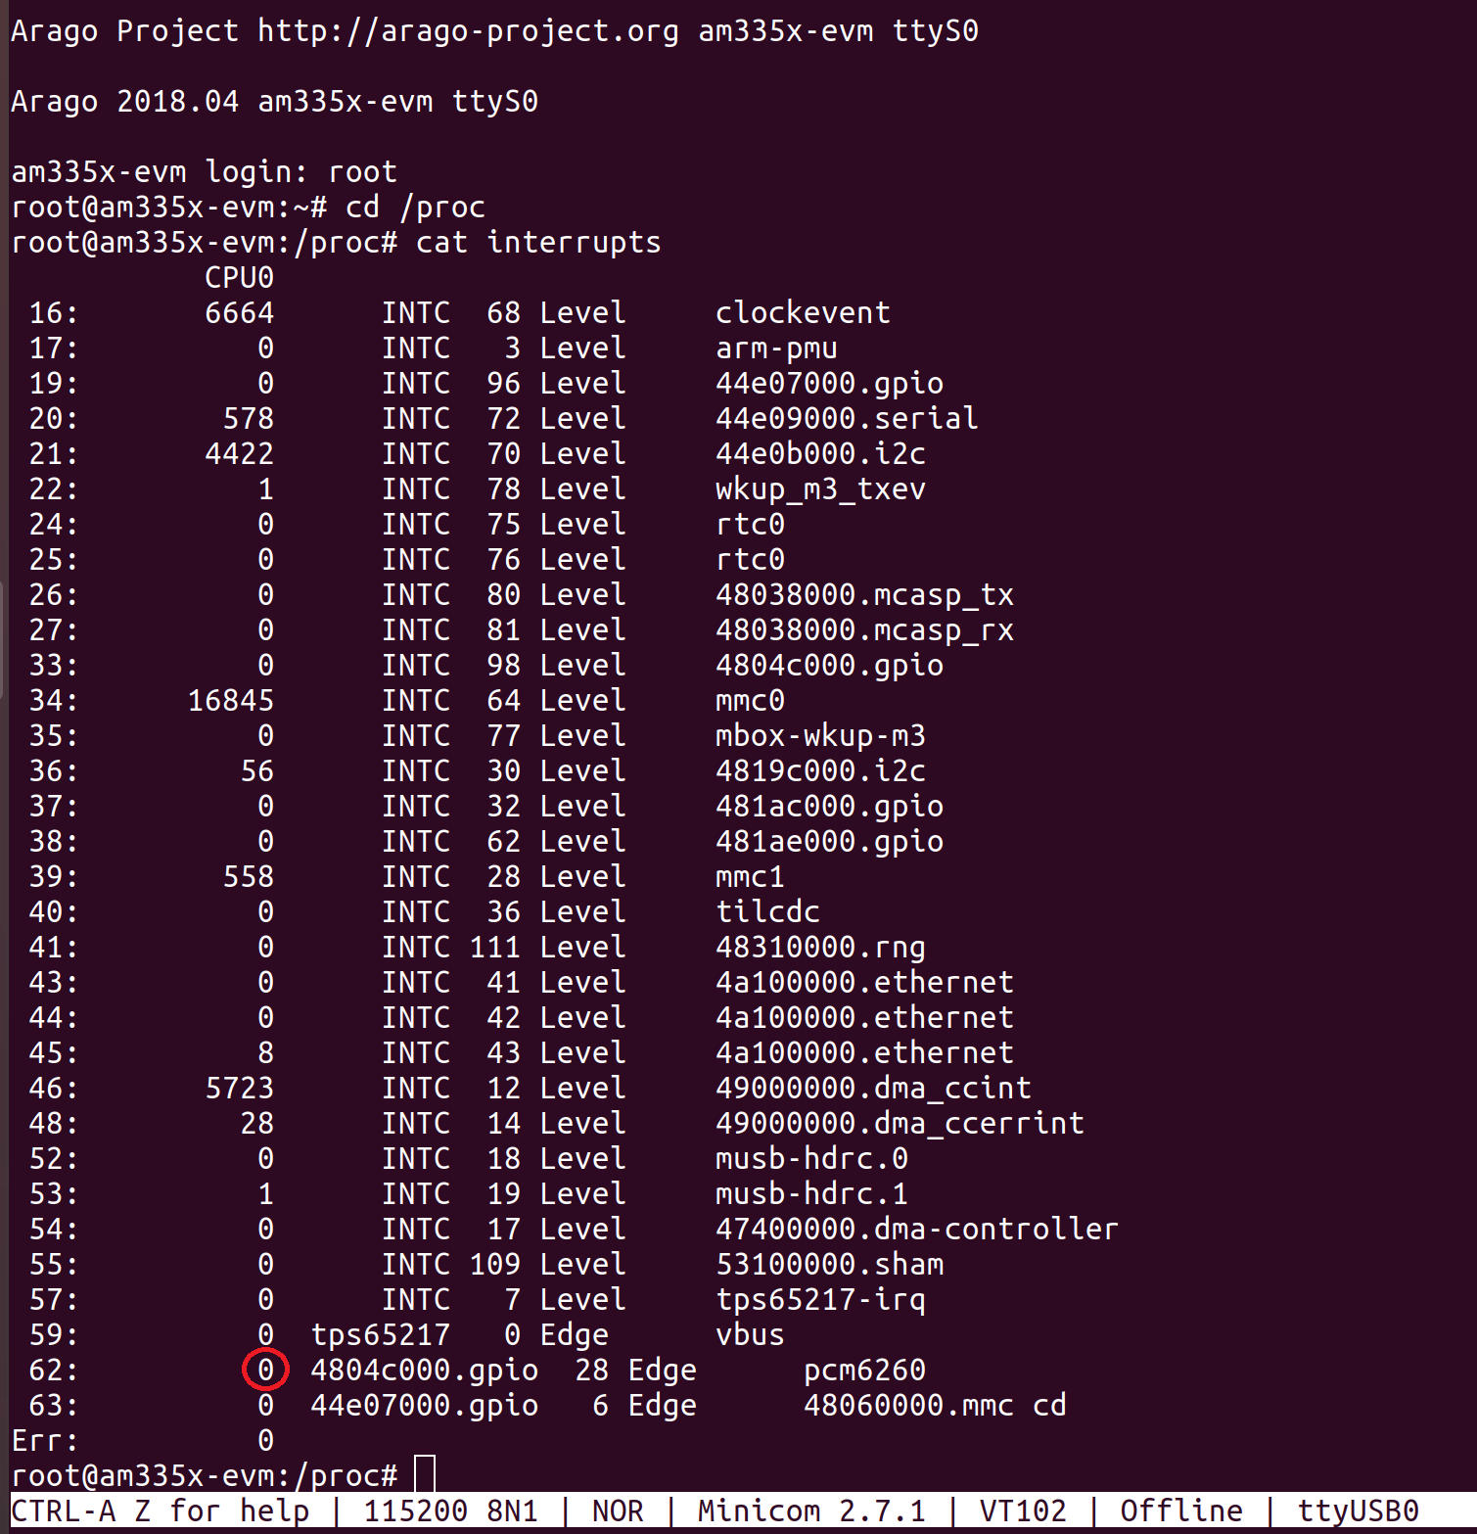
Interrupt handling test I
Run following command, when chip is power down mode. The number in the red circle in right picture is the times the chip interrupt triggered
cat /proc/interrupts

Slide 29
Interrupt handling test II
During recording, short the IRQ_GPIO, then run the command mentioned above again. The number in the red circle in right picture has fresh to a new one.

Slide 30
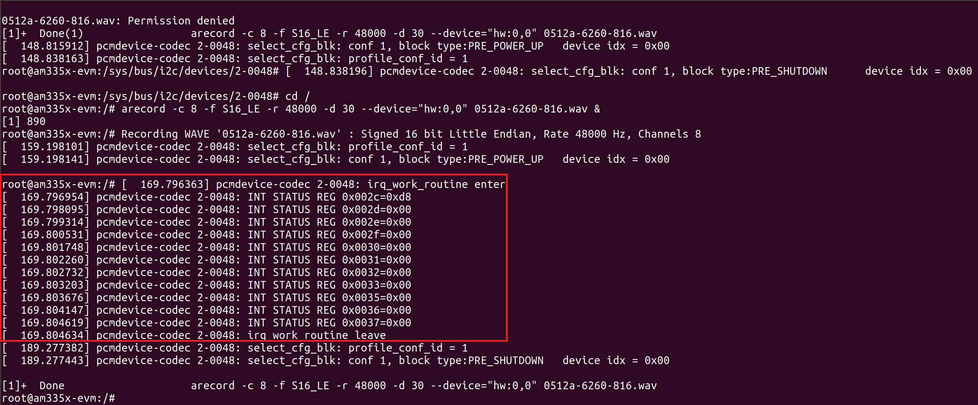
Interrupt handling test III
The log will be output like the red frame in the below picture.

Slide 31
Thanks!

