Slide 1
Customer is using TLV320AIC3101 for several years.
Recently, there have issue ( stuck no output ) in case fs change.
Customer is investigating the cause now , but
Customer is not fully confident with their procedure...
Inquiry
1)
Please kindly check Customer’s procedure in their products which is in page 2.
Is there any criteria to keep other than page2 ~ 3?
Do you have any problem in customer's procedure?
Would you please advise your recommended procedure (Do and Don’ts)
in order to change fs (48K~96K) ?

Slide 2
Fig 1 Fs change procedure
( ex. 48K to 96KHz)
Fig2 Block diagram
MCLK
Input
From X’tal
To AIC3101
BCLK/WCLK
Output
from AIC3101
To DSP
_codec Power Disable
AIC
3101
C55x
DAC MUTE
ADC MUTE
DAC Power Down
ADC Power Down
BCLK(64fs)
WCLK
12.0000
MHz
BCK 3.072MHz
/ WCLK 48KHz
Power down /up
recommended
In slaa230a.pdf
DOUT
DIN
Set I2S SLAVE MODE( Note1)
_setSampleRate
Set PLL Disable
Set PLL Settings (Note2)
Set I2S Master Mode
PLL Enable
BCK/WCLK
Stopps
MCLK(X’tal)
Supplied
continuously
MCLK
12.000
MHz
X’tal
6.144
MHz
/ 96KHz
I2C (MCU)
Wait 11msec for PLL stability
Note1
As per customer, to set slave mode is necessary for
Disabling PLL in order to stop WCLK, BCK.
As per customer, ADC/DAC power down/up,
to stop WCLK/BCK at once, change PLL setting is the
best way for Fs change, but it is by their cut&try,not authorized.
( I personally have no idea the reason why set slave mode at once in order to disable PLL and change PLL setting in master mode )
Note2
Pls refer PLL setting detail in the next page .( for 96KHz, same PLL setting but double rate)
_codec Power Enable
ADC Power Up
DAC Power Up
ADC unmute
DAC unmute
12.000
MHz

Slide 3
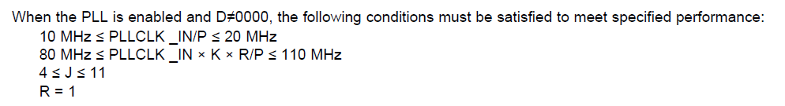
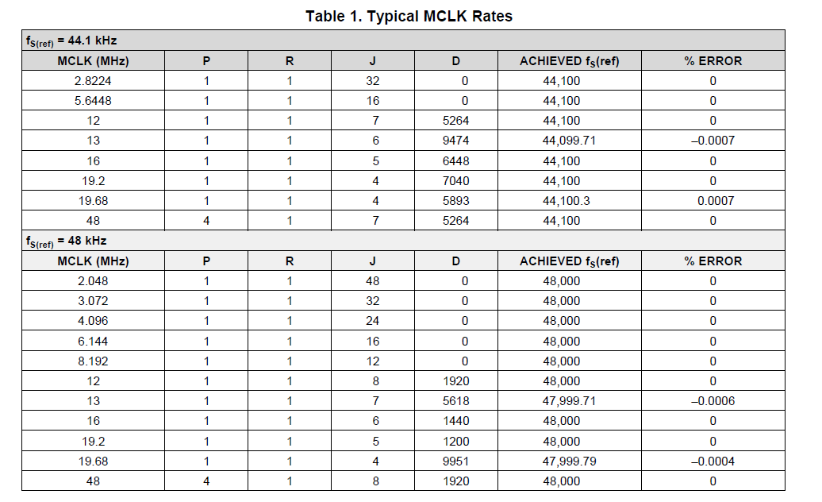
PLL setting detail
1) In case 44.1K/48K: Follow table2 and discription in data sheet p23
In case 96K
Set dual rate mode. ( Pother setting ;R,J,D is same as 48KHz case)

