Slide 1
PVDD
7.5Vpeak
When
I2s in=0dBFS
0V
GAIN LEVEL=1
Output does not clip at
14.4V
PVDD
15Vpeak
When
I2s in=0dBFS
0V
GAIN LEVEL=2
If PVDD was 14.4V, output
Clips.
TAS6424L
Q1
Please let me know the meaning of Gain level2 = 15V/FS also Gain level1=7.5V/FS.
Gain level2 t mean output is 15Vpeak regardless of PVDD? ( In case i2s input=0dBFS and PVDD=12V
output clips?)

Slide 2
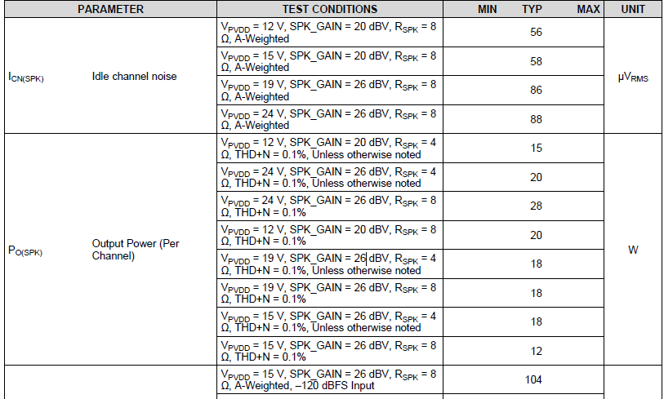
TAS5756M
Q2
Please let me know the meaning of SPK_GAIN, 20dBV or 26dBV.
For example, “ 20dBV” mean 10Vrms (0dBV=1Vrms) at i2s input=0dBFS ?
Q3
For SPK_GAIN=20dBV, Pvdd=12V, Rspk=8ohm,non-clip(0.1%) and Po(spk)= 20W…
Vo should be 12.65Vrms so, i2s input should be -2~3dBFS , is it wrong?

