Slide 1
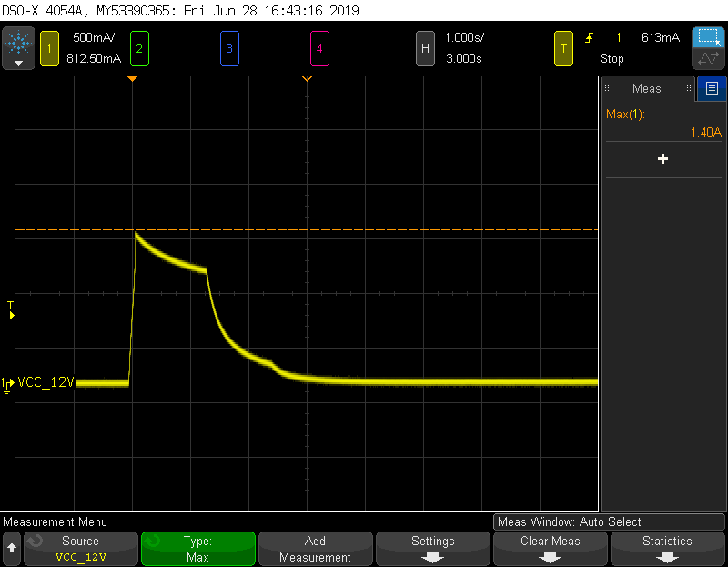
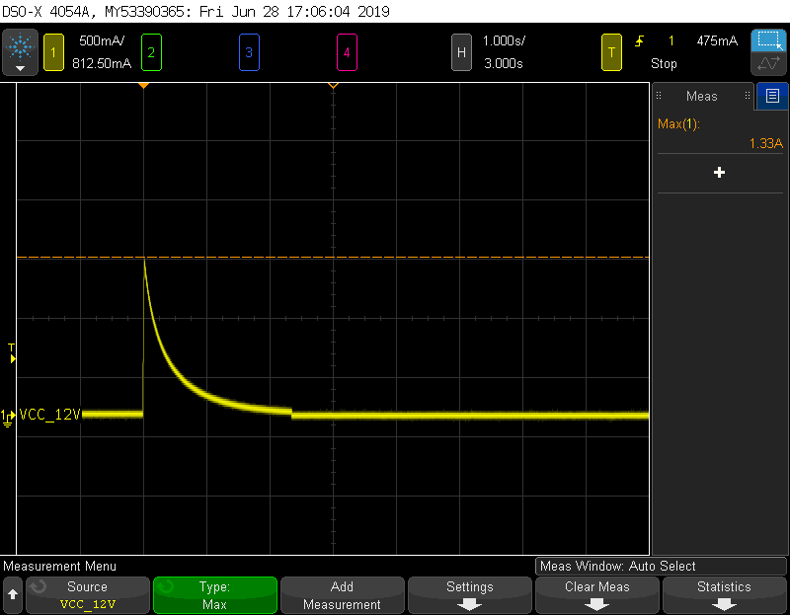
There is a large inrush current at VCC when SHDN toggles
SHDN：Low→High
SHDN：High→Low

Slide 2
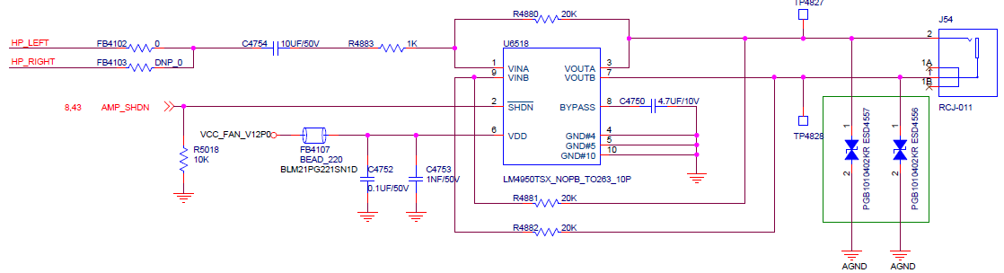
Audio power amplifier schematic

