Slide 1
ISO15693 Analysis
Erick Macias

Slide 2
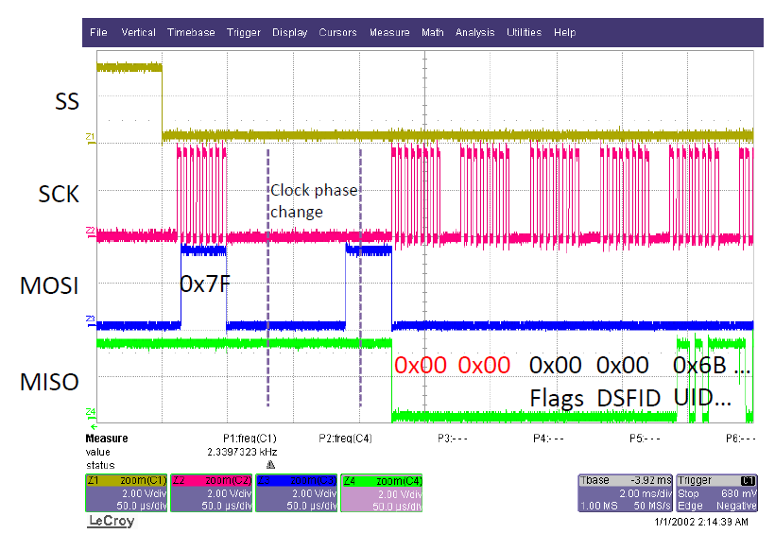
Problem Overview
ISO15693 Read Inventory:
2 extra dummy bytes were read through the SPI interface from the TRF796x.
The problem was successfully recreated on the TRF7961 EVM as shown in the next slide.

Slide 3
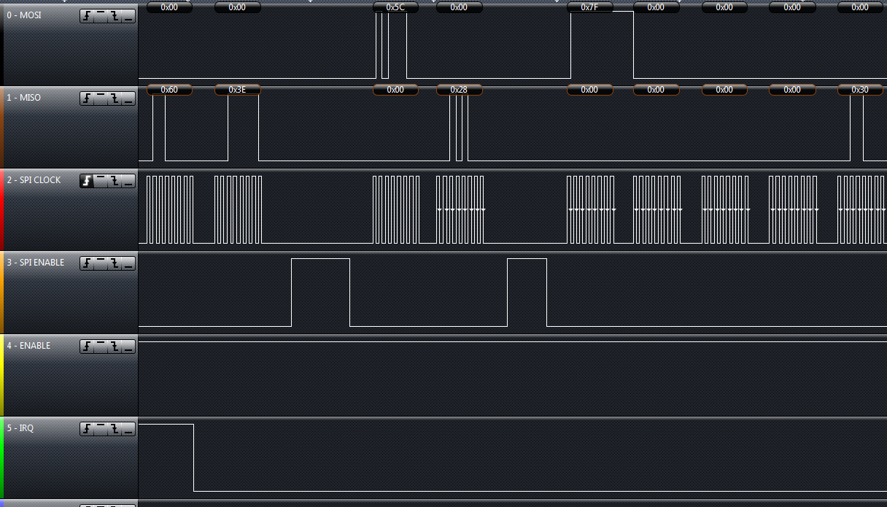
Original ISO15693 Read Inventory
Root Cause
Extra 2 0’s

Slide 4
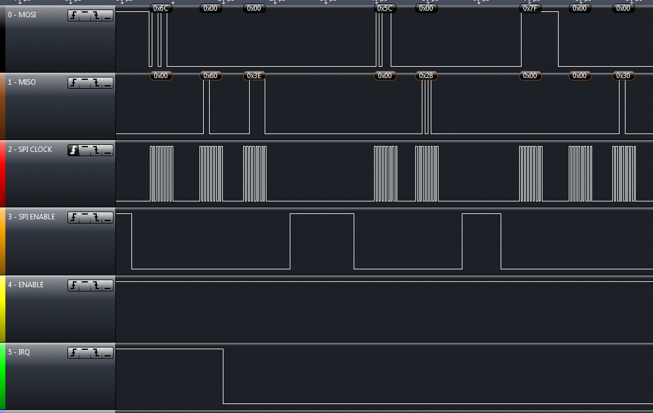
Modified ISO15693 Read Inventory
Modified SPI.c

Slide 5
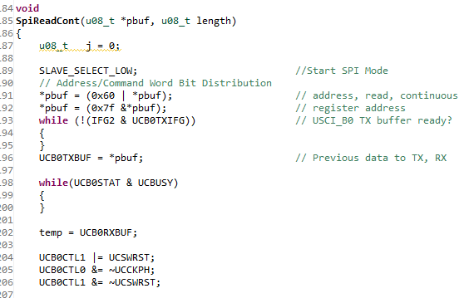
Required Changes
SPI.c modifications:
Remove the reading of extra 2 bytes in SpiReadCont().
Reset the SPI module before modifying the control register Note: When the MCU was not resetting the SPI module it was causing the MOSI line to stay high till the next clock cycle.

Slide 6
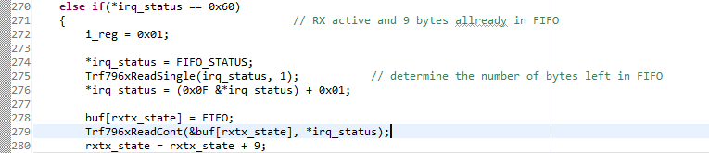
Required Changes (cont.)
trf796x.c modifications:
Read the FIFO status register before reading the FIFO register Note: The TRF796x has a FIFO (12 bytes long), thus when the interrupt would fire with an IRQ status value of 0x60 – the TRF796x has received data (9 bytes) into the FIFO, but is not complete yet. However, I would recommend to read the FIFO status register first, to ensure that we read the FIFO based on the FIFO status register.

Slide 7
Thank you

