Slide 1
Customer’s requirement
Master to Slave: stereo ( 44.1KHz)
Slave to Master : Mono (MIC)
HOST
I2S
CC8531
Tx
2.4GHz Down streaming
Headphone
Rx
CC8530
I2S
MIC
CODEC
2.4GHz Up streaming (MIC)

Slide 2
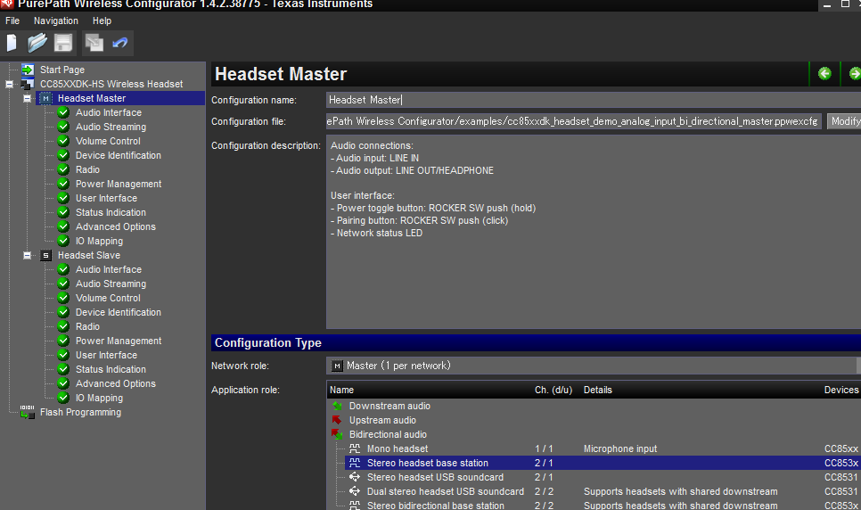
CC85xxDK-HS wireless headset
Application role :Headset base station 2/1

