Slide 1
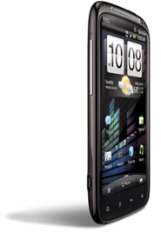







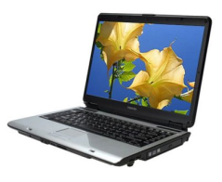
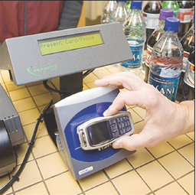

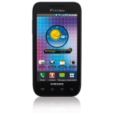

Operating Mode 1 – Peer-Peer
Consumer Elect.
POS/Retail
Short-Range Data Transfer
Exchange information
Transfer Content photos/images
Loyalty Coupon Transfer
Targeted Advertising
Main Function- Two NFC Devices Exchange Data
  NDEF - Encapsulated Data
Standardized in the IS0 18092
Data Rates – 106 kbps, 212 kbps, 424 kbps (Higher rates being considered)
1
Notes:
1
1

Slide 2
NFC Operating Modes
Peer to Peer
Active Operating Mode
Peer to Peer mode provides a communication between two devices where both devices are able to initiate communications when required
The communication parameters in both directions (Init.→Targ, Targ→ Init) are identical
Both devices have power supplies
Avery device generates it’s own RF field for the communication
The data Communicate in both directions is done by alternating the self generated RF signal.
Supported Protocols:
ISO14443A
ISO18092/ISO21481
NFC Logical Link Control Protocol
NFC Device #1
NFC Device #2
RF Signal shape
Active Initiator
Initiator
Request
Active Target
Target
Response
Notes:
2

Slide 3
NFC Operating Modes
Peer to Peer
Passive Operating Mode
  Only the initiator generates the RF field for the communication
  The Target responds to an Initiator command by applying a load modulation on the RF field generated by the Initiator.
  The device in Passive Target mode may draw the power from the RF signal (limited functionality and operating distance).
Supported Protocols:
ISO14443A
ISO18092/ISO21481
NFC Logical Link Control Protocol
NFC Device #1
NFC Device #2
Active Initiator
Passive Target
Initiator
Request
Target
Response
!
Notes:
3

Slide 4

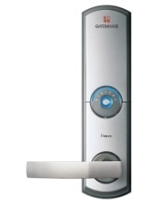

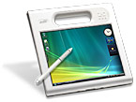
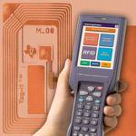
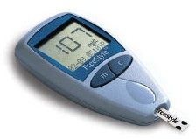
Operating Mode 2 – Reader/Writer
Financial
Content Access
Access Control
Point Of Sale (POS)
EMetering
Download Smart
Posters
Physical access
Hotel Door lock
Digital Door Lock
Main function – Read NFC Forum Mandated Tags
Key Protocol support - 14443A/B, FeliCa, ISO15693
Data Rates – 1.6, 26.4, 106, 212, 424, 848 kbps
Authentication
Medical
Asset tracking
Product Authentication
ePassport/eDocs
Patient & Staff authentication
Pharmaceutical authentication
Blood Glucose meters
4
Notes:
4
4

Slide 5
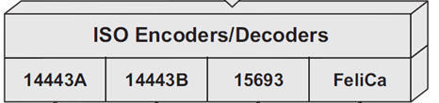
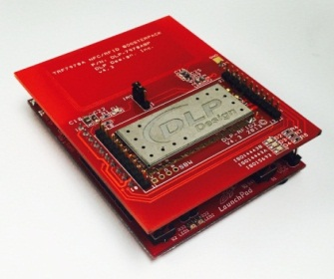

NFC Operating Modes
TRF79xx
PCD / VCD (Reader/Writer)
  The NFC device behaves like:
    Proximity Coupling Device (PCD) according to ISO14443A/B
    Vicinity Coupling Device (VCD) according to ISO15693
  The device has the ability to read, write and communicate with the a passive RFID tag.
  The Device “must” operate with all the NFC Tag Types and ISO15693 tags
Supported Protocols:
NFC-A ISO14443A
NFC-B ISO14443B
NFC-V ISO15693
NFC-F JIS X 6139-4/FeliCa
NFC Reader/Writer
NFC / RFID Tag
Reader
Request
Target
Response
Notes:
5

Slide 6

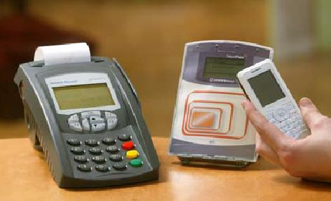
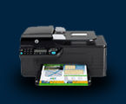




Operating Mode 3 – Card Emulation
Financial
Secure Pairing
POS with a NFC Reader
Pair your Tablet
over BT/WiFi
Main function – NFC “Tag” device appears to an external reader much the same as a traditional contactless smart card
Key Protocol support - ISO15693, 14443A/B, FeliCa
Data Rates - 106, 212, 424, 848 kbps
Transport
Access Control
Bus with a NFC Reader
Physical access
Hotel Door lock
Digital Door Lock
6
Notes:
6
6

Slide 7

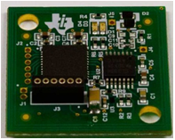
NFC Operating Modes
Card Emulation Mode
  In Card Emulation mode a NFC device is able to behave like a tag / contactless smartcard.
  Only the initiator generates the RF field for the communication
  The NFC Device in Card Emulation Mode responds to an Initiator command by applying a load modulation on the RF field.
  The device in Card Emulation may draw the power from the RF signal.
  NFC devices may have the ability to emulate the protocol of more than one card / protocol
Supported Protocols:
NFC-A ISO14443A
NFC-B ISO14443B
NFC-V ISO15693
NFC-F JIS X 6139-4/FeliCa
NFC Reader
RF Signal shape
NFC Dynamic Tag
Reader
Request
Tag
Response
Notes:
7

