Slide 1
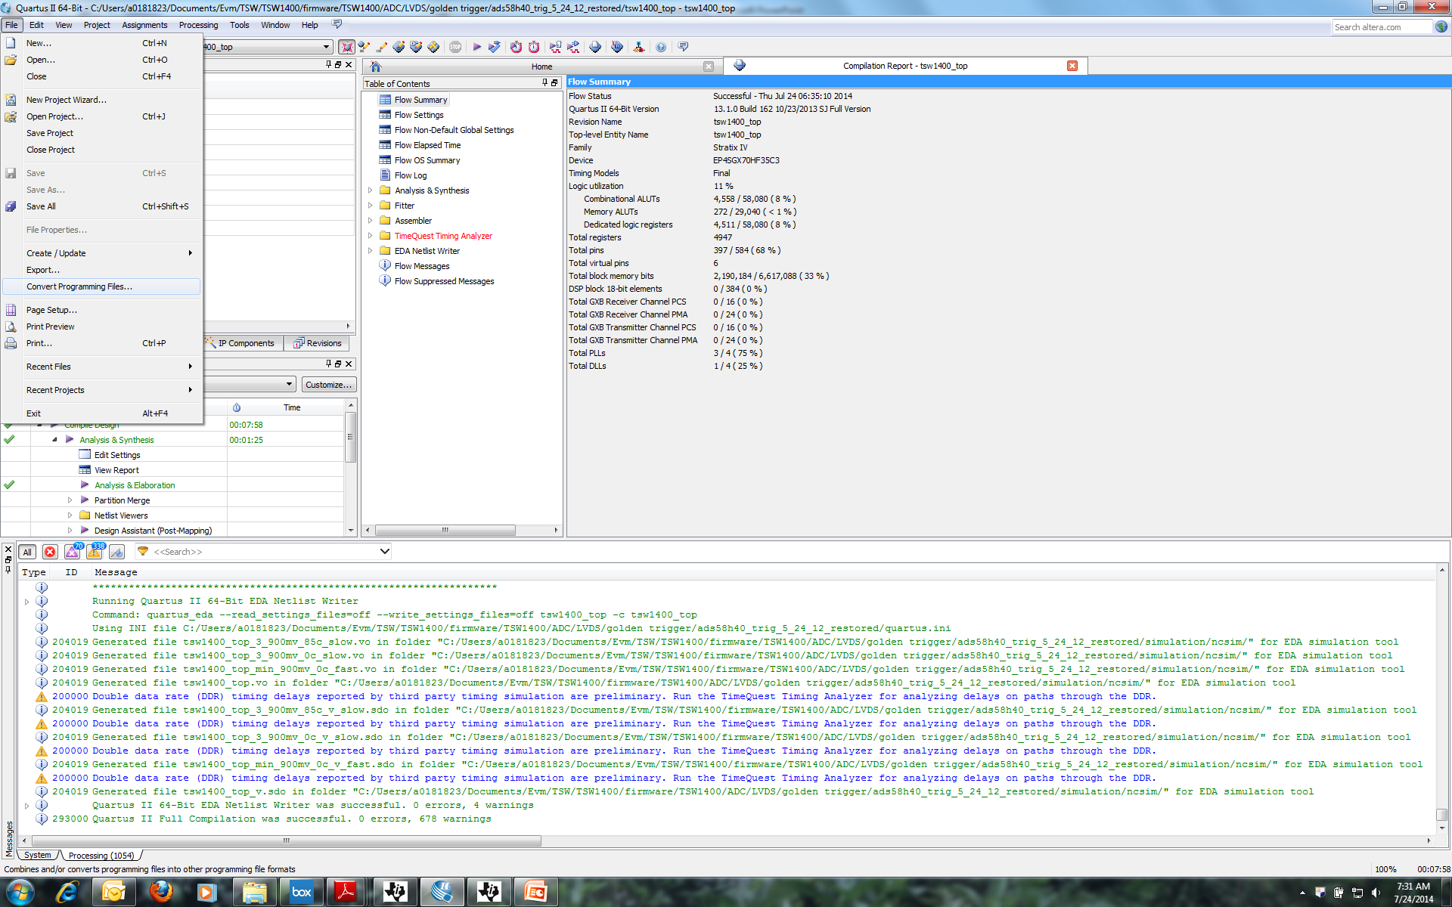
In Quartus, click on File, then Convert Programming File

Slide 2
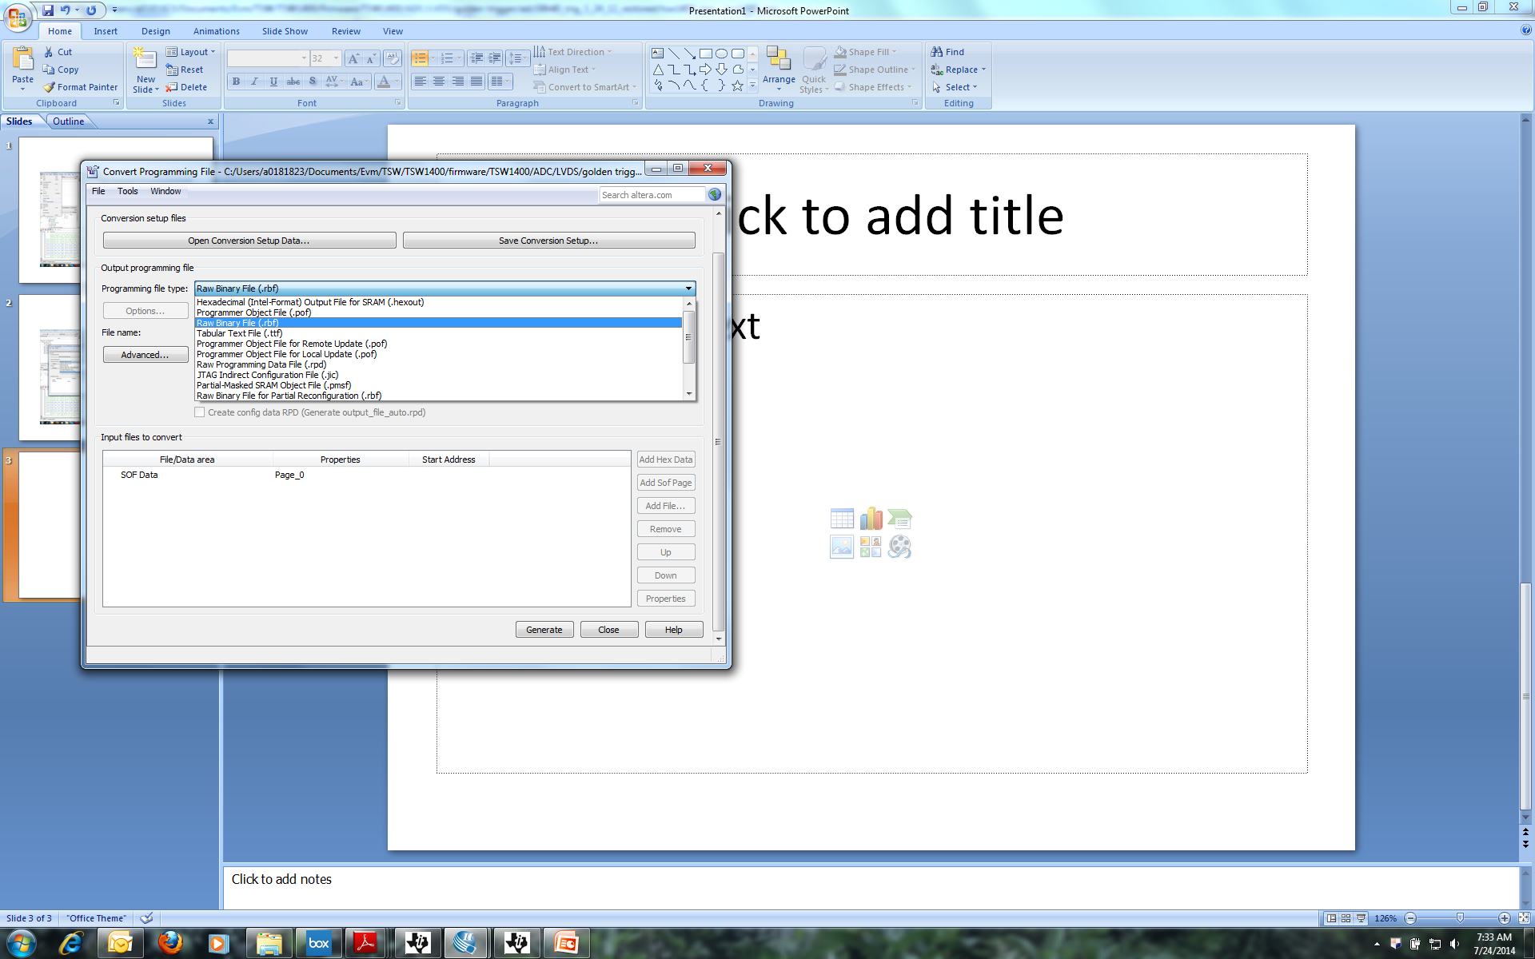
Select “Raw Binary File”.

Slide 3
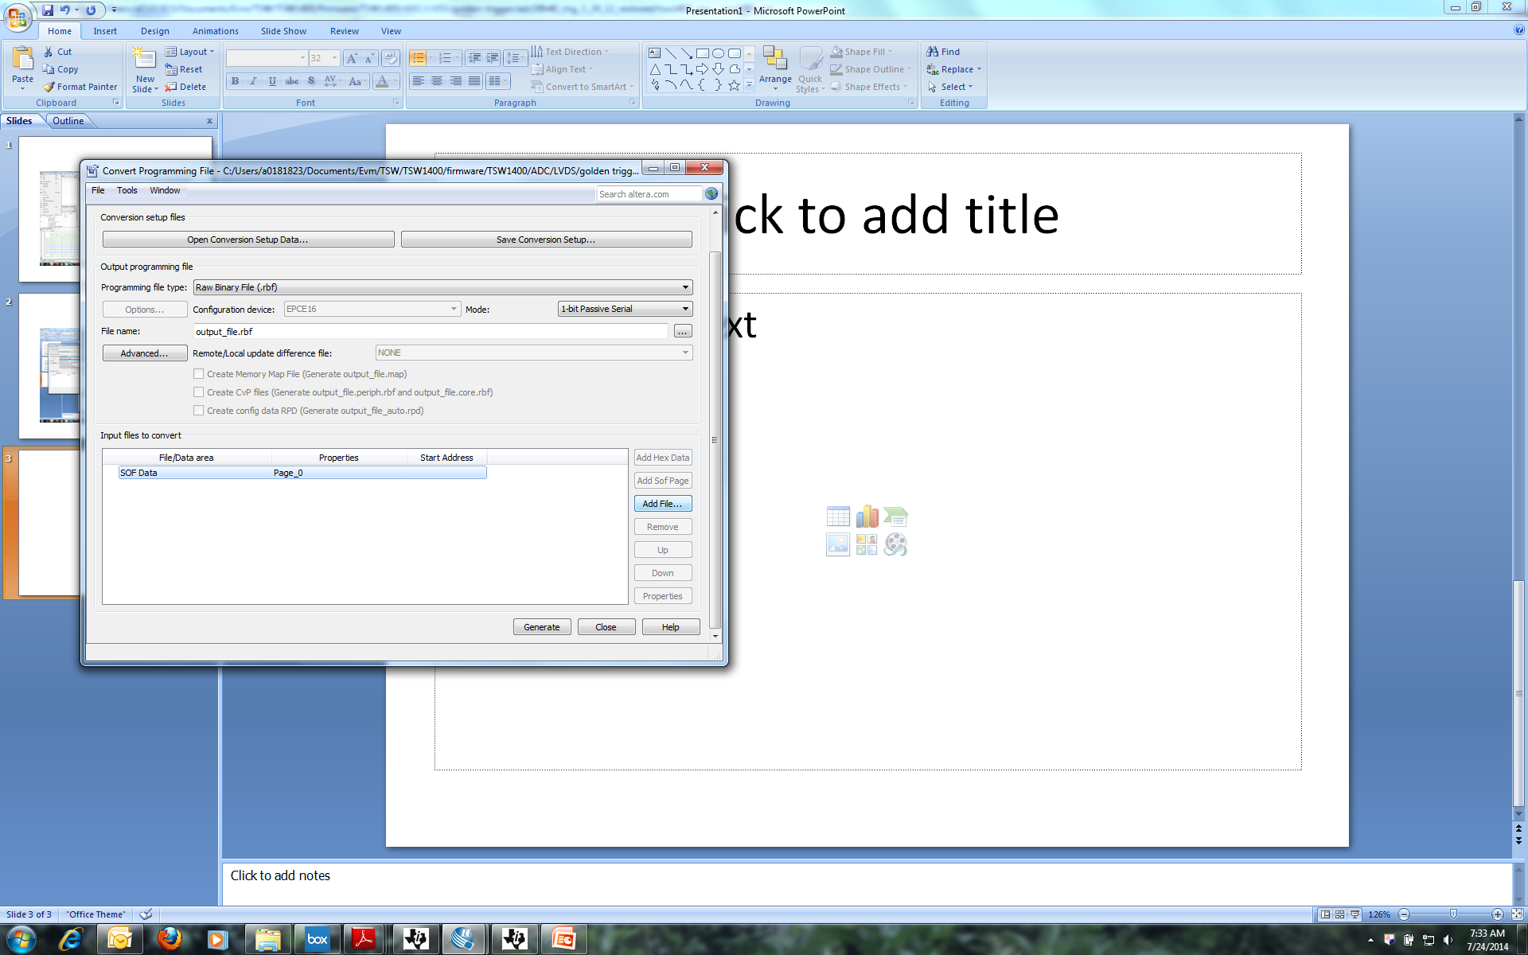
Click on SOF DATA, then click on “Add File”.

Slide 4
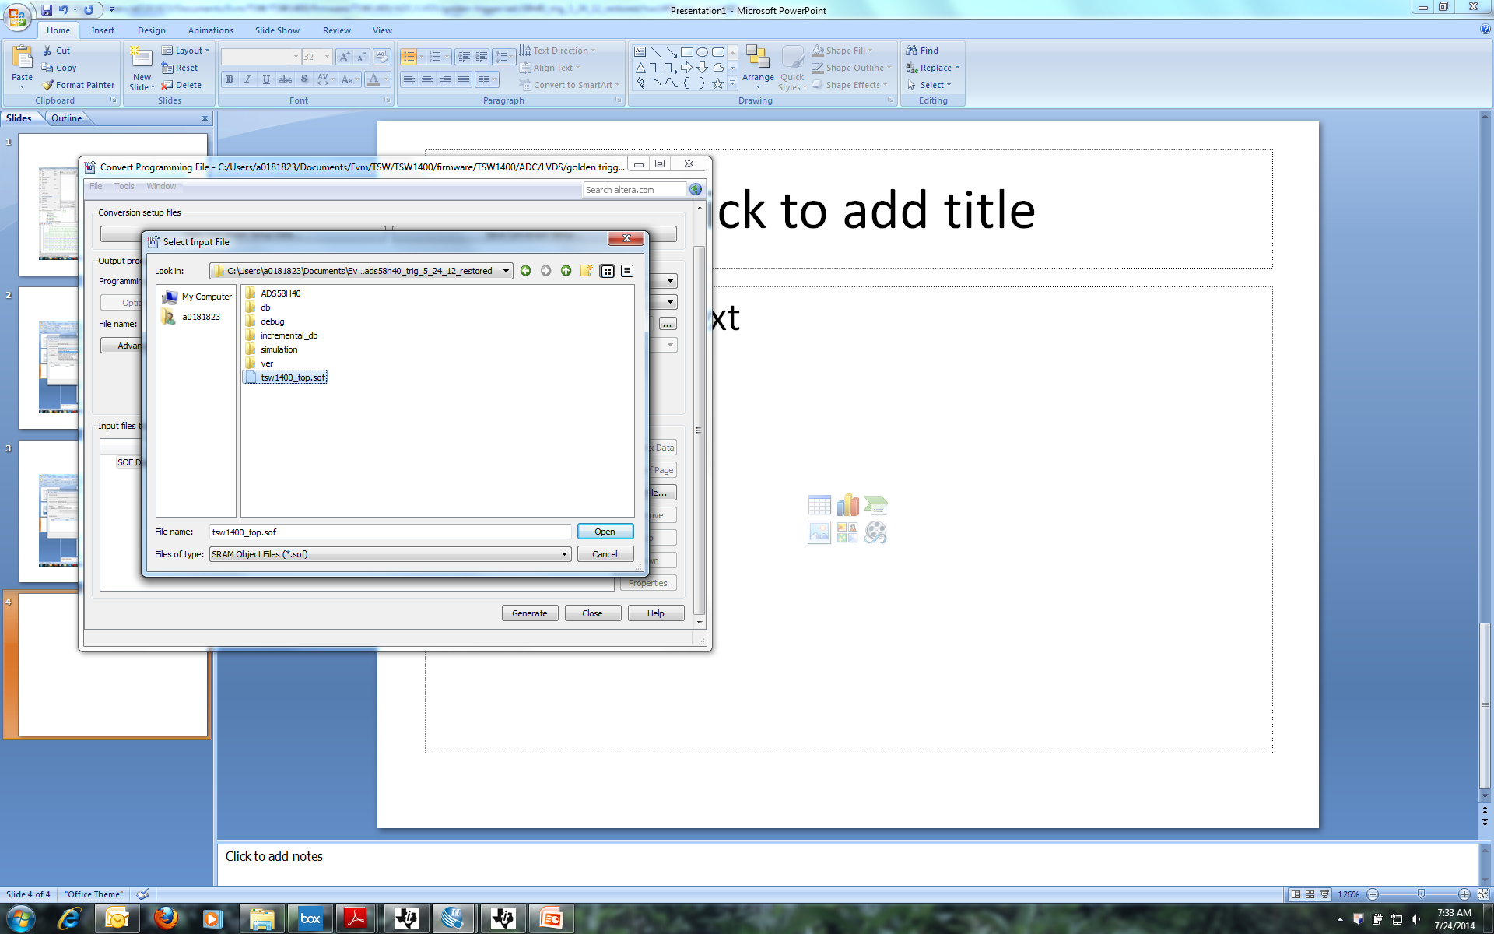
Select the new .sof file created by Quartus

Slide 5
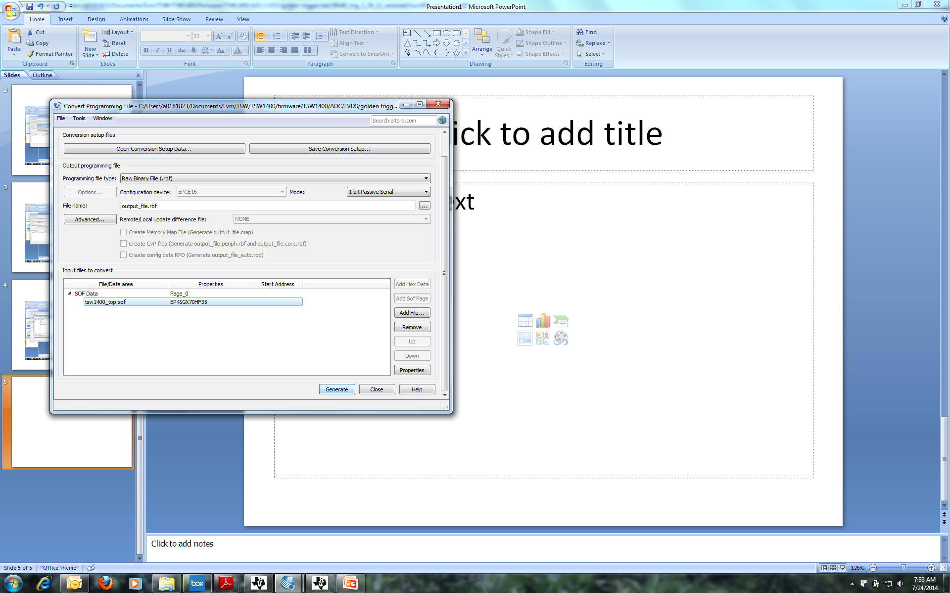
Click on “Generate”.

Slide 6
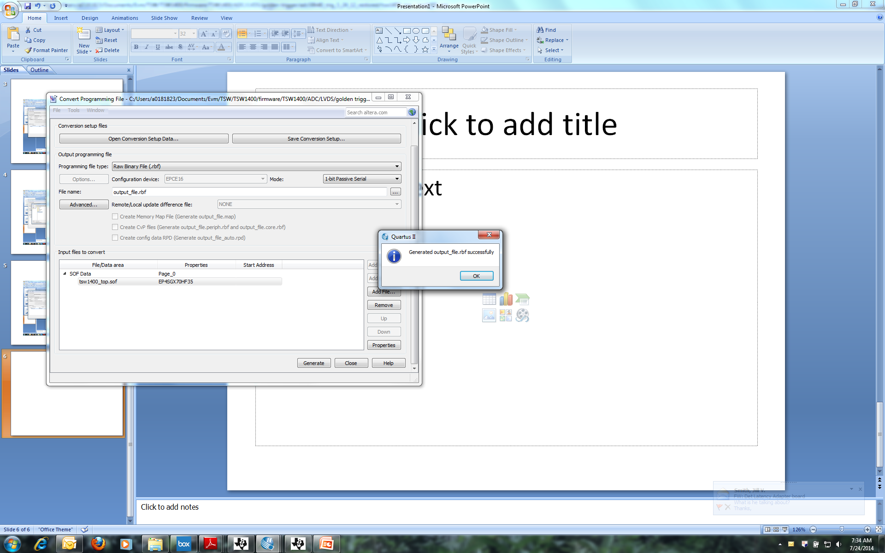
New rbf is now created and can be downloaded with HSDC Pro

Slide 7
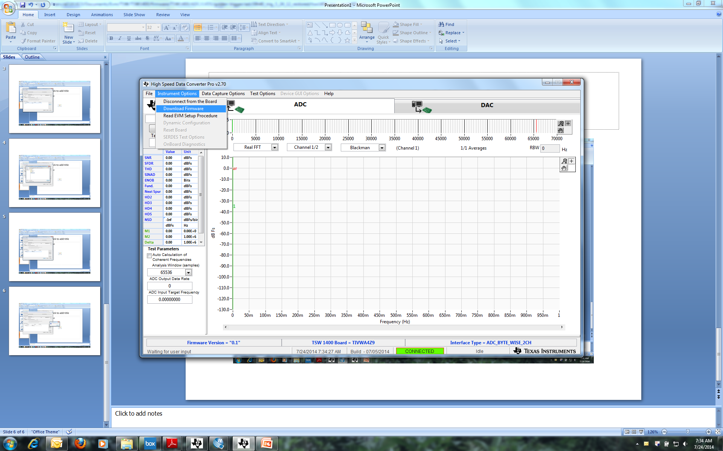
In HSDC Pro, click on Instrument Options, then select Download Firmware.

Slide 8
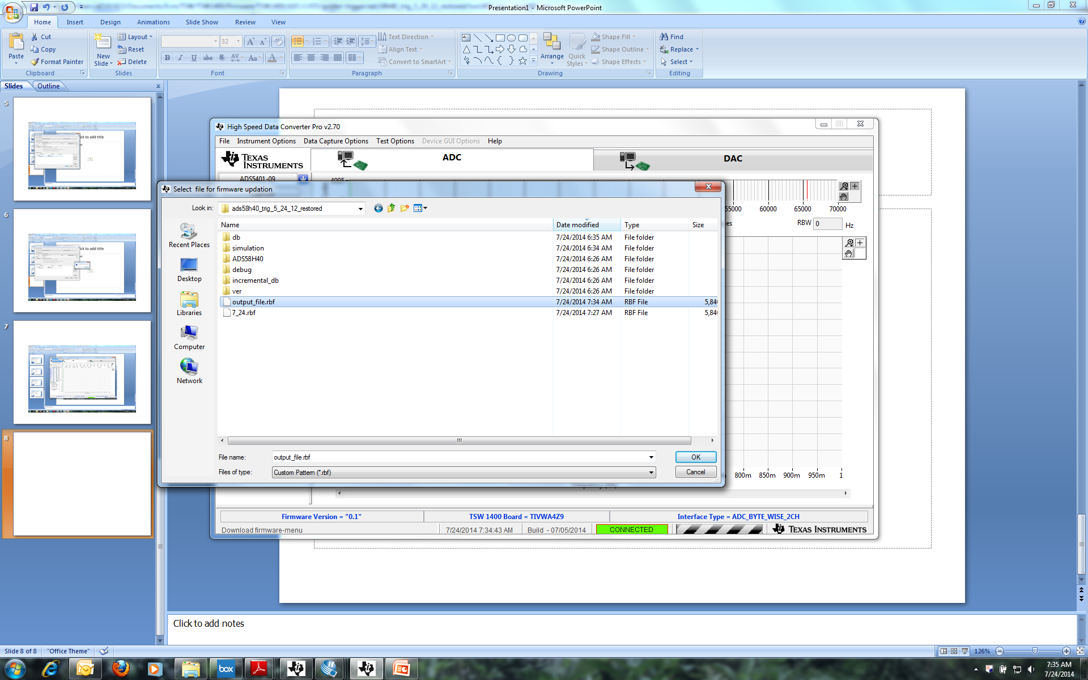
Navigate to the new .rbf file and select it.

Slide 9
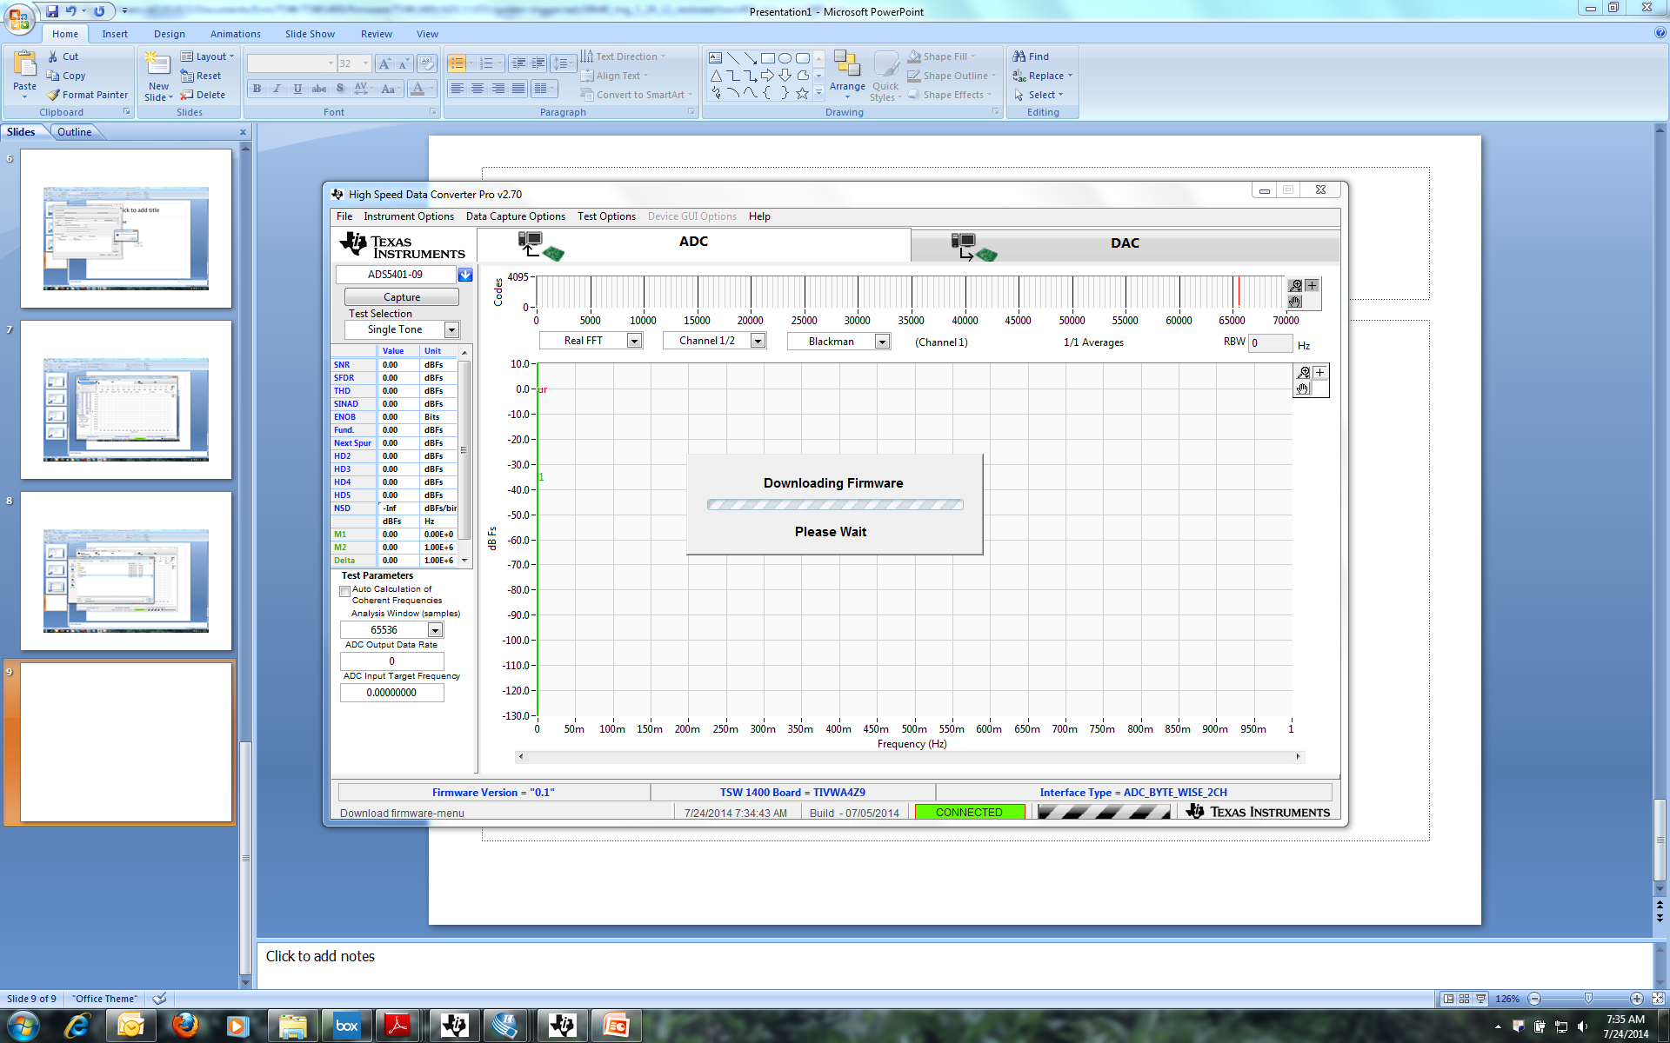
HSDC Pro will now load the new file.

